Slide 1
FORWARDER OPERATIONS
GOING FORWARD

Slide 2
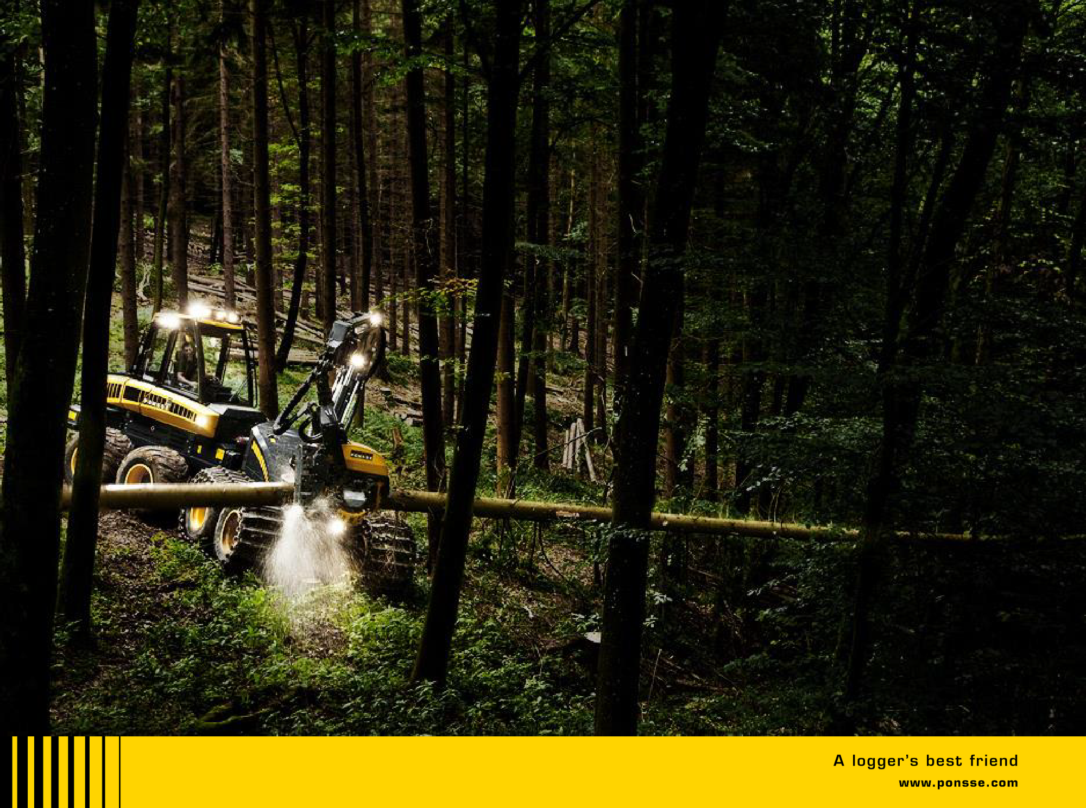

FORWARDER TRAINING
1
Ponsse

Slide 3
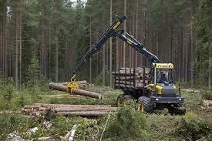
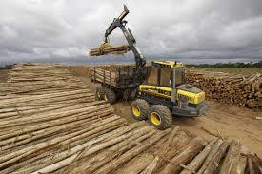
2
Stopping the forwarder to the correct place
When loading When unloading

Slide 4
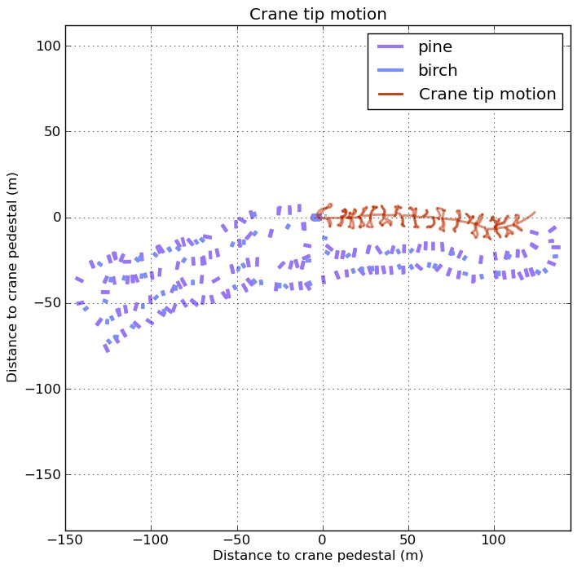
1 load loading 3 different way
3
1 load loading with this working technique
 | logs | Machine movement | Grapple movement | time
 | 148 pcs | 260 m | 1397 m | 22,41
VIDEO 1
1 load loading with this working technique
 | logs | Machine movement | Grapple movement | time
 | 148 pcs | 260 m | 1021 m | 19,02
VIDEO 2
1 load loading with this working technique
 | logs | Machine movement | Grapple movement | time
 | 148 pcs | 260 m | 865 m | 18,28
VIDEO 3

Slide 5
Grapple and rotator
4
If crane movements are calm, no need to open grapple wider than needed to pick up the pile
Calm movements and correct crane settings prevent grapple to start swinging. Grapple hits the target easier.
Logs settle better in the grapple if pile is lifted up from the ground a little bit before fully closing the grapple. Final closing in the air helps to avoid branches getting in to the load space
Rotate pile to correct position during lifting it up to the load space
- (video)

Slide 6
Unnecessary movement calculated at the level of the year
5
Unnecessary Movement (sec) | Grapples in 1 load | Loads in 1 shift | Work Days In year |  | Time in seconds |  | Hours in year |  | Work shifts
3 | 30 | 15 | 220 |  | 297000 |  | 82,5 |  | 10,3
2 | 30 | 15 | 220 |  | 198000 |  | 55 |  | 6,9
1 | 30 | 15 | 220 |  | 99000 |  | 27,5 |  | 3,4

Slide 7
Storage planning
6
How long is the pile if there is xx m3 of certain assortment?
Assortiment | 100 m3 | 200m3 | 300m3 |  | 400m3 |  | 500m3
Saw timber 5m | 16m | 30m | 40m |  | 50m |  | 60m
Pulp 5m | 25m | 43m | 55m |  | 65m |  | 75m
Pulp 3m | 35m | 60m | 78m |  | 92m |  | 105m

Slide 8
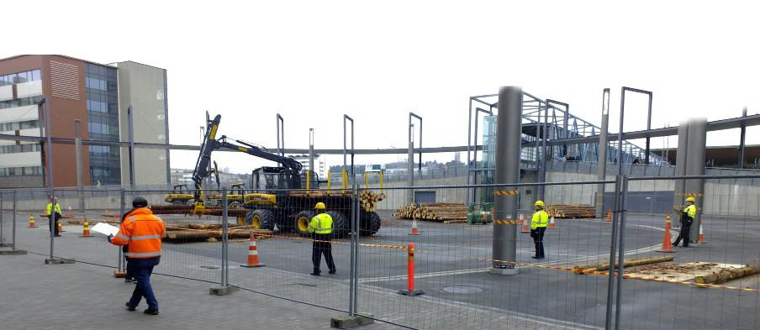
Vocational skills competition in Jyväskylä 24-26.4.2012
7

Slide 9
Competition Jyväskylä
8
 | Competitor 1 |  | Comparison |  | Competitor 8
Working time | 1h 15 min |  | 1h 15 min |  | 1h 15 min
Timber volume | 99,8 m3 |  | 100,5 m3 |  | 75,7 m3
Loading movements in the average
Grapples lifting in loads pace | 00:00:10.6 |  | 00:00:11.9 |  | 00:00:15.6
Take next grapples at the ground | 00:00:04.2 |  | 00:00:04.3 |  | 00:00:06.2
Grapples lifting on the pile | 00:00:10.2 |  | 00:00:13.6 |  | 00:00:14.2
Take next grapples in the load space | 00:00:05.1 |  | 00:00:07.2 |  | 00:00:07.0
Loader operating movement times
Crane turning (right / left) | 00:21:23/00:24:09 |  | 00:18:28/00:20:07 |  | 00:22:49/00:25:12
Lifting (up / down) | 00:26:21/00:26:16 |  | 00:23:01/00:22:15 |  | 00:29:24/00:27:14
Boom (far / near) | 00:23:39/00:22:30 |  | 00:21:44/00:18:19 |  | 00:25:59/00:24:08
Telescope (in / out) | 00:17:58/00:09:33 |  | 00:04:25/00:03:43 |  | 00:09:11/00:07:58
Rotator (right / left) | 00:15:52/00:20:11 |  | 00:11:17/00:12:00 |  | 00:13:03/00:18:11
Grapple (closed / open) | 00:28:58/00:08:58 |  | 00:08:32/00:06:12 |  | 00:24:48/00:07:23
Fuel consumptions
Total (l) | 15,1 |  | 11,9 |  | 12,8
Total for 1 load (l) | 1,5 |  | 1,2 |  | 1,6
Total for driving( l) | 17,1 |  | 14,8 |  | 15,3

Slide 10
Influence of crane settings to
9
fuel consumption
Telescope out
settings | rpm | kW | Different %
4 sec / 511 mA | 1536 | 31,36
3 sec / 550 mA | 1521 | 46,98 | 12,35
Lifting
handling | bar | kW | Fuel consumption
Grapple button not released | 150 | 62 | 13,7 l / h
Keeping Grapple button pressed | 230 | 95 | 21,1 l / h
 |  | difference | 7,4 l / h

Slide 11
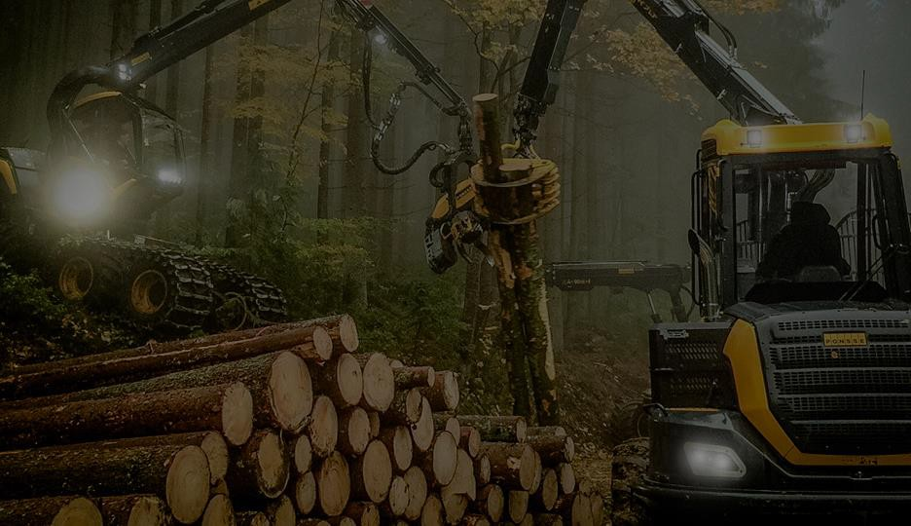

EFFECTIVE USE OF MACHINE
- F O R W A R D I N G P L A N N I N G -

Slide 12
FORWARDING
WORK PHASES IN FORWARDING
DRIVING EMPTY
Factors influencing to total time consumption in
forwarding:
Cutting type (clear cutting/selective cutting)
Average forwarding distance
Cutting scheme (e.g. fish bone), log/pile location on the strip road
Volume m3/m on strip road
Number of assortments
Forwarder load space size
Terrain, weather etc. circumstances
Operator’s skills
UNLOADING AT THE STORAGE PLACE
COLLECTING
THE LOAD
DRIVING LOADED

Slide 13
FORWARDING
OPERATOR CAN ONLY INFLUENCE TO HIS/HER OWN SKILLS!
Differences between the operators in productivity and effectiveness come from:
How to handle the crane
How to plan the work
With experienced operators the main source of differences is planning!

Slide 14
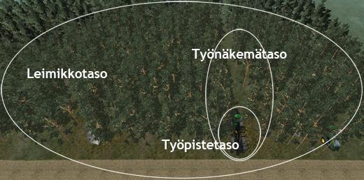
DIFFERENT LEVELS IN FORWARDING PLANNING
Visibility level
Cutting lot level
operating point level
Source: Metsäteho www.puuhuolto.fi

Slide 15
DIFFERENT LEVELS IN FORWARDING
OPERATING POINT AND VISIBILITY LEVELS:
Important skills:
Machine and crane handling
CUTTING LOT LEVEL:
Important skills:
Planning of work, things like
starting point, driving direction with load and without load, targeting to full loads, etc.
=> direct influence to productivity
=> direct influence to fuel consumption

Slide 16
PLANNING OF FORWARDING
1. PRELIMINARY INFORMATION ABOUT CUTTING LOT
Volumes by assortments (from the harvester)
Obstacles in terrain like soft and wet places, steep slopes, brooks etc.
(tehnologiseskaja karta)
Hazardous places ( tehnologiseskaja karta)
Shape and size of cutting lot ( tehnologiseskaja karta) Communication with harvester operator
Walking around the site

Slide 17
PLANNING OF FORWARDING
2. PLANNING OF STORAGES AND PILE LOACTION
Volumes by assortments – how much space each assortment needs at the landing place
Transporting order – what are priority assortments and what assortments can stay
longer in the storage piles
Landing shape and size – unloading to both sides of the machine or jut to one side Road condition – unloading from the road or from the forest side

Slide 18
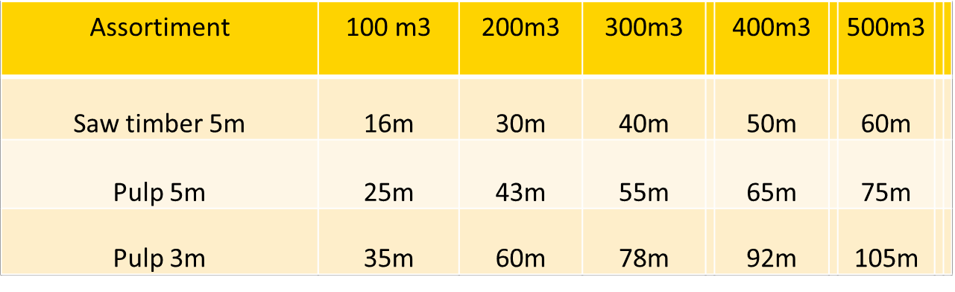
PLANNING OF FORWARDING
2. PLANNING OF STORAGES AND PILE LOACTION

Slide 19
PLANNING OF FORWARDING
3. FORWARDING SEQUENCE
Drive engine/bonnet ahead – reversing has risks!
Start from the most distant part of the cutting lot
Forward to the storage, not to the forest (don’t start collecting the logs besides of the pile heading away from the storage!)
Priority assortment(s) first and to the best place(s) in the storage places (to ensure
smooth truck transportation)
Try to bring to the storage full loads, if not enough one assortment, make mixed loads
When finishing the strip road, collect one assortment to the bottom of load space
when going to the end, take others when returning
Agree a sign for the empty strip road – operator of the next shift doesn’t have to drive on the empty strip roads for nothing
Soft places – avoid driving several times. Better to collect everything in the same
time and come off!

Slide 20
1 15.2.2018 Author / Subject
4.725-
Harvester EcoDrive

Slide 21
2
15.2.2018
Author / Subject
EcoDrive
Principle of operation
EcoDrive program analyzes the machine fuel consumption, work in different stages of the duration and efficiency of the operator and calculates the average of the whole work shift to a different volume classes of trees.
EcoDrive measure of efficiency, to show the effectiveness of the current work stages compared with the averages of the shift.
At the beginning of the work shift the comparative values will vary more, but the numbers are equalized when the work shift is progresses.
EcoDrive opti data is individual only for this driver and this shift. All individual information collected will be destroyed when the shift ends. The shifts average values are saved in 3- month-comparison in computer, but it does not send information anywhere.

Slide 22
3
15.2.2018
Author / Subject
EcoDrive
Eco-Drive program always starts automatically when the shift begins, the driver can choose whether the data visible
Click on the icon to change the mode of Eco-Drive
Eco-Drive program displays information about only after at least one tree has been processed
EcoDrive-modes
Eco-Drive data is not displayed
Eco-Drive data is displayed all time
Eco-Drive data is displayed, when tilt is up
•
•
•

Slide 23
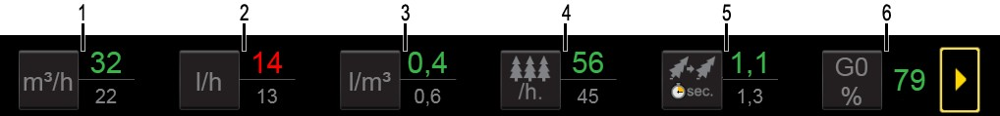
4
15.2.2018
Author / Subject
EcoDrive (icon)
Above the line in the value indicates the 5 last tree data calculated in 1 hour results and the underside line is the number for all this shift results
Values are updated each time when tree processing is end (cutting head open and tilt up) and will show this values until next tree is get processing end
Number red color indicates worse result and green indicates better result than the average of the hold work shift
In Eco Drive menus we can move forward pressing the arrow button
Efficiency
  Calculated value m3 / h in last 5 tree information / this whole work shift
Fuel consumption l / h
  Calculated value l / h in last 5 tree information / this whole work shift
Fuel consumption l / m3
  Calculated value l / m3 in last 5 tree information / this whole work shift

Slide 24
5
15.2.2018
Author / Subject
EcoDrive (icon)
Processing trees
  Calculated value in last 5 trees, how many trees in hour / whole work shift
Time between 2 different felling cutting
  In last 5 trees processing time and calculated 1 trees average processing time / whole work sift average processing time to 1 stem
Effective time, without breaks
  For example, the operator has been working for 2 hours, and this value is 79%. this means the machine has been effectively work for 1 hour and 35 minute. Program calculates in break time, if machine does not do anything between 15 seconds - 15 minutes

Slide 25

6
15.2.2018
Author / Subject
EcoDrive (icon)
Icons 7- 13 describing how the time spent is divided into various work phases of the processing at the trees
7 How to search for the next felled tree
The last work phase of the tree duration / the same information for 30 of the previous trees of the same size as an average in this shift
Time start when ending of the previous tree (Cutting head fully open), time ending when start the next tree felling cutting
How far away the operator take the next tree
How well the cutting head goes to the correct way to the next tree (crane settings)
How the tree is set inside the harvester head (harvester head settings and delays)
How well the felling cutting height can be found (need to feed up and down with hand feed)

Slide 26
7
15.2.2018
Author / Subject
EcoDrive (icon)
Icons 7- 13 describing how the time spent is divided into various work phases of the processing at the trees
8 Felling cutting time spend on
Last trees felling cutting time spend / the same information for 30 of the previous trees of the same size as an average in this shift
Time start when start the felling cutting → time ending when start feeding
If the operator is used manually feeding immediately when felling cutting is ending, this numerical value is very small

Slide 27
5
15.2.2018
Author / Subject
EcoDrive (icon)
Processing trees
  Calculated value in last 5 trees, how many trees in hour / whole work shift
Time between 2 different felling cutting
  In last 5 trees processing time and calculated 1 trees average processing time / whole work sift average processing time to 1 stem
Effective time, without breaks
  For example, the operator has been working for 2 hours, and this value is 79%. this means the machine has been effectively work for 1 hour and 35 minute. Program calculates in break time, if machine does not do anything between 15 seconds - 15 minutes

Slide 28
6
15.2.2018
Author / Subject
EcoDrive (icon)
Icons 7- 13 describing how the time spent is divided into various work phases of the processing at the trees
7 How to search for the next felled tree
The last work phase of the tree duration / the same information for 30 of the previous trees of the same size as an average in this shift
Time start when ending of the previous tree (Cutting head fully open), time ending when start the next tree felling cutting
How far away the operator take the next tree
How well the cutting head goes to the correct way to the next tree (crane settings)
How the tree is set inside the harvester head (harvester head settings and delays)
How well the felling cutting height can be found (need to feed up and down with hand feed)

Slide 29
7
15.2.2018
Author / Subject
EcoDrive (icon)
Icons 7- 13 describing how the time spent is divided into various work phases of the processing at the trees
8 Felling cutting time spend on
Last trees felling cutting time spend / the same information for 30 of the previous trees of the same size as an average in this shift
Time start when start the felling cutting → time ending when start feeding
If the operator is used manually feeding immediately when felling cutting is ending, this numerical value is very small

Slide 30
8
15.2.2018
Author / Subject
EcoDrive (icon)
Icons 7- 13 describing how the time spent is divided into various work phases of the processing at the trees
9 Time to felling cutting to first normal cutting.
The last work phase of the tree duration / the same information for 30 of the previous trees of the same size as an average in this shift
Used time to moving the tree with crane or driving the machine, time start when tilt sensor ending give data ant ending when start first normal cutting saving
If you are here at the same time is feeding manually or automatic, these seconds goes to the feeding time (icon 10)
The same second does not log into two different register, if used crane movement and same time used feeding, this time goes only in feeding time

Slide 31
9
15.2.2018
Author / Subject
EcoDrive (icon)
Icons 7- 13 describing how the time spent is divided into various work phases of the processing at the trees
10 Total feeding time spend on
All feeding calculated by summing
The last work phase of the tree duration / the same information for 30 of the previous trees of the same size as an average in this shift
Hand feeding
Automatic feeding
Feeding to find cutting window
Influence
  Feeding pressures / proportional pump liters
  Compressive pressures and feeding start compressive pressures in cutting head
  Diesel rpm
  Cutting knives sharping
  Feeding settings

Slide 32
10
15.2.2018
Author / Subject
EcoDrive (icon)
Icons 7- 13 describing how the time spent is divided into various work phases of the processing at the trees
11 Normal cutting time spend on
The last work phase of the tree duration / the same information for 30 of the previous trees of the same size as an average in this shift
Time start when saw chine star rolling and end when saw plate is in home
Influence
  Saw chain settings
  Saw plate settings
  Saw chain sharping
  Over sawing settings

Slide 33
11
15.2.2018
Author / Subject
EcoDrive (icon)
Icons 7- 13 describing how the time spent is divided into various work phases of the processing at the trees
12 Time to last cutting of this tree, to cutting head total open
The last work phase of the tree duration / the same information for 30 of the previous trees of the same size as an average in this shift
Last cutting sawing, saw plate home → cutting head total open
This tells how much time the operator uses moving the treetop
Time is ending when cutting head opening first time
If operator need to lifting treetops or branches to larger heaps, this is increase the time only in icon number 13

Slide 34
12
15.2.2018
Author / Subject
EcoDrive (icon)
Icons 7- 13 describing how the time spent is divided into various work phases of the processing at the trees
13 Time to processing last 1 tree
The last work phase of the tree duration / the same information for 30 of the previous trees of the same size as an average in this shift
Time is ending when cutting head is fully opening and tilt is up (tilt sensor in active)
Total time is calculating information what we have used in different work phase and break time in last stem processing
When cutting head is fully open and tilt up, automatic start to take total time for next tree

Slide 35

13
15.2.2018
Author / Subject
EcoDrive (save the changes)
Normal clock time.
Choice the
  Settings , if we make some changes in machine settings
  We changes cutting area and trees are different size
  We changes working techniques
  We make some service in the machine (example sharping cutting knives)
Click the icon to save time and what you made the change

Slide 36
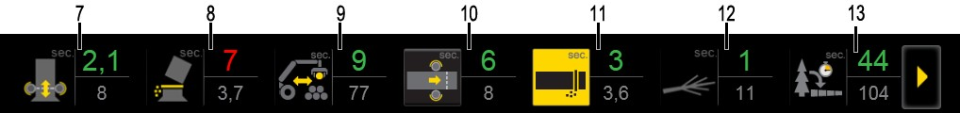
14
15.2.2018
Author / Subject
EcoDrive (Effect of changes in view)
Effect of changes in view of the data enable comparison the setting, different working techniques, different working areas and machine maintenance effect on fuel consumption and productivity.
Effect of changes in view graphically displays information about the selected work phase of the ongoing shift period. Press the icons in 1 - 6 or 10 or 11, to open the ongoing shift effect of changes in view
Effect of changes in view of the numeric values are different from the processing view, because the line appears above the last processed, the chassis measured data calculated hourly output, or a single value and below the line in the last 30 of the same size frame average data calculated hourly result or average

Slide 37
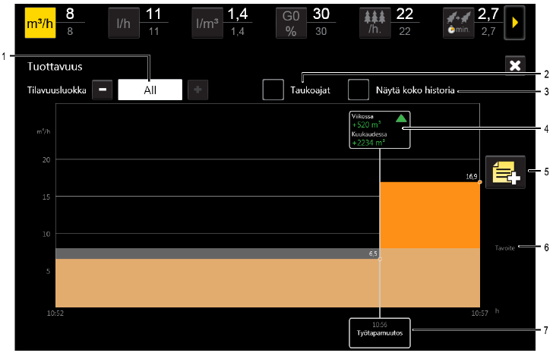
15
15.2.2018
Author / Subject
EcoDrive (work phases view)
Choose to be included calculating the volume of classes (stems liters)
Include short breaks (15 sec - 15 min.) in calculation
Show work phase history in the last three months.
Effect of change in working phase
weekly, and monthly.
Mark a new change
Averages of the shift
Description and time of the change

Slide 38
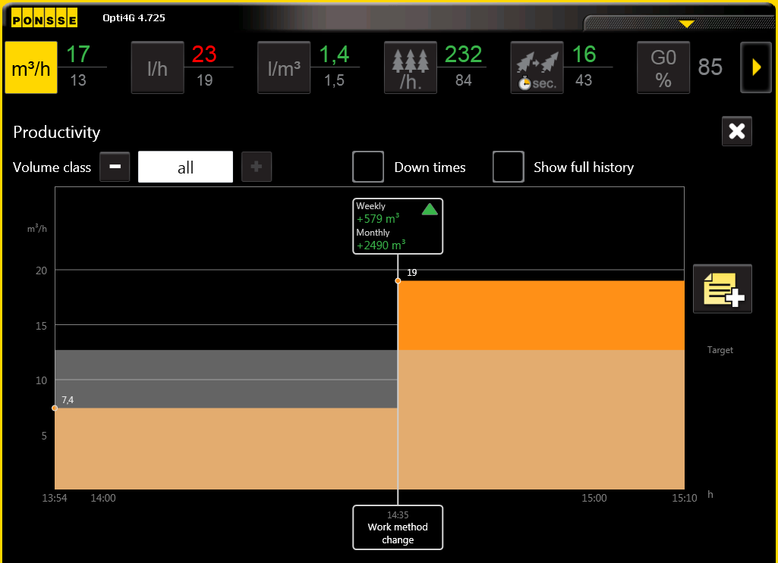
16
15.2.2018
Author / Subject
EcoDrive (work phases view)
An example to the effective of working method change m3 / h
Search in all size of frames
Reason and time of the changes
shown in the bottom
Effect of the change is also shown in hours per week, and month

Slide 39
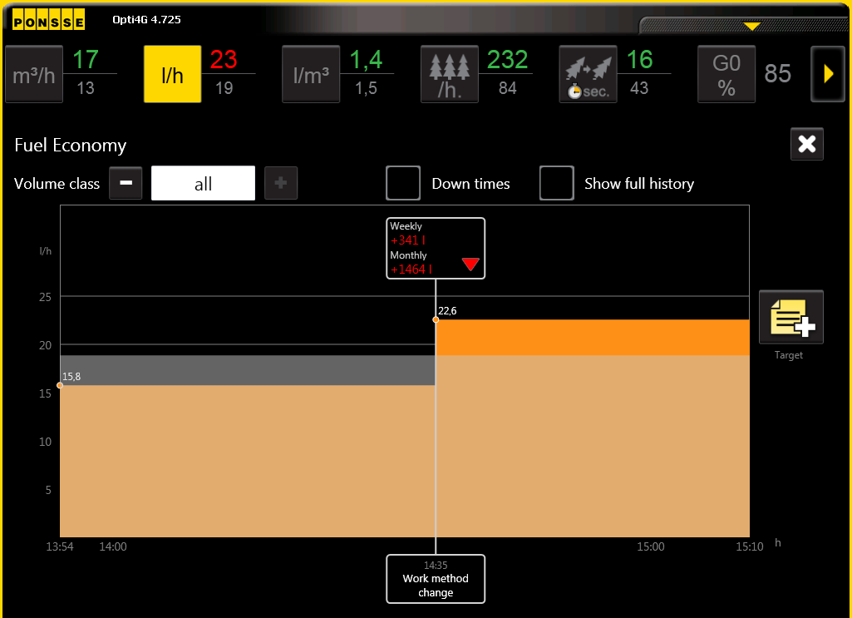
17
15.2.2018
Author / Subject
EcoDrive (work phases view)
An example to the effective of working method change l / h
Search in all size of frames
Reason and time of the changes
shown in the bottom
Effect of the change is also shown in hours per week, and month

Slide 40
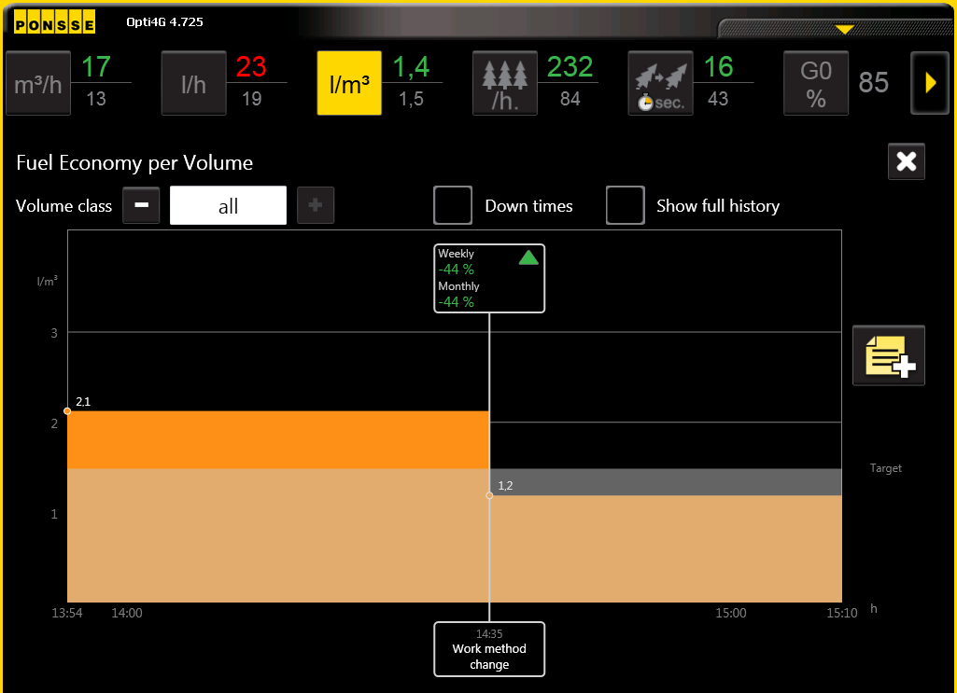
18
15.2.2018
Author / Subject
EcoDrive (work phases view)
An example to the effective of working method change l / m3
Search in all size of frames
Reason and time of the changes
shown in the bottom
Effect of the change is also shown in hours per week, and month

Slide 41
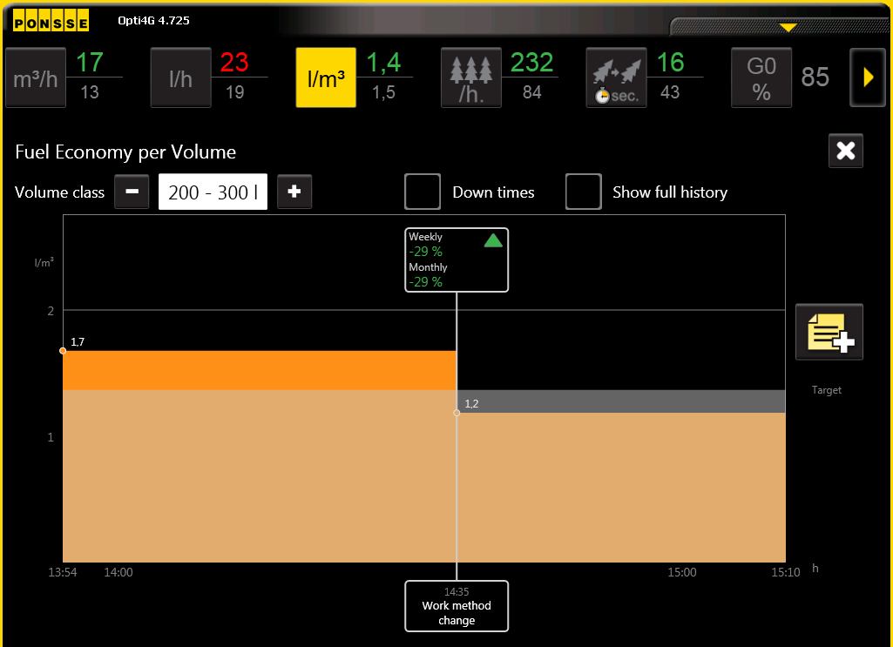
19
15.2.2018
Author / Subject
EcoDrive (work phases view)
An example to the effective of working method change l / m3
Search limited to 200-300L frames
Reason and time of the changes
shown in the bottom
Effect of the change is also shown in hours per week, and month

Slide 42
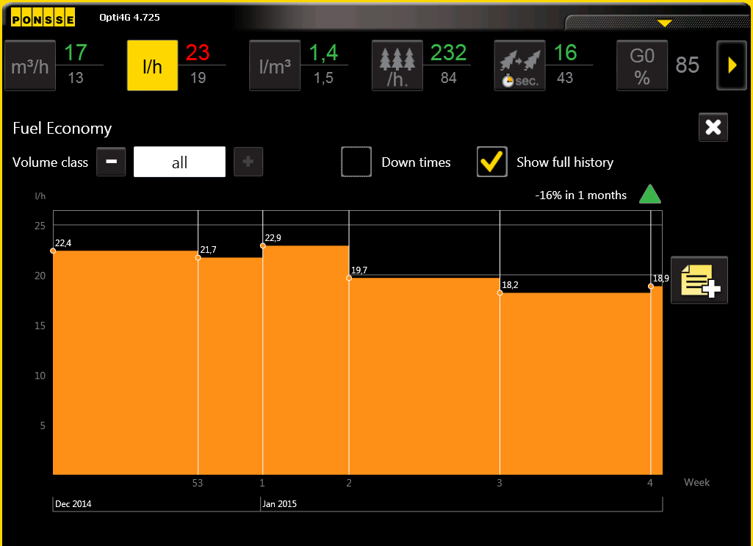
20
15.2.2018
Author / Subject
EcoDrive (work phases view)
An example of the fuel consumption of the last 3 months period l / h
All size stems
Show full history
The search is therefore of all sizes trees (clear cuttings / thinning)

Slide 43
21
15.2.2018
Author / Subject
EcoDrive
The program requires a the correct use and enough information to the different menus values for comparative
Only one change 'value should not pay too much attention
Adjustments and working techniques related matters should be taken into account at the work results quality, machine reliability and durability
  Timber grades, the peaks traces of feed rollers, branches ruptures within stem, cutting ruptures
  Hydraulic pumps, hydraulic motors, hydraulic hoses
  Mechanical strength of cranes / cutting heads frames
  The saw blade wear, the tip wheels of blades, the saw chain
durability

Slide 44
A logger’s best friend
22 15.2.2018 Author / Subject
PONSSE PLC
Ponssentie 22 FI-74200 Vieremä, Finland Tel. +358 20 768 800
Fax +358 20 768 8690
www.ponsse.com

