Slide 1
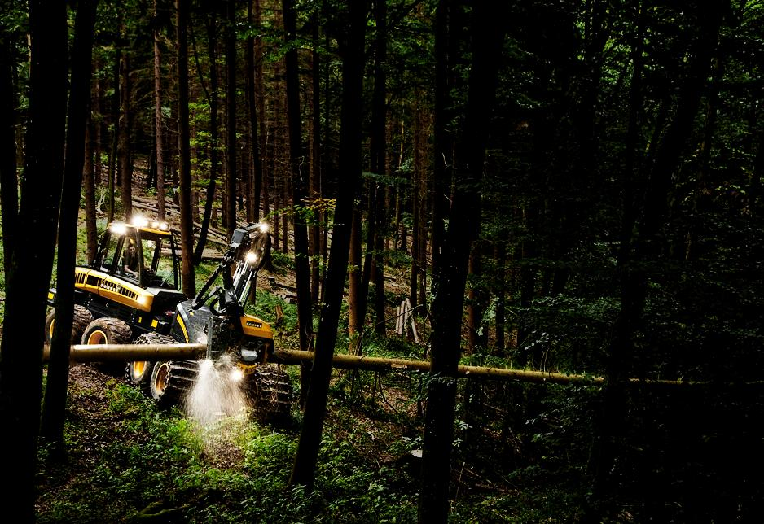
Opti Progress Control
Tuomo Moilanen

Slide 2
Opti Progress Control OPC
How to start the Ponsse OPC working time control in harvester
Principles of working time calculation
How to audit the work time and production control and possible errors
Reports of work time and production control
Contents and reading of reports

Slide 3
OPTI Progress Control OPC
Opti ProgressControl is tool for operator working time and production control.
The Opti ProgressControl is standard part of the Opti 4G harvester measurement and information system.
Harvester operator can switch OFF or switch ON the program, but when the program is ON it follow up the working times accurately
The results of the OptiProgressControll are able to report in the Opti Report program

Slide 4
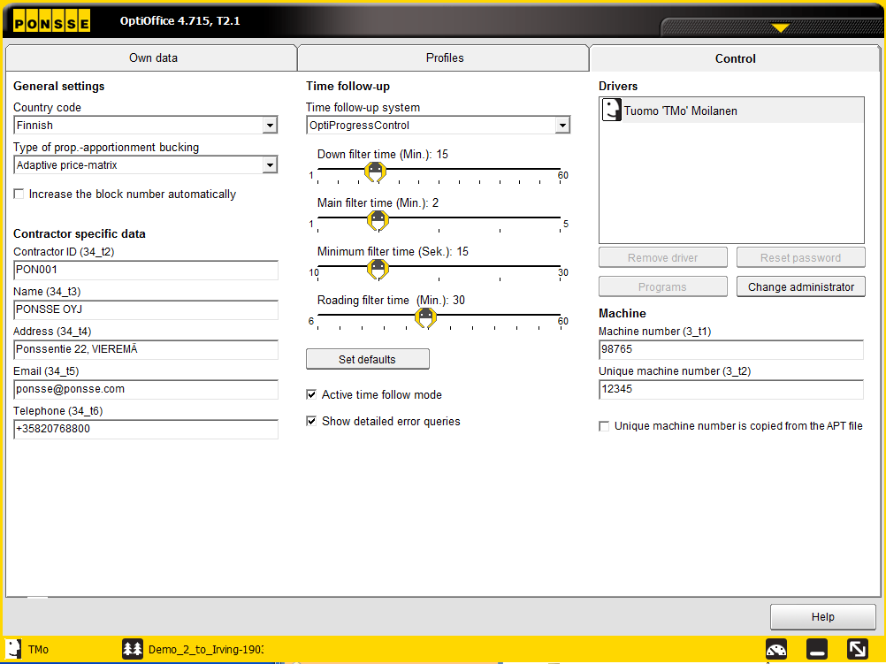
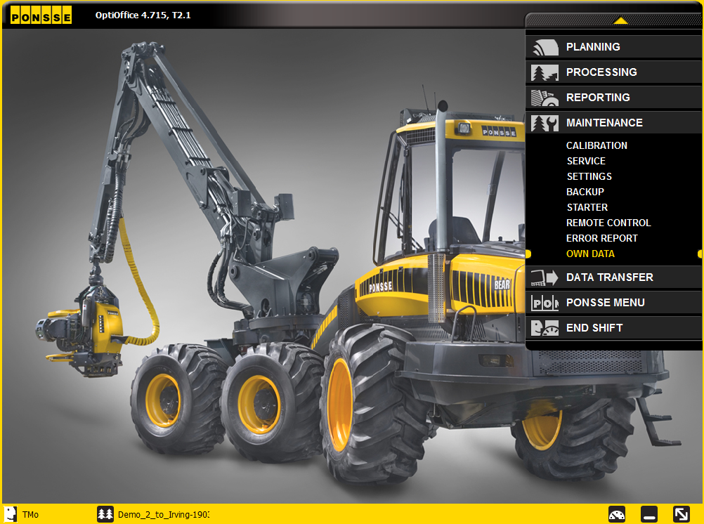
How to start the Ponsse OPC working time control in harvester

Slide 5
OptiProgressControl settings
Select OptiProgressControl from the list
If the downtime is shorter than this filter then down time will be calculated to work time. Otherwise downtime is calculated as downtime
If working (processing or driving) has continued with out breaks more than this filter time period, then working time is valid and working mode has changed from previous to current one

Slide 6
OptiProgressControl settings
The break time calculation starts if there are no pulses within this minimum filter time. Then time without pulses has to exceed “Down filter” time
Driving changed after this filter from terrain driving to road driving. Short road driving are calculated as terrain diving

Slide 7
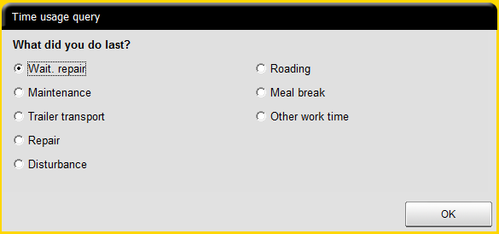
Pop Up of OptiProgressControl settings
This pop up comes on display in order to ask reason for the delay of production. Pop up come after delay which is set by “Delay time filter”. Some of reasons includes sub categories

Slide 8
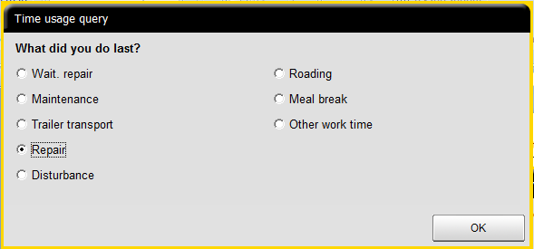
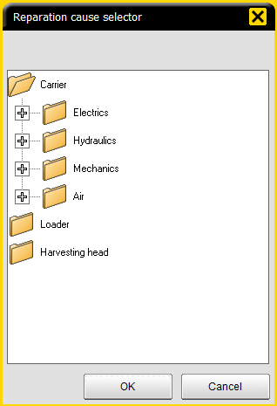
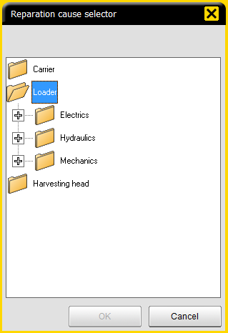
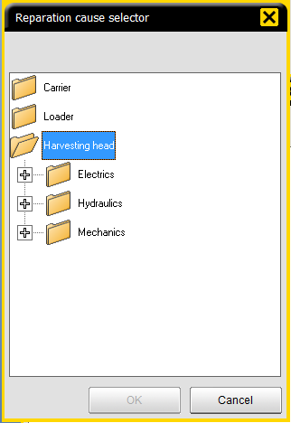
Sub categories of Repairing

Slide 9
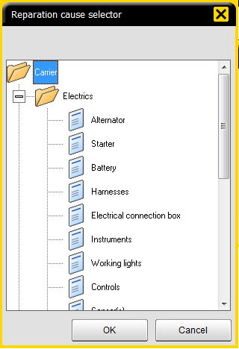
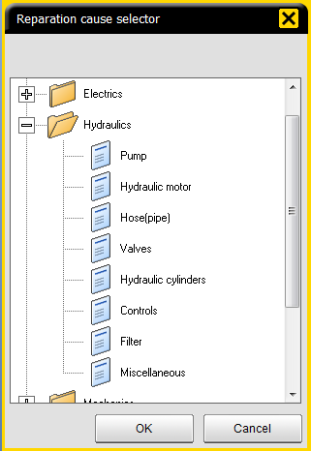
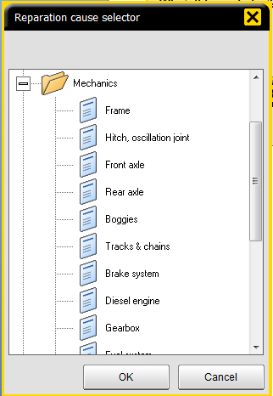
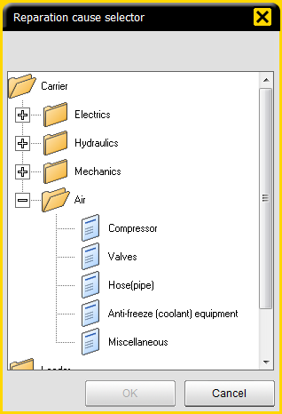
Sub categories of Repairing →Carrier
Carrier Electric
14 sub categories
Carrie Hydraulics
8 sub categories
Carrie mechanics
14 sub categories
Carrie Air
5 sub categories

Slide 10
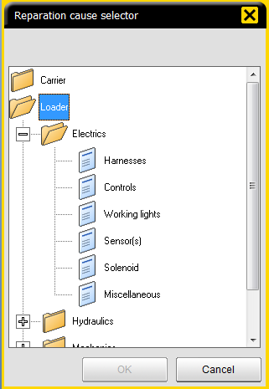
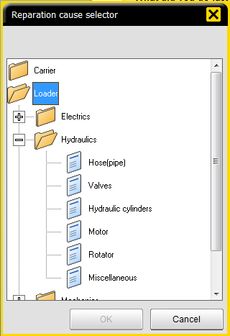
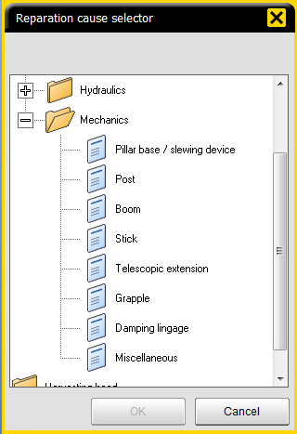
Sub categories of Repairing→ Loader
Loader Electric
6 sub categories
Loader Hydraulics
6 sub categories
Loader mechanics
8 sub categories

Slide 11
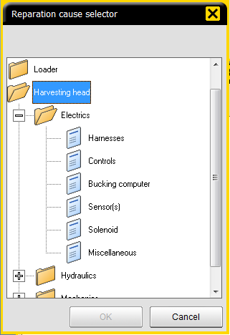
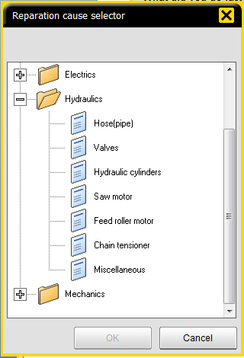
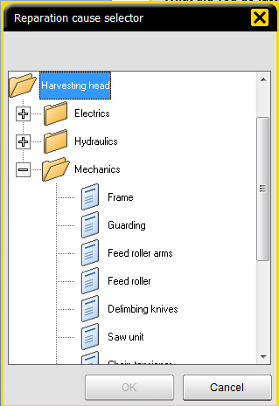
Sub categories of Repairing → Harvester head
Harvester head Electric
6 sub categories
Harv. head Hydraulics
7 sub categories
Harv. Head mechanics
12 sub categories

Slide 12
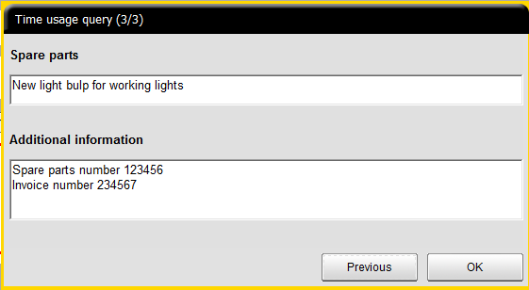
Additional information
Operator can give additional information of reason of the delay. Typical information is information of spare parts, like spare parts number, invoice number etc.

Slide 13
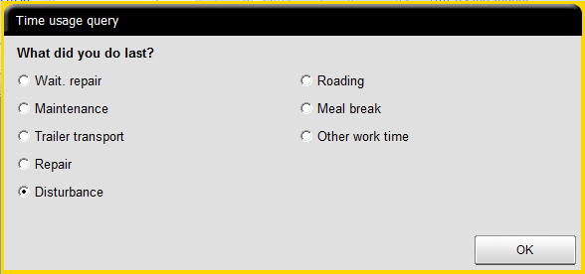
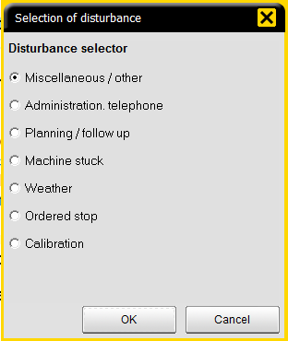
Sub categories of Disturbance

Slide 14
Time dividing according to standard
Calendar time
Total time on work
Lost time
Work time
Meal break
Other lost time
Efficient time (G15)
Down time
Processing time
Repair time
Driving on terrain
Waiting for reparation
Other work
Maintenance
Driving on road
Trailer transportation
Short down times < 15
Disturbance

Slide 15
Signals for work time
Signals for the Opti progress control comes from the harvester control systems from harvester head, from crane and from transmission.

Slide 16
Time concepts (page 2)

Slide 17
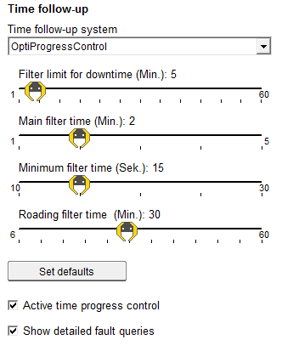
Example 1
Operator start to harvest and time follow-up system get pulses from the crane and from the harvester head. When harvesting continuous longer than “Main filter time” then work is registered as processing from beginning of the work.
= PROCESSING
= DOWN TIME
Processing time exceed main filter time
Registered processing time 25 minutes
0
5
10
15
20
25
30
35
40
45

Slide 18
Example 2
After harvesting operator take a brake and then start to harvest again. Brake is longer than “Filter limit for down time” therefore brake is registered as down time.
= PROCESSING TIME 10 minutes + 18 minutes
= DOWN TIME 17 minutes
Down time exceed filter limit for down time
Registered down time 17 minutes
10
18
0
5
10
15
20
25
30
35
40
45

Slide 19
Example 3
After harvesting operator take a short brake and then start to harvest again. Brake is shorter than “Filter limit for down time” therefore brake is registered as processing time.
= PROCESSING TIME 45 minutes
= DOWN TIME 0 minutes
Down time is shorter than filter limit for down time. Down time is not registered
Registered processing time time 45 minutes
0
5
10
15
20
25
30
35
40
45

Slide 20
Example 4
Operator is making some service. He test a machine for a while and continues with service. Processing time while testing is shorter than “Main filter time” therefore processing is not is registered as processing time.
= PROCESSING TIME
= DOWN TIME 25 minutes
Processing time is shorter than main filter limit time. Not registered.
Registered down time is 25 minutes
0
5
10
15
20
25
30
35
40
45

Slide 21
Example 5
After harvesting operator drive on terrain longer than “Main filter time” therefore terrain driving is registered.
= PROCESSING TIME 6 minutes + 29 minutes
= TERRAIN DRIVING 11 minutes
Terrain driving time is longer than main filter limit
Registered terrain driving time is 11 minutes
Total working time is 46 minutes
6
29
0
5
10
15
20
25
30
35
40
45

Slide 22
Example 6
After harvesting operator drive on road longer than “Roading filter time” therefore driving on road is registered.
= PROCESSING TIME 10 minutes + 3 minutes
= ROAD DRIVING 33 minutes
Road driving time is longer than “Roading filter limit”
Registered road driving time is 33 minutes
Total working time is 46 minutes
0
5
10
15
20
25
30
35
40
45

Slide 23
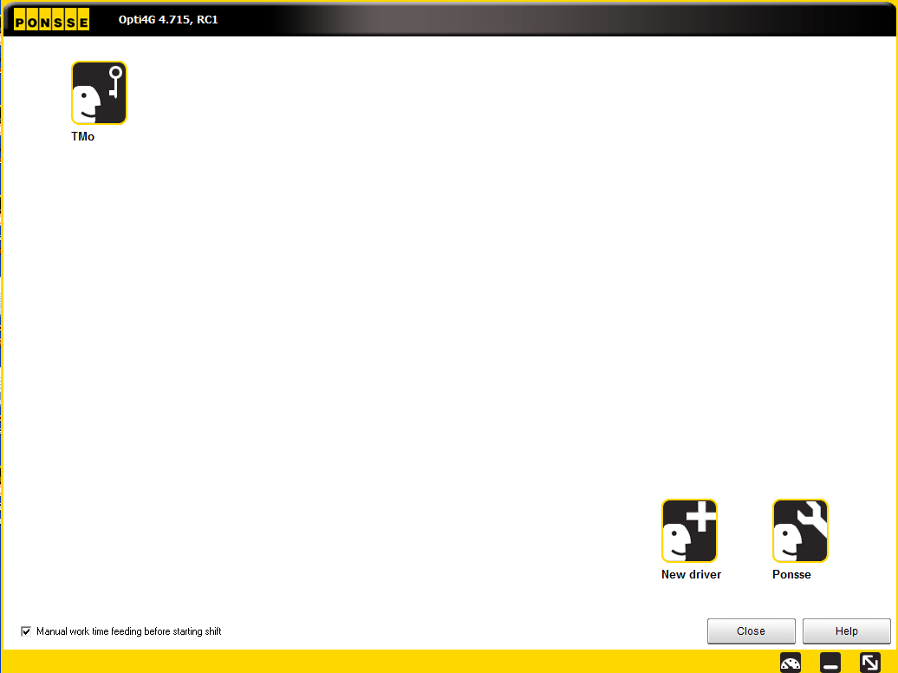
Manual work time feeding
Select “Manual work time feeding before starting sift”.
Click your own operator icon

Slide 24
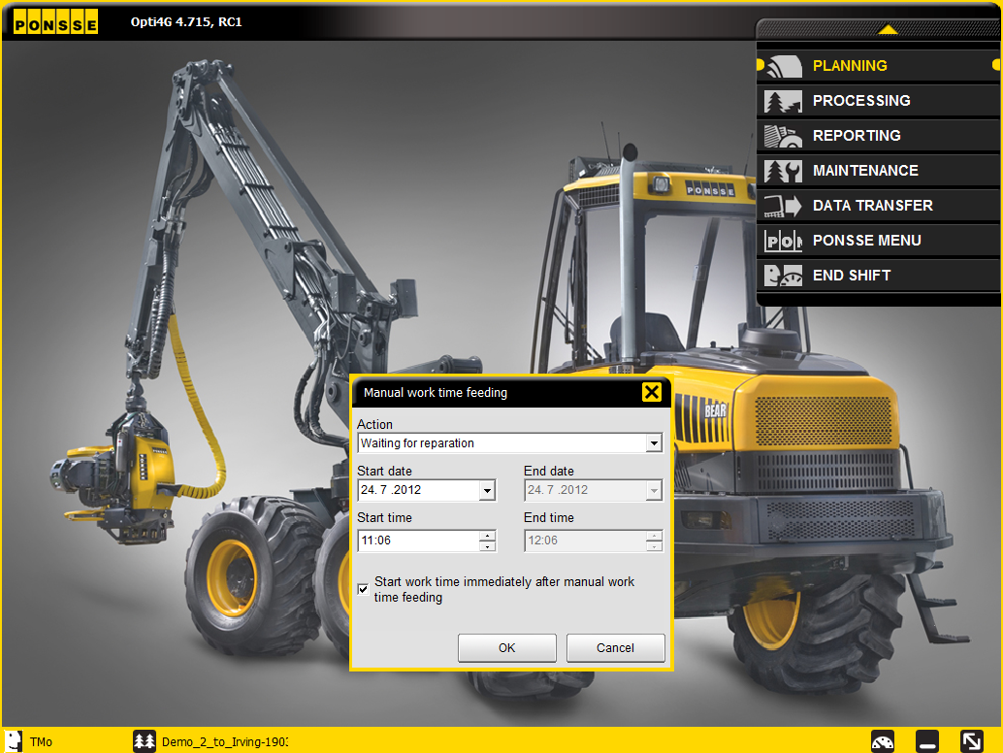
Manual work time feeding
Select Action from the list box.
Input starting and ending date and time.
Click OK
If you select “Reparation” or “Disturbance” then system ask to give also subcategories. Subcategories are the same than mentioned earlier.
Now work time which has made is registered.

Slide 25
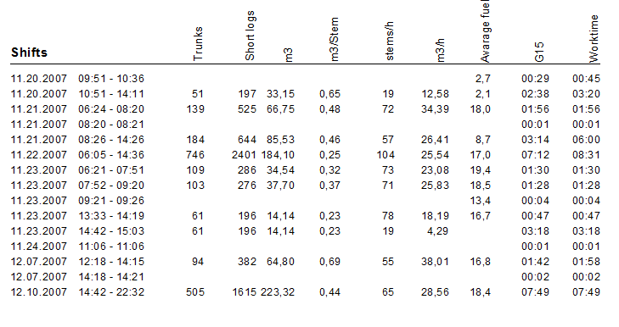
How to audit the system?
Make sure that OptiProgressControl is switched ON in the harvester.
Check from the reports that the system has been ON
Here the Opti Progress Control or the computer has switch off for 15 minutes

Slide 26
A logger’s best friend
PONSSE PLC
Ponssentie 22
FI-74200 Vieremä, Finland
Tel. +358 20 768 800
Fax +358 20 768 8690
www.ponsse.com

