Slide 1
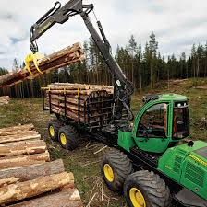
FORESTRY OPERATIONS STANDARD OPERATING PROCEDURES

Slide 2
Fuel and Oil Spill Procedure:
• Spill Kit required on site at all times.
• All machines must have spill response material on board.
• Fuel tanks and trucks are certified and properly labeled.
• Operators are trained to transport dangerous goods if necessary.
In the event of a fuel or oil spill, the following action must be taken:
1. Begin clean-up with absorbent material.
2. Communicate the incident to the supervisor.
3. Dispose of contaminated soil in an approved location.
4. Supervisor immediately reports spills >20 l (5 gal) to the appropriate environmental agency

Slide 3
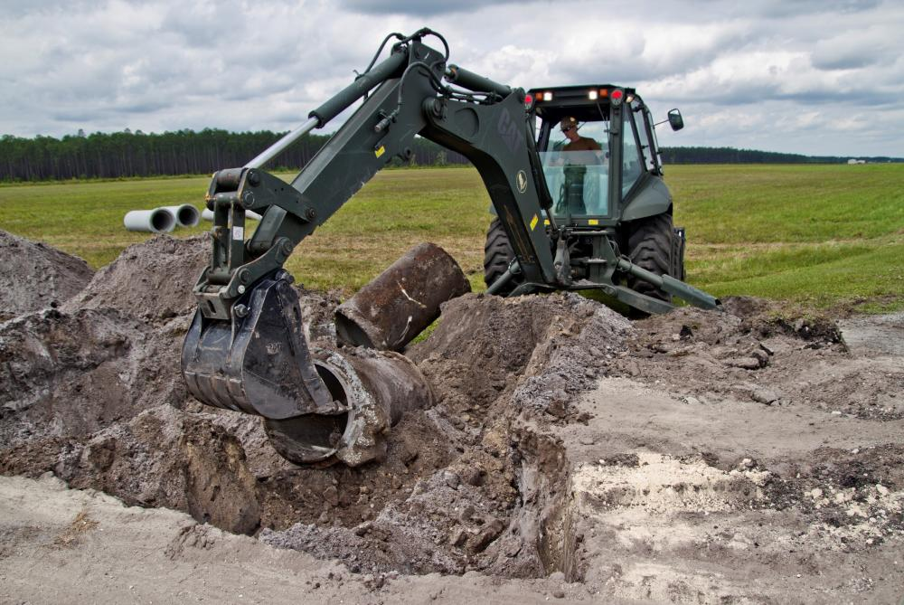
Road and Culvert Damage Procedure:
When damage to off-takes, culvert pipes or uncontrolled damage to road
surfaces or shoulders occurs:
1. Communicate the incident to the supervisor.
2. Supervisor must take appropriate action

Slide 4
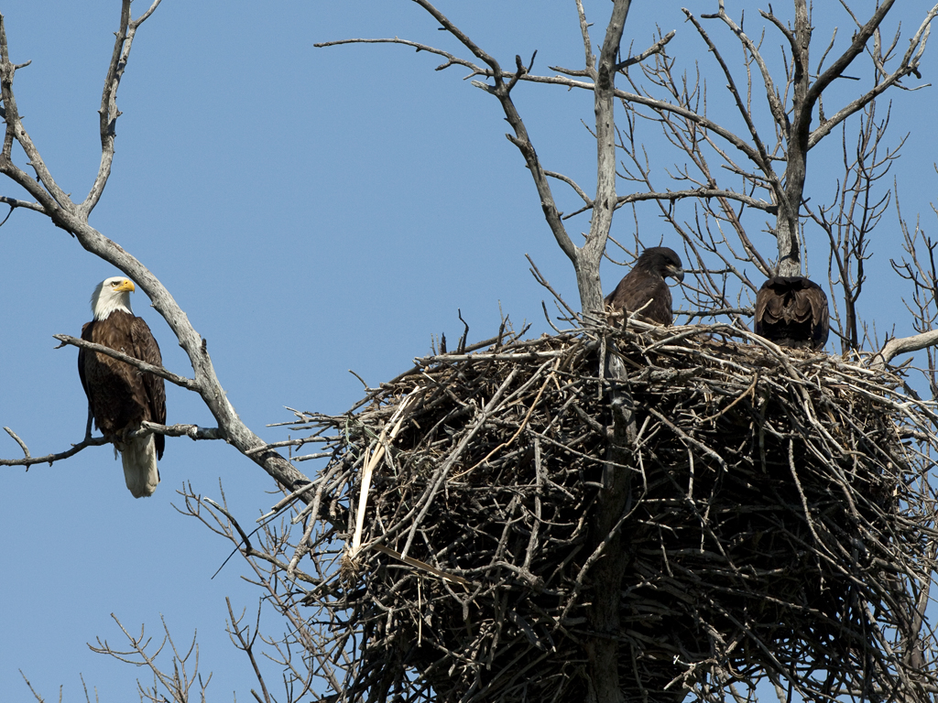
Site Specific Habitat Procedure:
If an unexpected site specific habitat is encountered (e.g. stick nest, vernal, pool, bear den, legacy tree), the following action must be taken:
1. Avoid the area.
2. Communicate the incident to the supervisor.
3. Supervisor must follow proper procedures
This Photo by Unknown Author is licensed under CC BY

Slide 5
Working near Watercourses:
• Communicate the non-conformance to the supervisor.
• No fueling machines or fuel storage within 30 m (100’).
• Appropriate permission is required (on site if necessary) when
working near watercourses.
• Avoid felling or dragging trees through watercourse.
• No debris left in the watercourse.
• For watercourses <0.5m(1.6ft) with intermittent flow, identify 7m
(25ft) no track zone with physical markings such as fence posts,
ribbons, or small trees placed in an X at the end of each trail.

Slide 6
Watercourse Size > 0.5m (1.6ft) or Year Round Flow < 0.5m (1.6ft) and Intermittent Flow
Riparian Zone Width 30 m (100 ft) NB and Maine, 20m
in NS 7 m (25ft)
No Mineral Soil Exposure 30 m (100 ft) NB, 15m(50ft) in Maine and NS 7 m (25ft)
No Track Zone 15 m (50 ft) NB, 7m(25ft) in Maine
and NS 7 m (25ft)
Forest Products Piled Roadside 30 m (100 ft) 30 m (100 ft)
Forest Products Piled in Woods 15 m (50ft), 7m(25ft)
in Maine 7 m (25ft)

Slide 7
Site Disturbance Procedure:
When the risk of rutting is high; follow the Harvesting and Forwarding
on Soft Ground BMP for Cut to Length operations, brush trails, or
move to low risk areas.
If a rut 12”(30cm) deep and 60 ft (20m) long occurs {Commercial
Thinning standard is 6”(15cm) deep and 15 ft (5m) long}, the
following action must be taken:
1. Take action to minimize disturbance.
2. Communicate the incident to the supervisor.
3. Make any necessary repairs if there is a risk of siltation entering a
natural watercourse (slopes greater than 35% need to have a
water management system employed).
Any harvest area where more than 30% of the trails contain a rut, will
be considered a management non-conformance.

Slide 8
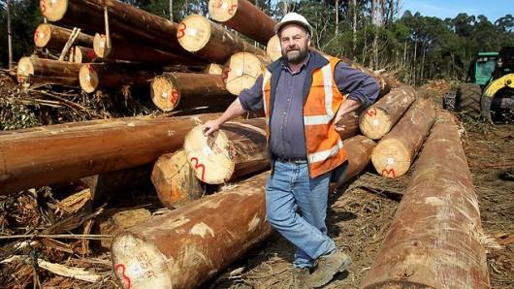
Trained Operators:
• Operators must be trained to implement the Work Order and
Standard Operating Procedures.
This Photo by Unknown Author is licensed under CC BY-NC-ND

Slide 9
Emergency Reporting Procedure:
1. Report Emergency to Woodlands or Scale office or Dial 911 if radio communication in not available
2. Request Emergency Response
.
This Photo by Unknown Author is licensed under CC BY-SA

Slide 10
Personal Protective Equipment:
• Hard hat, safety boots, high visibility reflective clothing, and safety
glasses required by all (exception: tree planters in open block planting safety
boots only).
• When operating a chainsaw: hearing, eye, leg, and hand protection is
required.
• When operating a thinning saw: hearing, eye, and hand protection is
required.
• When operating any machine hearing protection is required if noise is) excessive (> 80 decibels

Slide 11
Fire Suppression on Site:
• 40 lbs of fire extinguisher are required on machines at all times.
• Operator and Contractor are responsible to have prescribed fire
suppression equipment on site in good working order.
• Smoking restricted as per supervisors instructions.
• Operator is responsible to have ability to be pumping water on the fire
in 20 minutes, when the fire hazard is moderate or higher (a back tank
can be used for felling, processing,& site prep machines working alone).

Slide 12
Accident Prevention and Preparedness:
• Manufacturer’s safety features are in use on all equipment (including
lockout and tag-out process).
• Follow proper fall protection procedures.
• Follow proper excavation and trenching procedures.
• Follow Chicot work instructions
• Have required number of First Aid trained people and First Aid kits
stocked.
• Follow working alone procedures

Slide 13
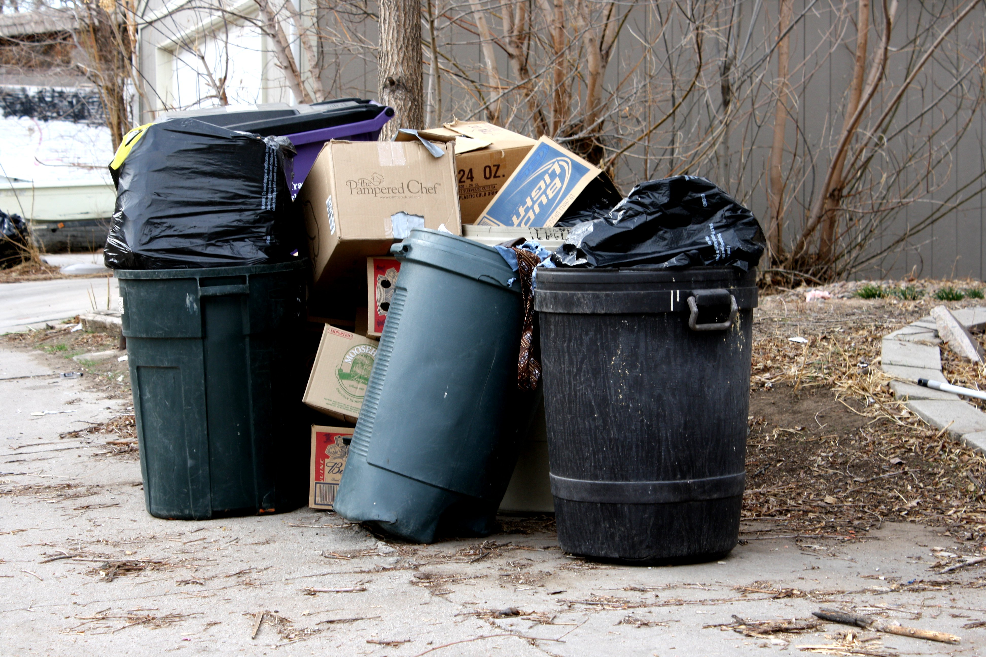
Garbage:
• Remove garbage from work-site and dispose in an approved location.

Slide 14
Working Near Legal Boundary Lines:
• No trees or brush can be cut or left on legal boundary lines. (unless
approved)
• Machinery can only cross boundary lines where located on the map
and work order.
Working Near Plantations, Thinnings, and Residual
Trees:
• Operations must work actively to avoid damage to planted and
residual trees

Slide 15
Logging Slash Dispersal:
• Slash and chipper debris must be managed to accommodate tree
planting and natural regeneration, avoid damage to standing trees, and
minimize fire risk.
• Slash or chipper debris piles can not exceed 8 m (26ft) in height and
should be free of earth and rocks.
• On Freehold Land – when there is a fire risk, a road or 5 m (17ft)
grubbed area is required next to plantations, thinnings, and standing or
piled timber (if not possible a minimum 15 m (50ft) separation zone is
required).

Slide 16
• On NB Crown Land – during fire season, chipper debris piles near
standing timber and silviculturally improved areas must be at least 15 m
away, and if closer than 30 m must be surrounded by a strip with no
burnable material at least 5 m wide.
• All redistributed piles must occupy less than 10 to 15 m2 (110 to 160
ft2) of surface area and be at least 10 to 15m (33 to 50ft) apart.
• Debris on Chipper D zone less than 20m from chipper setup, debris on main trails less than 6 meters wide

Slide 17
QUESTIONS?

