Slide 1

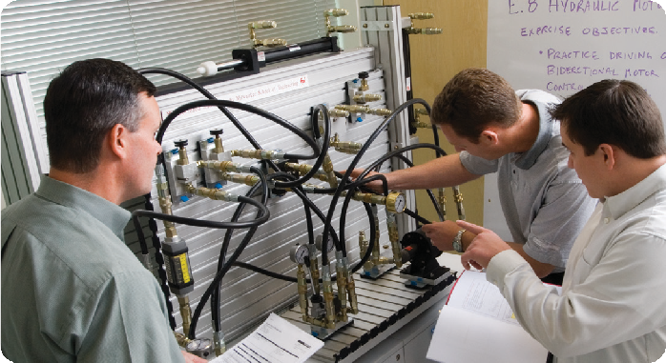
Preventive Maintenance for industrial & Hydraulic Hose systeMs
chaPter 1
hydraulic Preventive Maintenance:
Establishing a Program
A solid preventive maintenance (PM) program is critical to the safe and productive operation of hydraulic and industrial hose systems. This multi-chapter Gates Fluid Power eBook will delve into the many advantages gained by taking proper safety precautions and identifying system weaknesses before failure occurs. It will also take a step-by- step approach to hose and coupling selection, assembly, installation and troubleshooting.
This initial chapter focuses on hydraulic assemblies, introducing the reasons for establishing a PM program and outlining the necessary steps – from inspection to troubleshooting – to keep safe systems run- ning at maximum efficiency.
Preventive Maintenance as a necessity
Even in the toughest economic climate, no business should cut corners when it comes to preventive maintenance. Avoid- ing costly emergency repairs, production downtime and compromised worker safety is strong incentive for following careful maintenance plans.
The main objective of a PM program is to identify component weaknesses before failure and loss of production. In the case of hydraulics, high pressures and temperatures make hose and fitting maintenance, as well as component selection, particularly important.
Benefits of Preventive Maintenance
From cost savings to protecting workers, every organization has much to gain from a solid preventive maintenance pro- gram. Here are some examples:
Efficient production, since equipment is in prime operating condition.
Better use of in-shop maintenance personnel
with less emergency work.
Improved control of spare parts inventory and reduced parts usage.
Less equipment downtime through scheduled inspections.
Safety hazards are minimized.
Increased life expectancy of equipment.
Fewer capital outlays for premature purchases of new equipment.
Reduced repair costs from fewer breakdowns.

Slide 2
coMPonents of a PM PrograM
An effective PM program includes these key elements:
Maintaining a safe work environment.
Maintenance records.
Regularly scheduled inspections.
Troubleshooting.
Proper hose and fitting selection.
Proper assembly, routing and installation.
Periodic maintenance and product training.
surized hydraulic system. Serious emergencies arise and medical attention is needed when fluid punctures the skin, even if no pain is felt.
Leak. Leaking hydraulic fluid is not only unsightly, it is hazardous. It makes workplace floors slippery and dangerous and can also contaminate the environ- ment. In fact, as little as one quart of oil can pollute up to 250,000 gallons of water, and it is estimated that 100 million gallons of oil leak from hydraulic equipment annually.
QUICK TIP:
Before cleaning an oil spill,
always check EPA, state and local regulations.
safety
Although establishing and maintaining a safe work environ- ment might seem like common sense, refreshing associates and employees on the basics will help lessen the risk of catastrophic outcomes.
Pressure, temperature, flammability, mechanical parts and electricity are all factors to consider when working with hydraulic equipment.
Burst. Whether due to improper selection or damage, a ruptured hose can cause injury. If it bursts, a worker can be burned, cut or injected or may slip and fall.
Coupling Blowoff. If an assembly isn’t properly made or installed, the coupling could come off and hit or spray a worker, possibly resulting in serious injury.
Whipping Hose. If the hose end or end fitting comes apart under pressure, the loose hose can whip
around with great force. This has the potential to cause serious injury. If this hazard exists, the hose should
be restrained or shielded using clamps or protective shielding.
Stored Energy. Hydraulic systems sometimes use accumulators to store potential energy or absorb shock. This energy can create pressure that keeps a system’s components moving.
QUICK TIP:
Charged accumulators can be lethal. Always open the accumulator’s valve to release pressure.
QUICK TIP:
Society of Automotive Engineers (SAE) recommended practice J1273 contains many useful suggestions about design, installation, maintenance and other activities involving hose assemblies
in hydraulic systems.
Pressure
Operating pressures of hydraulic systems reach as high as 10,000 psi. With hydraulic fluid under pressure, the follow- ing dangers are encountered:
Pinhole. Fluid escaping from a pinhole can be virtually invisible and yet cause serious injury. Workers must avoid touching and even approaching any part of a pres-
Pascal on Pressure
Blaise Pascal, the French scientist and philosopher, was the first to discover that a pressure applied to any part of a confined fluid transmits to every other part with no loss. The pressure acts with equal force on all equal areas of the confining walls and perpendicular to the walls. Pascal’s studies centered on the principles of hydraulic fluids led him to invent the hydraulic press and the syringe.

Slide 3
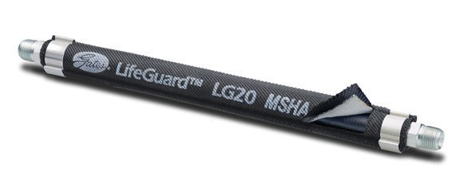
Dose, Duration & Manner of contact
As a federal public health agency of the U.S. Department of Health and Human Services, the Agency for Toxic Substances and Disease Registry (ATSDR) notes that many factors determine whether one is harmed when exposed to hydraulic fluids. These include the dose, duration of exposure and the manner in which one comes into contact with it.
Lifeguard™ Lives Up
to its name: The Sleeve Protects Against Hydraulic Hose Failure
A pinhole leak in a hydraulic hose under pressure can have catastrophic effects – threatening life and limb. That is why those working with hydraulic equipment seek out new ways to protect against toxic fluids under pressure.
Pole tampers, protective hoses and ordinary nylon sleeving simply do not offer the level of safety needed when lives are at risk. The LifeGuard™ Line- of-Sight Sleeving System from Gates Corporation is an unprecedented product, containing 6,000 psi bursts and 3,000 psi pinhole leaks on -four (1/4 inch), -six (3/8 inch) and -eight (1/2 inch) hose sizes up to 212°F.
temperature
Most hydraulic systems operate between 150° and 180°F, but some go as high as 300°F. Liquid at these temperatures, as well as metal parts, can cause burns.
flammability
With the exception of those comprised primarily of water, all hydraulic fluids are flammable when exposed to the proper conditions. Leaking pressurized hydraulic fluids may develop a mist or fine spray that can flash or explode upon contact with a source of ignition. Precautions should be taken to eliminate igni- tion sources, including electrical sparks, open flames, extremely high temperatures, and hot manifolds and engine blocks.
Mechanical
Swinging arms, booms, rollers, presses and anything that moves can be dangerous if a hose fails. For example, when a hose bursts, objects supported by fluid pressure may fall, and vehicles or machines may lose their brakes.
Compatible with a wide range of fluids, from environmentally friendly liquids to biodiesel fuel, the double-layer Life-
Guard sleeving protects workers within a three-foot line-of-sight of a hydraulic system. Its inner layer is made of tightly woven, extruded filament nylon designed to absorb the energy of a hydraulic hose burst or pinhole leak by stretching up to 20 percent. The outer sleeve, which is resistant to abrasion but not specifically designed for abrasive environments, is a bolt-cut, air-textured nylon material that contains escaped fluids and redirects them to the clamped ends of the hose.
The sleeve is secured at either end of the hose with special “channel” clamps. The clamps allow leaking fluid to safely escape, so it will not collect behind the sleeve and cause a burst. Plus, leaked fluid allows for fast hose failure detection.
LifeGuard sleeving has been subjected to rigorous testing programs – in the lab and in the field – to offer a true safety solution. Visit www.gates.com/ lifeguard to learn more.
QUICK TIP:
If equipment is mobile, always chock the tires to prevent rolling.
electrical
Hydraulic equipment must be turned off before it is worked on. With plant equipment, the control box should be locked and it should be tagged with a warning sign. With mobile equipment, the key should be removed and/or the battery should be disconnected so that it cannot be started.
High-voltage power lines and underground power sources must be identified before equipment is run. OSHA standards require that all hydraulic tools used on or near energized power lines or equipment are supplied with non-conducting hose having adequate strength for normal operating pres- sures [29 CFR 1926.951(f)(3)].

Slide 4
In addition to the factors above, proper hose selection, cou- pling selection, hose assembly and installation are all critical to ensuring the safe operation of hydraulic systems. These topics will be covered in depth in following chapters of this eBook.
abrasion, blisters, nicks, cracks, cuts, hardness or color changes. Determine what is causing the damage. When inspecting for leaks, look for puddles of fluid around the equipment, low fluid levels in the reservoir or greasy/dirty hose. Proper hose routing is critical in preventing early hose failure. Make sure hoses do not rub against each other or metal parts. Also check that they are not located near a high heat source. Check for twisting or kinking, and make sure there is enough slack to allow for length changes under pressure.
QUICK TIP:
Never check for leaks by running your hand over hose or hydraulic connections. Instead, use a piece of cardboard to locate a pressurized leak. For drips, use a rag to clean the area and determine where the leak originates.
insPection
Hydraulic equipment should be monitored during normal operation, as any noticeable difference in how it sounds, looks or feels often indicates a problem. In addition, peri- odic inspections ensure that systems are running safely and efficiently.
When to inspect
Recommended inspection schedules vary by type of equip- ment, so operating manuals should be referenced. That noted, here are some basic guidelines:
Mobile equipment should be inspected every 400-600
hours or every three months, whichever occurs first.
Stationary equipment should be inspected every three
months.
The critical nature of the equipment, operating tem- peratures, operating pressures, environmental factors, type of usage and the accessibility of the equipment all influence how often hose should be inspected.
Repair or replace hose assemblies as needed.
Inspect other hydraulic components. Look beyond hose and fittings to valves, pumps and cylinders for leaks and damage.
Reinstall the access panels.
Turn on the power.
Be aware of your equipment. Your eyes, ears and nose are your best inspection tools. If something seems off, inspect further to avoid hose assembly failure.
QUICK TIP:
Look for opportunities to inspect and correct potential trouble spots like high heat sources, rough abrasion areas and tight bends or twisting.
QUICK TIP:
Is your hose hot to the touch?
If you can’t hold it for five seconds, the operating temperature may be too high.
inspection Procedure
The following is an outline to help maintain hydraulic hose efficiently and safely:
Turn off equipment power and release pressure from the accumulators. Lock the control box, and tag it with a warning sign that reads, “DOWN FOR MAIN- TENANCE. DO NOT TURN ON POWER.” With mobile equipment, turn the key off, put it in a safe place and disconnect the battery.
Place equipment and components in a safe or neutral position. Make sure components are not in mid-stroke, in mid-cycle or holding a load. Before working around the equipment, drop the load, retract cylinders, relieve pressure and allow cool-down time.
Remove access panels and inspect hose and fittings
for damage or leaks. Check the cover for signs of
Keeping a detailed log of inspection and service information helps identify problem areas and monitor maintenance trends.

Slide 5
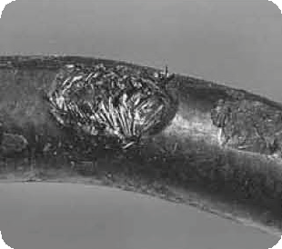
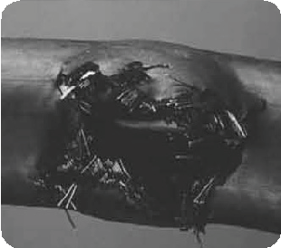
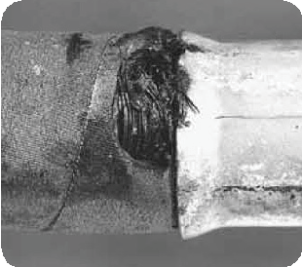
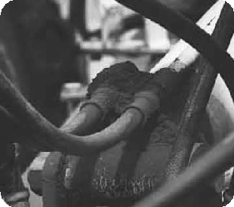
troUBLeshooting
The following guide reviews common problems found in hydraulic assemblies and offers possible solutions:
Problem: Hose Abrasion
Solution: Reroute the hose to keep it away from abrasive sources or guard the hose with a protective sleeve.
Problem: Hose Burst Away from Hose Ends
Solution: Inspect system operating pressure and select a hose that meets or exceeds the system’s maximum pressure. Try rerouting the hose to prevent excessive flexing or keep the hose from exceed- ing its minimum bend radius.
Problem: Hose Burst at Coupling
Solution: Increase the hose assembly’s length to accommodate contraction under pressure; increase the hose bend radius or install bend restrictors; or replace the hose assembly with a properly crimped assembly.
Problem: Leak at Thread End/Seat
Solution: Remove the connection and inspect.
Certain couplings require the use of an O-ring. If it’s missing, replace it. If an O-ring is used, check for damage caused during installation or possible material breakdown from heat or fluid incompatibility. Alternative O-ring materials may be required. Replace if necessary.
Check the threads and/or seat angle on both mating sur- faces for damage that may have occurred prior to or during installation. Any ding or burr may be a potential leak path. Replace if necessary.
continued on next page

Slide 6
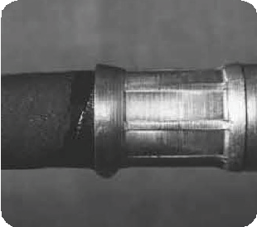
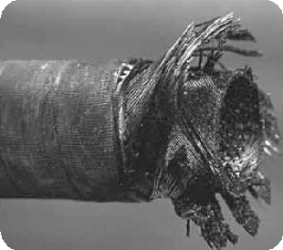
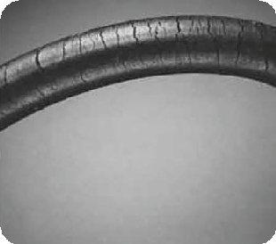
If the coupling was misaligned during installation, threads may have been damaged. Replace and carefully install.
It is possible to thread together some components that are not compatible. Use Gates thread I.D. kit to assist in identi- fying mating components. Some thread end configurations have better sealability than others. Also, ensure proper cou- pling selection.
Over-torquing of a threaded connection can damage threads and mating seat angles. Over-torquing can also damage the staking area of the nut causing cracking of either the nut or seat. Under-torquing does not allow proper sealing. Use of a torque wrench can alleviate such problems.
Problem: Weep/Seep at Hose Coupling Interface
Solution: Whether it has been undercrimped or the stem has been improperly inserted, the hose assembly must be replaced with one that has been properly assembled.
Problem: Coupling Blow-Off
Solution: Examine and replace the hose assembly to ensure proper assembly procedures are followed. Modify hose length and/or rout- ing to accommodate potential hose length reduction under pressure. Never mix different manufacturers’ hose, couplings or crimpers.
Problem: Hose Cracks
Solution: Select a hose that meets the temperature and flow require- ments of the application. Also, identify the heat source and consider rerouting it away from the source to minimize the effects. Examine reservoir size (if necessary).

Slide 7
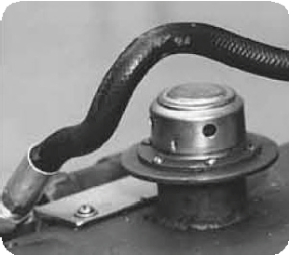
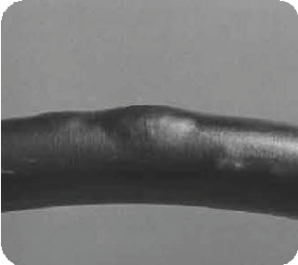
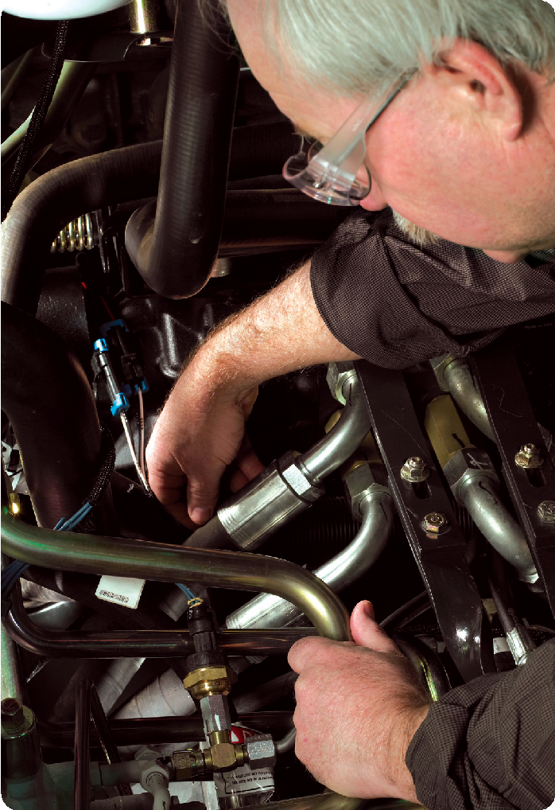
Problem: Hose Twist
Solution: Replace and reroute the hose to ensure that bending occurs only in one plane. The use of bent tube or block style couplings and adapters may improve routing. Also, when installing the assembly, hold the backup hex to prevent it from turning and applying a twist. If male and female couplings are used on the same hose assembly, install the male (non-swivel) end first.
Problem: Cover Blisters
Solution: Replace the hose with one that is recommended as compat- ible with the fluid being used. If it is compressed gas, the cover can also be perforated (pin-pricked) to allow the gas to seep through the cover. Textile hose covers also eliminate blistering. Bleed the system to eliminate any trapped air.
aDDitionaL resoUrces
For more Gates Fluid Power resources on safe hydrau- lics practices and preventive maintenance, visit www.gatesprograms.com/safehydraulics. Gates offers “Safe Hydraulics,” a special hydraulic preventive main- tenance training program designed to help maintenance managers, repair technicians and machine operators identify component weaknesses before failure. For more information, contact pa0000@gates.com. You will also find information on Gates hose, couplings, crimpers and accessories at www.gatesprograms.com/hydraulics.

Slide 8
PREVENTIVE MAINTENANCE FOR INDUSTRIAL & HYDRAULIC HOSE SYSTEMS
CHAPTER 2
Hydraulic Preventive Maintenance: Hose & Coupling Selection
A solid preventive maintenance (PM) program is critical to the safe and productive operation of hydraulic and industrial hose systems. This multi-chapter Gates Fluid Power eBook delves into the many advantages gained by taking proper safety precautions and identifying system weaknesses before failure occurs. It also takes a step-by-step approach to hose and coupling selection, assembly, installation and troubleshooting.
Improperly matched or coupled hose will likely fail, causing down- time and possible personal injury. In this chapter, we outline criteria for selecting the right hose and couplings for safe and efficient hydraulic assemblies.
RIGID TUBING VS. HOSE ASSEMBLIES
There are two common types of fluid connection — rigid tubing and hose assemblies. Their respective advantages are compared in this table:
HOSE CONSTRUCTION
In choosing the proper hose for an application and for the purposes of replacement, it is important to consider the three components of a typical hydraulic hose:
Tube: As the innermost layer, the tube’s function is to contain the material conveyed.
Reinforcement: The reinforcement is the hose’s muscle. It provides the necessary strength to resist internal pressure (or external pressure in the case of suction/vacuum). The three basic types of reinforce- ment are braided, spiraled and helical.
Cover: The cover protects the reinforcement and tube from environmental conditions including weather, ozone, abrasion, temperature and chemicals.
RIGID TUBING | HOSE ASSEMBLIES
Better heat dissipation | Less susceptible to damage from vibration or movement
Tighter bend radius | No brazing or specialized bending requirement
Lighter weight | Easier to obtain in the aftermarket
Ability to handle pressures over 6,000 psi | Sound absorption
 | Dampens pressure surges
While bent tubing has offered a weight advantage and tighter bend radius, recent advancements in hydraulic hose have made it lighter and created improved bend radius. In addi- tion, the wide availability and routing advantages of hose have made it a popular option for maintenance personnel in replacing hard-to-reach failed tubing.
www.gatesprograms.com/safehydraulics
1

Slide 9
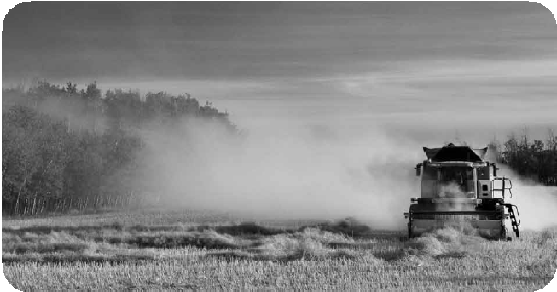
Types of Reinforcement
Maximum service life can be attained by complying with the following recommendations:
Working Pressure
The hydraulic system pressure should not exceed the rated working pressure of the hose. Pressure surges or peaks exceeding the rated working pressure are destruc- tive and must be taken into account when selecting a hose. It is not safe to use hose assemblies above their rated working pressure.
Minimum Burst Pressure
Burst pressures are reference pressures intended for destructive testing purposes and design safety factors only.
Temperature Range
Hose should not be exposed to internal or external temperatures exceeding the recommended limits. Consult additional technical data when hydraulic fluids contain emulsions or solutions. The fluid manufacturer’s recommended maximum operating temperature for any given fluid must not be exceeded, regardless of hose temperature range. Some fluids reduce the safe operating temperature of a hose (i.e. water in a hydraulic hose).
Fluid Compatibility
The hydraulic assembly (tube, cover, reinforcement and couplings) must be fluid compatible. The correct hose must be used since phosphate ester and petroleum-based hydraulic fluids have drastically different chemical characteristics. Many hoses are compatible with one or the other but not all fluids.
Minimum Bend Radius
Do not bend or flex hose to a radius smaller than the minimum recommended, and do not subject hose to tension or torque. This can place excessive stress on the reinforcement and severely reduce the ability of the hose to withstand pressure.
Hose Size
The hose size (inside diameter) must be capable of handling the required flow volume. A hose I.D. too small for a given flow volume results in excessive fluid turbu- lence, pressure drop, heat generation and tube damage. It is generally a best practice not to exceed 30 feet per second fluid velocity in a hydraulic system. Using a larger
I.D. hose will lower fluid velocity.
Hose Routing
Use clamps to restrain, protect or guide hose to minimize risk of damage due to excessive flexing, whipping or contact with other moving parts or corrosives. Determine hose lengths and configurations that will result in proper
Braided reinforcement can be wire or textile and have single or multiple layers.
Spiraled reinforcement is typically wire or textile and has four or six layers. Spiral-reinforced hose can typically handle more severe applications with longer impulse service life.
Helical coil reinforcement keeps the hose from col- lapsing during suction/vacuum and tight bending.
QUICK TIP:
Think about the life of your equipment and the safety of its operators. Never use hoses to pull external loads or to replace ropes or cables.
HOSE PERFORMANCE CHARACTERISTICS
The life of hydraulic hose and hose assemblies are dependent on service conditions. Subjecting hose and hose assemblies to conditions more severe than the recom- mended limits significantly reduces service life. Plus, exposure to combinations of recommended limits, such
as continuous use at maximum rated working pressure, maximum recommended operating temperature or mini- mum bend radius, also reduces service life.
QUICK TIP:
Hose assemblies in service should be regularly inspected for leaks, abrasion, kinks, cover blisters or other such damage. And assemblies showing signs of wear or damage should be replaced immediately.
www.gatesprograms.com/safehydraulics
2

Slide 10
routing and protection from abrasion, snagging or kinking and provide leak-resistant connections.
Hose Length
Correct hose length determinations include consid- erations for length changes under pressure, machine vibration and motion, as well as hose assembly routing.
Hose Applications
Select the proper hose for the application. Vacuum ser- vice and special fluid or high temperature capabilities are among the applications requiring particular consideration and a specific hose.
QUICK TIP:
Before cutting an original hose assembly, measure the overall assembly length and coupling
orientation. This measurement will be required to build the replacement assembly or match the hose I.D. to the port size.
Hose O.D. should not be used to identify the I.D. of the hose. Different hose constructions will vary with the wall thickness and O.D.
The hydraulics industry has adopted a measuring system called Dash Numbers to indicate hose and coupling size. The number that precedes the hose or coupling descrip- tion is the dash size. This industry standard number denotes hose I.D. in sixteenths of an inch. (Exceptions are SAE100R5, SAE100R14 and refrigerant hoses, where dash sizes denote hose I.D. compared to equivalent tube O.D.)
Hose O.D. can be a critical factor when hose routing clamps are used or when hose is routed through bulkheads. Check the manufacturer’s individual hose specification tables for O.D.s.
Temperature
When selecting a replacement assembly, two areas of temperature must be considered. These are fluid tempera- ture and ambient temperature. The hose selected must
be capable of withstanding the minimum and maximum temperatures of the system. Care must be taken when routing hose near hot manifolds, and in extreme cases, a heat shield is advisable.
HOSE SELECTION
To take into account the hose performance characteristics and the demands of a particular application, a simple and easy method is used to properly select hydraulic hose: STAMPED.
STAMPED
S = Size
T = Temperature A = Application
M = Material to be conveyed P = Pressure
E = Ends or couplings D = Delivery (volume)
QUICK TIP:
To avoid equipment breakdown and possible injury, the fluid manufacturer’s recommended maximum operating temperature for any given fluid must not be exceeded. If it is different from the listed hose temperatures, the lower limit must take precedence.
Size
The inside diameter of the hose must be adequate to keep pressure loss to a minimum and avoid damage to the hose due to heat generation by excessive turbulence. Velocity of hydrau- lic fluid in suction lines should always fall within a specific range recommended to ensure efficient pump operation.
To determine the replacement hose size, read the layline print- ing on the side of the original hose. If the original hose layline is painted over or worn off, the original hose must be cut and inside diameter measured for size.
Actual service life at temperatures approaching the recom- mended limit will depend on the particular application and the fluid being used in the hose. Intermittent (up to 10 percent of operating time) refers to momentary temperature surges. Detrimental effects increase with increased expo- sure to elevated temperatures.
www.gatesprograms.com/safehydraulics
3

Slide 11
Application
Determine where or how the replacement hose or assembly is to be used. Most often, only a duplicate of the original hose will have to be made, provided the original hose assembly gave acceptable service life.
To fulfill the requirements of the application, additional questions may need to be answered, such as the following:
Where will the hose be used?
What type of equipment is this?
What are the working and surge pressures?
Is this a suction application?
What are the fluid and ambient temperatures?
Have I considered fluid compatibility?
What are the environmental conditions?
What are the routing requirements?
Are government and industry standards being met?
Am I contending with unusual mechanical loads?
What hose construction will work best?
What thread end connection type should I use?
What thread type is right?
Should I use permanent or field attachable couplings?
What is the minimum bend radius?
Is non-conductive hose required?
Will there be excessive abrasion?
What is the expected service life?
permeation through the hose, such as explosions, fires and toxicity. Refer to applicable standards for specific applica- tions such as fuels and refrigerants. If gas permeates through the tube, consider pin-perforated covers to prevent gas build-up under the cover. Also consider the compat- ibility of the system fluid not only with the tube but also with the braid, cover, fittings and other components since permeation may expose the entire hose assembly to the system fluid.
Pressure
It is essential in the hose selection process to know the system pressure, including pressure spikes. Published working pressures of the hose must be equal to or greater than the system pressure. Pressure spikes greater than the published working pressure shorten hose life.
Burst pressures are reference pressures intended for destructive testing purposes and design safety factors only. Typically, for dynamic hydraulic applications, the minimum burst pressure rating is four times that of the maximum working pressure rating.
What Is Pressure Drop?
Pressure drop is the difference between the pressure of a fluid as it enters one end of a hydraulic hose assembly and the pressure of that fluid as it leaves the other end.
Here are some factors that can influence the amount of pressure drop:
Friction: This is the rubbing of fluid against the inside walls of the hose assembly.
Viscosity: Different fluids behave differently under pressure. Thicker fluids are moved with greater difficulty and will exhibit greater pressure drop.
Fluid Temperature: Warming fluids thins them so they are moved more easily, as with automotive oil.
Length of Hose Assembly: The longer it is, the more surface there is for friction to decrease pressure.
Size (I.D.) of Hose: Size affects the fluid velocity for a given flow rate. Higher velocities result in greater pressure drop. Therefore, a larger I.D. hose will produce less pressure drop.
Couplings and Adapters: Any change in bore or change in direction (such as with 45° or 90° elbows) can increase the amount of pressure drop.
Flow Rate: Pressure drop increases with flow rate for the same size hose.
Material to Be Conveyed
Some applications require specialized oils or chemicals to be conveyed through the system. Hose selection must
ensure compatibility of the hose tube, cover, couplings and O-rings with the fluid used. Additional caution must be exercised in hose selection for gaseous applications where permeation can occur.
Permeation, or effusion, is seepage through the hose result- ing in loss of fluid. This may occur when hose is used with fluids including these:
Liquid and gas fuels
Refrigerants
Helium
Fuel oil
Natural gas
Consider whether there are potential hazardous effects of
www.gatesprograms.com/safehydraulics
4

Slide 12
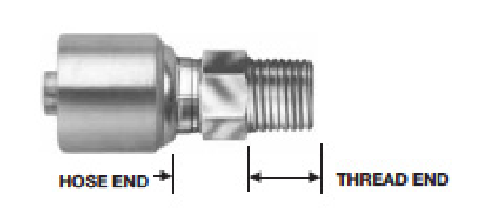
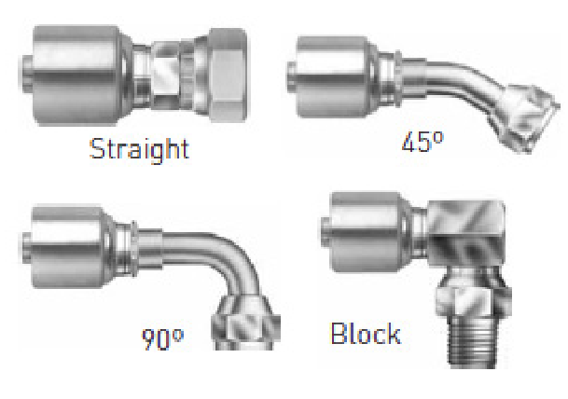
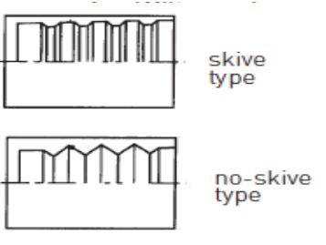
Ends or Couplings
Identifying the proper end connectors, the hose barb end and the port connecting end for a hose assembly is critical. Find details in the “Coupling Selection” section of this chapter.
QUICK TIP:
Never mix couplings and hoses from different manufacturers, and never recrimp or recouple used hose with permanent or field attachable couplings.
Delivery
The amount of fluid that must pass through a hose deter- mines the size of hose needed. Undersizing a hose leads to increased pressure loss, while oversizing the hose adds unnecessary cost, weight and bulk.
Finally, there are also different types of field attachable fit- tings – skive, no-skive, mandrel type, lock-on, C5 and those that are stamped for Department of Transportation use.
SAE
The Society of Automotive Engineers (SAE) estab- lishes the American standards for most hydraulic hose. SAE guidelines provide general properties of size, tolerances and minimum performance
characteristics of each major hose type. SAE-rated hoses from different manufacturers are not exactly the same but tend to be similar. SAE documents are available through SAE Customer Service at 724-776-4970.
Coupling Identification
A hydraulic coupling stem consists of two functional ends:
The hose end for hose attachment.
The thread end for port attachment.
COUPLING SELECTION
There are two types of hydraulic couplings – permanent and field attachable.
Permanent couplings require crimping or swaging equip- ment to assemble to a hose. They are available in either preassembled or two-piece configurations. Preassembled couplings are made with the ferrule permanently attached to the stem. Two-piece couplings consist of a stem and separate ferrule. When using two-piece couplings, it is important to match the ferrule with its appropriate stem and hose.
There are also two types of ferrules – skive and no-skive.
The hose end is identified by the hose size and type to which it is attached. Serration patterns are specified by the hose manufacturer to meet hose performance.
The thread end of a coupling (or adapter) can be identi- fied by comparing it with the coupling being replaced or by measuring the port or thread end to which it will be attached. The thread end may also come in different configurations.
Skive ferrules have blunt serrations (teeth), while serrations on no-skive are sharp to bite through the hose cover.
None of these compo- nents – hose, stem or ferrule – is reusable once it’s been part of another assembly.
www.gatesprograms.com/safehydraulics
5

Slide 13
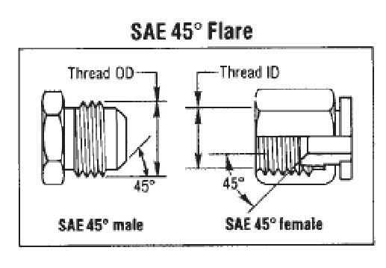
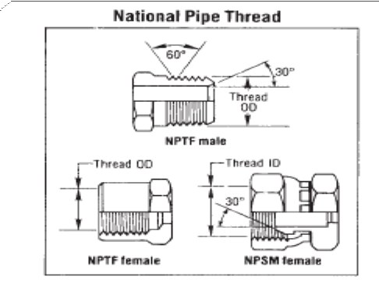
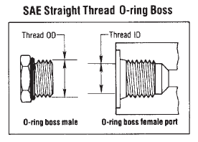
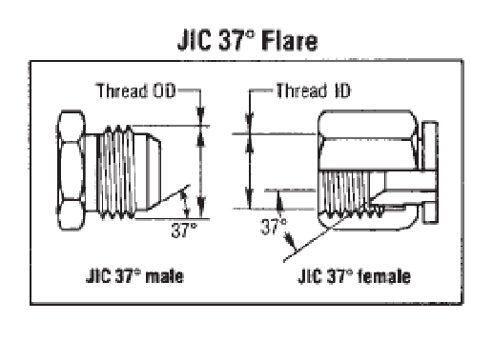
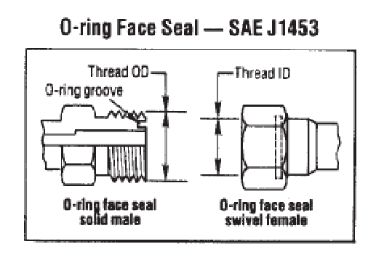
North American Standards
Listed below are the common North American hydraulic thread types. While all these couplings are widely used in the U.S. and Canada, they are also found on a worldwide basis in a variety of applications.
SAE 45° Flare
The SAE 45° flare will only mate with a SAE 45° flare female. Both male and female couplings have straight threads and a 45° flare seat. The seal is made on the 45° flare seat. Once again, because some sizes of this coupling have the same threads as the JIC 37° flare, carefully measure the seat angle to identify the correct coupling.
National Pipe Thread
These threads are available in several varieties: National Pipe Tapered for Fuels (NPTF), National Pipe Straight for Fuels (NPSF) and National Pipe Straight for Mechanical Joints (NPSM). The NPTF male coupling will mate with the NPTF, NPSF or NPSM female coupling.
SAE Straight Thread O-ring Boss
The O-ring boss male will only mate with an O-ring boss female, and the female is generally found on ports. The male has straight threads and an O-ring. The female has straight threads and a sealing face. The seal is made at the O-ring on the male and the sealing face on vthe female.
JIC 37° Flare
The Joint Industrial Conference (JIC) is now defunct, and this standard is included as a part of SAE J516. The JIC 37° flare male coupling will mate with a JIC female only. The JIC male and female have straight threads and a 37° flare seat. The seal is made on the 37° flare seat. Some sizes have the same threads as the SAE 45° flare. Carefully measure the seat angle to differentiate between the two.
O-ring Face Seal
The solid male O-ring face seal fitting will mate with a swivel female O-ring face seal only. An O-ring rests in the O-ring groove in the male coupling. The seal is made when the O-ring in the male contacts the flat face on the female coupling.
www.gatesprograms.com/safehydraulics
6

Slide 14
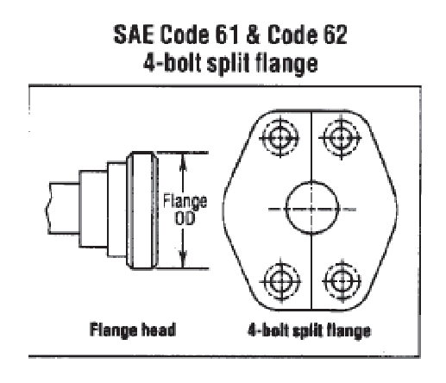
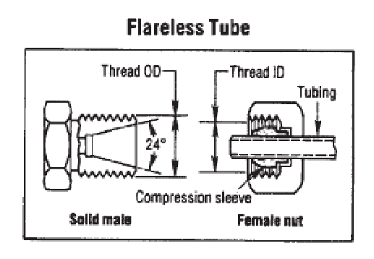
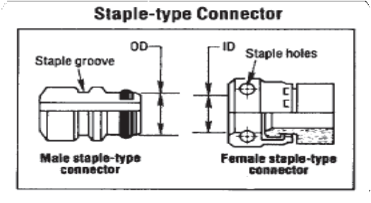
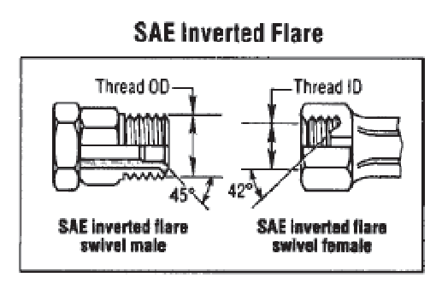
Flareless Tube
The flareless solid male only mates with a female flareless nut and compression sleeve. The male has straight threads and a 24° seat. The female has straight threads and a compression sleeve for a sealing surface. The seal is made between the compression sleeve and the 24° seat on the male and between the compression sleeve and the tubing on the female.
Komatsu flanges are dimensionally the same as SAE flanges except for their O-ring grooves.
Staple-Type
The seal on these connectors is made when the O-ring on the male contacts the inside surface of the female. The two connectors are held together with a staple. Staple-type couplings are commonly found on mining equipment worldwide.
SAE Inverted Flare
The SAE 45° inverted flare male will only mate with an SAE 42° inverted flare female. The male has straight threads and a 45° inverted flare. The female has straight threads and a 42° inverted flare. The seal is made on the 45° flare seat on the male and the 42° flare seat on the female.
International Thread Ends
As the volume and types of machinery imported into the United States grow, and the marketplace becomes more global, it is important to be aware of the differences between domestic and foreign couplings and to be able to identify each.
Knowing the country of origin for a piece of equipment provides a clue as to what type of thread end is used. Deutsche Industrial Norme (DIN) fittings indicate a German or Swedish manufacturer, while BSP is found on British equipment.
SAE Code 61 and Code 62 Flanges
These two couplings are used worldwide, usually as a con- nection on pumps and motors for extremely high pressure lines. There are four exceptions:
The dash 10 size, which is common outside of North America, is not an SAE standard size.
Caterpillar flanges, which have the same flange O.D. as SAE Code 62, have a thicker flange head and require different flange halves, clamps and bolts.
Poclain flanges are completely different from SAE flanges and are not interchangeable with them.
www.gatesprograms.com/safehydraulics
7

Slide 15
Here is a closer look at some examples of how these criteria apply:
Pressure
Working pressure should be considered when selecting a fitting. Some fittings don’t seal well at high pressures and can develop a leak. O-ring-type fittings as well as solid port connectors work well at high pressures. Avoid the use of swivel staked nut couplings at extremely high pressures.
Vibration
Coupling selection may be influenced if the end connection has quite a bit of motion and/or vibration, which can poten- tially weaken or loosen a connection. Use of split flange couplings, or other couplings that use an O-ring for sealing, perform better under vibration. Avoid use of couplings that seal on the threads.
Temperature
Metal surfaces can expand and contract under extreme temperature fluctuations. Choose couplings that use O-rings for sealing. The O-ring will seal as the metal moves. It may be necessary to use O-ring materials that are suitable for high temperatures. Also, use a fitting material that is best suited for the application’s temperature (e.g. if the applica- tion is high temperature, avoid using brass or aluminum).
QUICK TIP:
International thread ends can be metric, measured in millimeters, but also include British Standard Pipe (BSP) threads, measured in inches.
Japanese Komatsu machinery uses Komatsu fittings with metric threads, while other Japanese equipment mostly uses Japanese Industrial Standard (JIS) BSP threads, or in some cases, BSP straight or tapered threads.
These criteria help correctly identify couplings:
Seat: Inverted (BSPP & DIN), regular (JIS & Komatsu) or flat (flange, flat-face)
Seat Angle: 30° (JIS, BSP, DIN and Komatsu) or 12° (DIN)
Threads: Metric (DIN or Komatsu), BSP (BSPP, BSPT or JIS) or tapered (BSPT or JIS tapered)
What is critical is that the coupling or hose interface is compatible with the hose selected. The hose manufacturer’s coupling recommendations should be followed, and the proper mating thread must be selected so that leak-free sealing is ensured.
Additional Selection Criteria
It is important to keep in mind that the hose assembly is only one component of a larger system. In choosing the correct end terminations for the couplings attached to the hose, formal design standards and sound engineering judgment should be used.
In the absence of formal design standards, an engineer should consider the following factors in choosing the proper end termination:
Pressure
Temperature
Impulse frequency, amplitude and wave form
Vibration
Corrosion
Dissimilar metals (galvanic corrosion)
Maintenance procedures and frequency
Installation reliability
The connection’s risk in the system
Exposure to the elements
The operator and bystander’s exposure to the connection
Installation, operation and service activities and prac- tices that affect safety
CONCLUSION
Suppliers offer hundreds of types and styles of hydraulic hoses, and thousands of different couplings and fittings. From corrosion resistance to fluid compatibility, each of the system’s requirements must be carefully considered in the hose and coupling selection process. As always, matching parts from the same manufacturer for an integrated systems approach helps ensure that assemblies will perform above and beyond industry standards.
ADDITIONAL RESOURCES
For more Gates Fluid Power resources on safe hydrau- lics practices and preventive maintenance, visit www.gatesprograms.com/safehydraulics. Gates offers “Safe Hydraulics,” a special hydraulic preventive main- tenance training program designed to help maintenance managers, repair technicians and machine operators identify component weaknesses before failure. For more information, contact pa0000@gates.com. You will also find information on Gates hose, couplings, crimpers and accessories at www.gatesprograms.com/hydraulics.
www.gatesprograms.com/safehydraulics
8

Slide 16
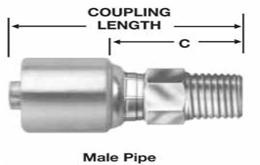
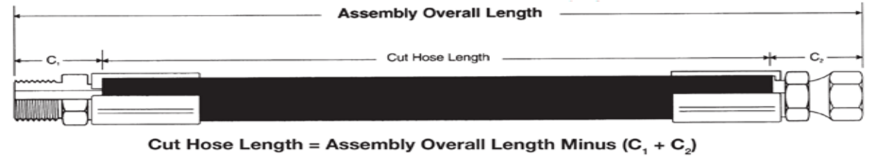
Preventive Maintenance
for industrial & Hydraulic Hose systeMs
CHApter 3
Hydraulic preventive maintenance: Hose System Assembly & Installation
A solid preventive maintenance (PM) program is critical to the safe and productive operation of hydraulic and industrial hose systems. This multi-chapter Gates Fluid Power eBook delves into the many advantages gained by taking proper safety precautions and identifying system weaknesses before failure occurs. It also takes a step-by-step approach to hose and coupling selection, assembly, installation and troubleshooting.
Chapter 2 covered the criteria for selecting the right hose and couplings for safe, efficient hydraulic assemblies. With that groundwork laid, this chapter details the processes of proper hose assembly and installation.
Hose Assembly
Components and equipment for the three types of hose assembly – permanent crimped, permanent swage and field attachable – may vary, but approaches to measuring, cutting procedures and fitting orientation are the same across the board.
measuring Hose
With some assemblies, the length must be within a tight tolerance for proper installation. This is especially true for short, high-pressure hose assemblies. Before cutting the hose, it is important to understand the difference between “cut hose length” and “assembly overall length” as shown below.
Cut-off value “C” is the length of that part of the coupling not directly in contact with or applied to the hose. Subtract- ing the sum of the two “C” values from the total length of the
assembly determines the approximate hose length to be cut.
For male thread couplings, the cutoff is measured from the locking collar to the end of the threads as shown.

Slide 17
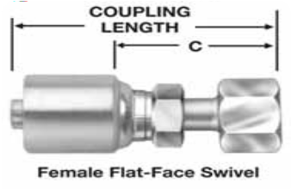
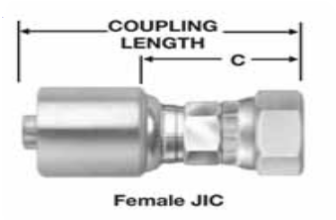
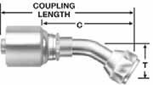
For straight female couplings, the cut-off is measured from the locking collar to the end of the nut or the seat
depending on whether the nut can be pulled back exposing the seating surface as shown.
Cutting Hose
After the hose cut length has been determined, hose is cut with a cut-off saw. The blade may be either notched (serrated) or abrasive. A notched blade gives a clean, efficient cut on one- and two-wire braid hose and textile hose. Though notched blades will cut spiral hose, they are not recommended as they can dull quickly or become damaged.
The abrasive wheel efficiently cuts all hose types, including spiral-reinforced hose. The drawback with this blade is
the amount of debris it creates from cutting. As the blade wears out, its diameter becomes smaller and eventually requires replacement.
Once the appropriate blade has been installed, the hose is placed in the bending fixture. This draws the hose away as it is cut, minimizing binding and making cutting easier. Hand- held cutters can be used on some textile-reinforced hose.
QUICK tIp:
When cutting hose, always wear safety glasses and avoid loose fitting clothing. Hearing protection is also strongly recommended.
Bent tube couplings are measured to the center line of the seating surface as depicted below.
Cutting Teflon® hose requires special consideration. It can be cut cleanly with a cutting shear. An abrasive wheel can also be used, but the hose’s cutting location must be wrapped with heavy-duty masking tape at least twice. Once the cut is made, the Teflon tube must be deburred using a sharp knife. And, of course, tape must be removed before assembly.
QUICK tIp:
Cutting of any hose will generate some debris that can damage the hydraulic system if not properly removed. Always follow strict standards of cleanliness.
sAe length tolerances for Hydraulic Hose Assemblies and specified Hose lengths
LENGTH | TOLERANCE
For lengths from 0” up to and including 12” | ±1/8”
For lengths from 12” up to and including 18” | ±3/16”
For lengths from 18” up to and including 36” | ±1/4”v
For lengths above 36” | ±1% of length measured to the nearest 1/8”
When cutting any hose, keep the cut as straight as possible and square with the side of the hose. The maximum allow- able angle of the cut is 5°.
Fitting orientation
Fitting orientation is necessary when both fittings are at an angle. They must be oriented to each other to ensure proper installation with minimal stress on the hose from twisting. First, the far coupling is positioned vertically

Slide 18
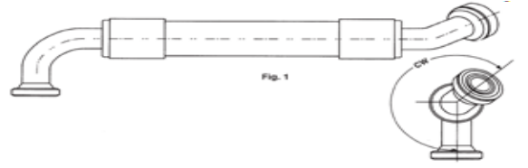
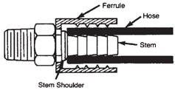
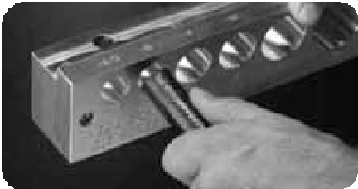
downward. Then the orientation angle is measured clockwise. The orientation angle tolerance should be ±2°.
3. To check for full insertion, pull the ferrule down. The stem shoulder should be level with the top of the ferrule.
Hose preparation
Skiving
A wire abrasion wheel or hand-skiving tool may be used to remove the hose cover down to the reinforcement for cou- pling assembly and/or ferrule crimping. Thick-covered hose typically requires skiving because the ferrule serrations can- not bite through the cover and into the wire. Hoses with a thin cover, on the other hand, usually do not require skiving.
4. Push the ferrule so that it rests against the stem’s hex. Hose and coupling are now ready for crimping.
preassembly Using one-piece Fittings
Place the hose next to the coupling. Use your thumb or mark the depth of the insertion.
With your thumb (or mark) in place, push the coupling until the shell touches the tip of your thumb or the mark. Twist it tightly to ensure it is fully inserted.
QUICK tIp:
The skive length is the length of cover removed, and the skive diameter is the diameter after skiving.
megaCrimp® Coupling Insertion tool
Confirming the proper insertion depth for Gates wire-braid hydraulic hose is simple with the MegaCrimp® coupling insertion tool. Made of light-
weight solid aluminum, and designed to mount either on top or on the side of a work bench, it has a slot for holding a marking pen or grease pencil. You simply locate the slot with the correct dash size, insert the hose and push it all the way in. Check to ensure the cut is square and then mark the insertion depth on the hose. Now you can easily see if the coupling is properly seated on the hose before you crimp. Ask your Gates representative for product no. 7482-1342.
Buffing
Some non-wire-reinforced hose requires buffing, which is similar to skiving but doesn’t require removing the hose cover to the reinforcement. When a hose is buffed, its cover is removed but only to a specific diameter as defined by crimp data. A grinding wheel, and not a wire wheel, is used.
preassembly Using two-piece Fittings
Lubricate the first two or three serrations on the stem with lightweight oil.
Clamp the stem in a vise on the hex portion, and push the hose onto the stem. The hose shoulder should be flush against the stem shoulder.

Slide 19
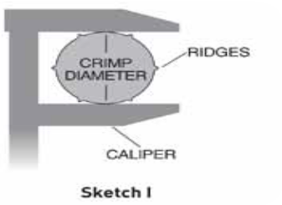
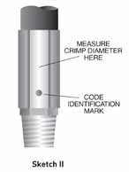
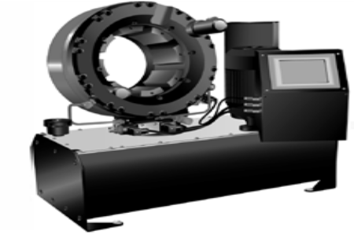
Crimp procedures
Listed here are crimp procedure basics. Always reference the operator’s manual for instructions specific to individual crimpers. Also remember to wear safety glasses and to keep hands and clothing away from moving parts.
Refer to a crimp data chart for skive data, die selection, finished crimp diameter and approximate crimp setting.
Load the selected dies into the crimper. When using a die set for the first time, apply a thin coat
of lubricant to the contact surface and cone but not to the bore of the die. This layer of lubricant must be thinly re-applied when
contact surfaces become shiny. Locate dies in the crimp position.
Adjust the machine to the proper crimp setting.
Adjust the depth stop if necessary.
Insert the assembly, and locate it with the die fingers.
Install a die cone if needed.
Activate the crimp mechanism.
Remove the assembly from the dies, and measure the crimp diameter.
Note: If the actual crimp diameter is not within the recommended crimp tolerance, you may need to check the calibration of the machine and recalibrate.
QUICK tIp:
Always check the crimp diameter to ensure that it is within the published limits. Record your actual crimper setting to achieve the specified crimp diameter for future use.
GC96™ Crimper
Gates GC96™ crimper is your solution for making leak-free, factory-quality assembles. Crimp ¼” to 6” hose (with the exception of 2”, 6-spiral hose), and use a touch pad screen to load Gates eCrimp settings and activate the crimper. Its horizontal front-end feed makes the process fast and easy. Ask your Gates repre- sentative about product 7480-9001.
How to properly measure Crimp Diameter
Measure halfway between the ridges.
(See Sketch I.) When using dial calipers, be sure the caliper fingers do not touch the ridges.
Measure halfway down the crimped portion of the ferrule. (See Sketch II.)
When measuring small crimp diameters (3/16” and 1/4”), a set of jaw-type micrometers is recommended.
Do not measure the top of the code identification marks.

Slide 20
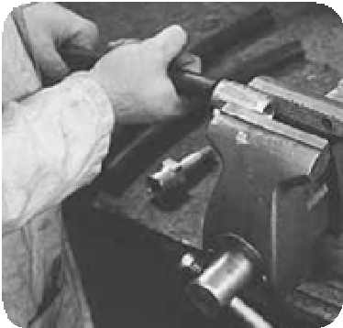
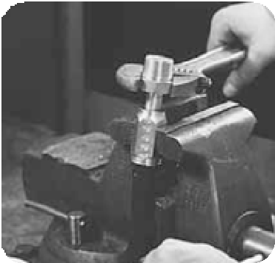
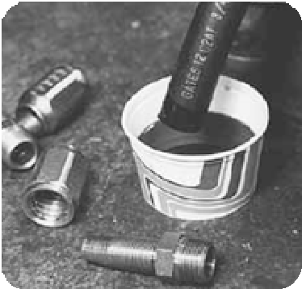
permanent swage procedures
Hose must be marked for proper insertion depth into
the coupling. After checking the swage data chart for the right depth, lightweight oil is used to lubricate the inside diameter of the hose. The coupling hex is placed into a vise, and hose is inserted to the given depth.
2. Put the socket in the vise as shown. Turning counterclockwise, thread the hose into the socket until it bottoms on the inside shoulder
of the socket. Then turn the hose back one-half turn.
The following are basic swage procedures, but it is always prudent to refer to an operator’s manual for specifics.
Insert the correct die and pusher into the swaging machine.
Lubricate the inner bore surfaces of the dies with a thin film of lightweight oil.
Put the hose assembly through the dies, feeding the hose and coupling into the pusher.
Pull control lever while guiding the coupling into the die until the pusher bottoms against the top of the die surface.
Push the control lever to retract the pusher and open the die halves. Remove the swaged hose assembly.
3. In clockwise motion, thread the stem into the hose and socket until the stem hex shoulders against the ferrule.
QUICK tIp:
For safety’s sake, use swagers only if you have received hands-on training. Always follow current operating manual instructions, use new hose and fittings and wear safety glasses.
Field Attachable
“Field attachable” means no crimper is needed to attach the couplings. Here are the basic steps in the assembly of field attachable couplings:
1. Thoroughly oil the hose and nipple.
Hose Cleanliness
Contamination is generated during system operation, built into the system during assembly or ingested by the system during operation. It can affect valves, pumps and drives and system cooling, decreasing equipment life and causing expensive failures. That is why it is important to use clean components and assemblies and to monitor contamination levels.
QUICK tIp:
For optimum performance, the working fluid in hydraulic systems should be as homogeneous as possible and free of all visible and microscopic debris. Be sure to use clean hose and couplings, since the best approach to cleanliness is preventing contamination in the first place.

Slide 21
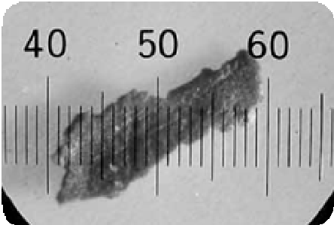
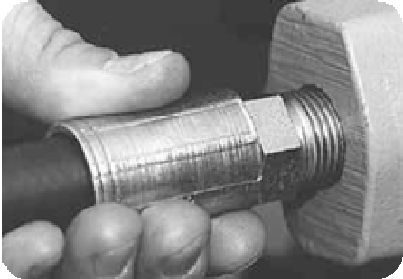
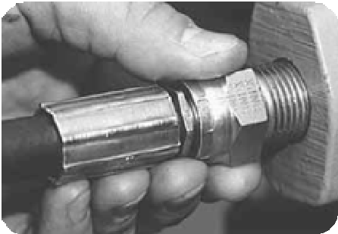
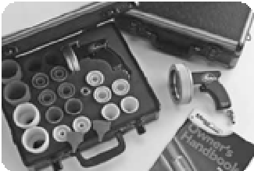

methods of Contamination measurement
Contamination particles are usually sized using a metric unit called a micrometer, otherwise known as a micron. A micron is equivalent to 39 millionths (.000039) of an inch, and the human eye can discern a particle no smaller than forty microns.
InstAllAtIon
Installation procedures vary based on coupling configura- tions, adapters and routing, but it is always necessary to follow proper safety precautions.
Coupling Configurations
Male Fitting to Port Connections
Male fitting to port connections can be made using four types of configurations: solid male (MP, MB, MBSPT, etc.); male swivels (MPX, MBX, MIX); flanges (FL, FLH, FLC, FLK); and block-style adapters with lock nuts.
The International Standards Organization (ISO) has established these three principal methods to measure the contamination level within a component, circuit or system:
Gravimetric Measurement (ISO 4405)
Particle Size Distribution (ISO 4406)
Maximum Particle Size Analysis (ISO 4407)
Solid male fittings are installed by rotating the entire hose assembly as you thread the male into the port. Teflon® tape can be used on the tapered threads to ease installation and improve the seal.
Find details at ISO.org.
If an O-ring is used, it should be lubricated with oil before installation. A dry O-ring will stick and pull away from the sealing area resulting in a poor seal.
megaClean™ system
The easiest method of cleaning a hose is to blow air through it, but that is really only a half-measure. To do the job thoroughly, Gates recommends using the Gates MegaClean™ system. Pressurized launchers and compatible nozzles blow foam projectiles through the inside surface of the hose, scrubbing away fine particles of loose dirt and contaminants. The projec- tiles are 20-30 percent larger than the hose ID and leave nothing behind but a clean hose.
Once hand-tight, a wrench is used on the hex to properly torque the fitting. Since hose rotation is necessary, two solid males should never be used on the same hose assembly.

Slide 22
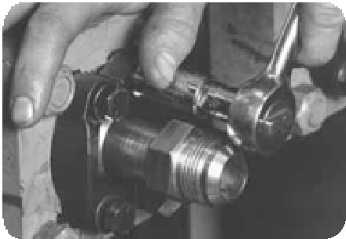
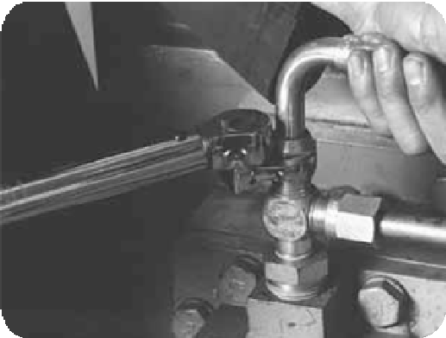
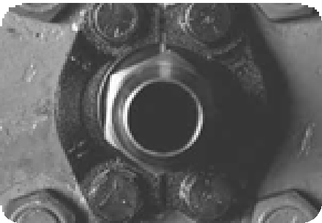
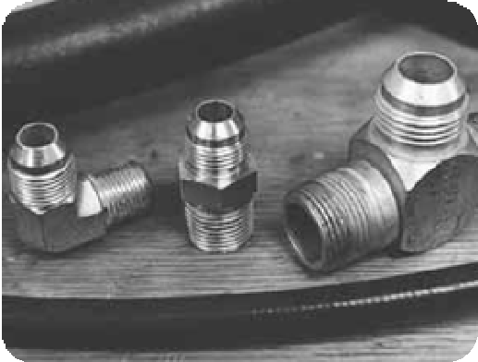
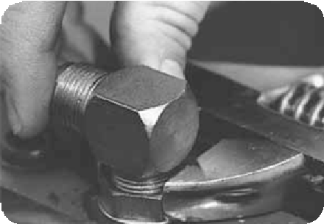
Male swivel installation does not require hose rotation. Simply thread the male into the port and use a wrench to torque properly. Since the hose does not rotate, you can orient the hose curvature to assist in routing. Be aware that male swivels (except MIX) have internal O-rings that must be compatible with the fluid used.
Female Swivel Connections
Female swivel connections are made by rotating the swivel nut over the solid male threads. Never use a swivel female with a swivel male. Once hand-tight, use a wrench to hold the backup hex while tightening the swivel nut to proper torque. This will prevent stem rotation and hose twist.
Flanges are installed using split flange clamps. Here are steps for proper flange fitting installation:
Put a small amount of oil on the O-ring and place it in the fitting groove.
Place the fitting over the port.
Bent tube and block-style fittings must be held in position by hand while tightening.
Compression-Style Fittings
Compression-style fittings (MSP, MFA, STA, ABC) use a bite sleeve and nut for connecting to tubing. Installation steps are as follows:
Make sure the tube is cut cleanly with no burrs or paint buildup.
Place the nut and then the bite sleeve over the tube. The bite sleeve must be oriented with the taper facing away from the tube.
Locate the tubing into the male fitting and secure the nut over the threads. The bite sleeve will compress against the tube and seal with the
male internal taper.
Install the clamp halves over the flange head and thread in bolts by hand.
Use a torque wrench to tighten using a crossing pattern.
Torque to the manufacturer’s specifications.
Some block-style male port adapters use lock nuts to orient the fitting. Rotate the block and thread the fitting into the port. When nearly tight, hold the block in position and tighten the lock nut against the port.

Slide 23
Use of Adapters
Adapters can be used to make installation and orienta- tion easier. Be aware, however, that adapters can also be a potential leak point. They can be used in the following situations:
To avoid fitting orientation, use a straight fitting and an angle adapter on one end. This makes installation easier and eliminates the need for orientation. However, this requires more parts and increases the number of joints for potential leakage.
When jump-size fittings are not available, make the jump with an adapter.
To ease port connection and hose installation.
To change to a different thread configuration, including international threads.
As a rule of thumb, it is better to use a straight adapter and bent tube coupling than an angled adapter and straight hose end. This promotes laminar flow and reduces pressure drop. When using adapters, the preferred method is to install the adapter first and the hose assembly next.
2. Use proper angle adapters to avoid tight bends in hose.
twist
Prevent twisting and distortion by bending hose in same plane as the motion of the port to which hose is connected.
When installing hose, make sure it is
not twisted. Pressure applied to a twisted hose can result in hose failure or loosening of connections.
Avoid twisting of hose lines bent in two planes by clamping hose at change of plane.
strain
Elbows and adapters should be used to relieve strain on the assembly and to provide neater installations which will be more accessible for inspection and main- tenance.
Abrasion
Run hose in the installation so that it avoids rubbing and abrasion. Clamps are often required to support long hose runs or to keep hose away from moving parts. Use clamps of the correct size. A clamp too large allows hose to move inside the clamp, causing wear.
Collapse
To avoid hose collapse and flow restriction, keep hose bend radius as large as possible. Refer to hose specifi- cation tables for minimum bend radius.
High Heat
High ambient temperatures shorten hose life, so make sure hose is kept away from hot parts or use protective sleeving.
reduce Connections
Reduce the number of pipe thread joints by using hydraulic adapters instead of pipe fittings.
Appearance
Route hose directly by using 45° and/or 90° adapters and fittings. Avoid excessive hose length to improve appearance.
Hose routing tips
Many assemblies fail because of improper routing. To minimize damage caused by excessive flexing or whipping, all replacement hose should be restrained, protected or guided using clamps. Protective armor, spring guards or sleeves made of abrasion-, temperature- or chemical-resistant material will help protect hose from cuts, abrasions, corrosives or hot components.
Here are some hose routing tips that will prevent unnecessary assembly failures:
length Change
When hose installation is straight, allow enough slack in hose line to provide for length changes that will occur when pressure is applied.
movement/Flexing
Adequate hose length is necessary to distribute move- ment on flexing applications and to avoid abrasion.
tight bend
1. When radius is below the required minimum, use an angle adapter to avoid sharp bends.

Slide 24
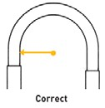
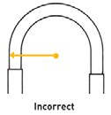

bend radius
The minimum bend radius of a hose is 1/2 the smallest diameter the hose can be bent without internal damage or kinking. Most hydraulic hose manufacturers list the
minimum bend radius for their hose, which is based on the hose construction, pressure rating, size and wall thickness. Bend radius is measured to the inside of the curvature as shown below.
bolt on the port area. Undertorquing does not allow proper sealing.
If a threaded connection leaks, maintenance personnel may be inclined to tighten the connection until the leak stops. This approach may solve the leak problem, but it also may cause more damage. Torque should first be checked before continued tightening to ensure it is within accepted limits.
The most reliable method of torquing threaded connections is to first hand-tighten the connection and then use a torque wrench to measure the torque.
Full-torque nut™ Couplings
Crack down on nut cracking, seat damage, leaks, corrosion and premature coupling failure in your hydraulic system. Available on MegaCrimp® couplings for wire-braid hose and GlobalSpiral® couplings for spiral-wire hose, Gates Full-Torque Nut™ has a large holding shoulder that evenly distributes stress forces for unsurpassed resistance to over-torquing and cracking.
seven easy steps to Assembly Installation
Clean the surrounding area where connections are to be made. Do not let dirt or contaminants into
the opening.
If adapters are used, install them now.
Lay the hose assembly into the routing position to verify length and correct routing.
Thread one end of hose assembly onto
the port or adapter. Install angled fitting first to ensure proper positioning.
Thread the other end of the assembly without twisting the hose. Use a wrench on the fitting’s backup hex while tightening.
Properly torque both ends.
Run the hydraulic system under low pressure and inspect for leaks and potentially damaging contact points.
bundling
When installing hose assemblies, bundling techniques can improve space utilization, appearance and hose life. Here are some tips:
Group and bundle similarly constructed and sized hose together using clamps, nylon straps or nylon sleeving.
Never bundle high-pressure hose with low-pressure hose. Under pressure, they can work against
each other.
Never bundle rubber hose with thermoplastic or Teflon® hose. Under pressure, they can also work against each other.
Installation torque
Installation torque is very important to ensure a proper leak-free seal. Overtorquing of a threaded connection can stretch and damage threads and mating seat angles. It can also damage the staking area of a nut or possibly break a

Slide 25



4. Always consider mechanical movement when bundling. Allow sufficient slack without pulling on a fitting or another hose. Bundles should bend in one plane only.
bend restrictors
Bend restrictors typically are PVC sleeves which are installed near the coupling during hose assembly. They reduce bending stress in the hose to prevent damage.
sleeving
A number of sleeving types are used today. The most com- mon is nylon, which is typically used to protect hoses from
abrasion or for bundling hoses.
ConClUsIon
Once a hydraulic system has been installed and is
operational, it is important to closely monitor how the equipment sounds and functions. Regular inspection helps ensure that equipment is running strong, raises red flags, and in the long run, saves the heavy costs incurred through downtime or equipment failure.
ADDItIonAl resoUrCes
For more Gates Fluid Power resources on safe hydrau- lics practices and preventive maintenance, visit www.gatesprograms.com/safehydraulics. Gates offers “Safe Hydraulics,” a special hydraulic preventive main- tenance training program designed to help maintenance managers, repair technicians and machine operators identify component weaknesses before failure. For more information, contact pa0000@gates.com. You will also find information on Gates hose, couplings, crimpers and accessories at www.gatesprograms.com/hydraulics.
QUICK tIp:
Remember that most sleeving provides little or no operator protection. Use sound engineering judgment in the design of equipment in order to control the hazard of direct exposure of operators to fluids under pressure.
spring Guards
There are many types of spring guards – flat armor, plated wire, plastic, etc. They can be used to bundle hose, provide stability or protect against abrasion. In addition, tightly wound plated wire guards can be used as bend restrictors to ease stress on the hose.

Slide 26
Preventive Maintenance
for industrial & Hydraulic Hose systeMs
chapTer 4
Industrial hose preventive maintenance
A solid preventive maintenance (PM) program is critical to the safe and productive operation of hydraulic and industrial hose systems. This multi-chapter Gates Fluid Power eBook delves into the many advantages gained by taking proper safety precautions and identi- fying system weaknesses before failure occurs.
Previous chapters have reviewed inspection and troubleshooting, hose and coupling selection and assembly and installation pro- cesses for hydraulic systems. In Chapter 4 we detail the various benefits and essential components of a preventive maintenance program for industrial hose systems.
The ImporTance of prevenTIve maInTenance
Preventive maintenance programs are a combination of preventive knowledge, from proper hose and coupling selec- tion to proper coupling attachment, and preventive action, from periodic inspections and hydrostatic pressure testing to scheduled replacement and troubleshooting.
Following such a program is critical, as unexpected hose fail- ure can damage equipment, stop production and even cause injury or death. The key is to identify and prevent potential problems before failure occurs by using the right hose for the application, replacing hose on a regular schedule (regardless of condition) and, of course, replacing hoses showing signs of deterioration or damage.
When care is taken, the benefits of a preventive mainte- nance program are clear. Costly repairs are eliminated, and production downtime is minimized. Hose life expectancy is increased, costly EPA spill cleanups are reduced and workers are kept safe.
DefInIng InDusTrIal hose
An industrial hose is a flexible, reinforced tube used for conveying liquids, solids and gases. A typical industrial hose is dragged, coiled, run over, kinked and subjected to all kinds of wear and tear as well as abuse. It is critical that the application and its environment are taken into consideration for proper hose selection. Selection of the proper hose and materials will increase hose life, improve performance and ensure safety.
Industrial hose is used for three purposes:
To transfer gases, liquids, solids and mixtures of these materials.
As a flexible connector to absorb surges and vibrations.
As a conduit to protect other hoses, pipes and wires.

Slide 27

The Basic elements of a hose
sTampeD
Here is a list of hose selection considerations for quick reference:
Size
I.D. (inside diameter)
O.D. (outside diameter)
Length
Flow rate requirements
(GPM for liquids; CFM for gases)
Tube – Its purpose is to handle specific fluids or solids. It is the innermost rubber or plastic com- ponent of the hose and must be resistant to the material being conveyed. A variety of compounds can be used depending on the application.
Reinforcement – Its purpose is to withstand a specific amount of working pressure measured in pounds per square inch (psi) or Pascal (Pa) or vacuum (In Hg, inches of mercury). The reinforcement may consist of multiple layers of fabric, yarn or wire placed on top of the tube and referred to as “plies.”
Cover – Its primary purpose is to protect the tube and reinforcement from external factors such as ozone, weather, abrasion and heat. A variety of com- pounds can be used depending on the application.
Temperature
Ambient temperature
Internal temperatures
Temperature impact on material being conveyed
Application
Where the hose will be used
How the hose will be used
How often the hose will be used
Environmental conditions
Special hose construction needs
Conductivity requirements
Critical applications (flammable fluids, compressed gas, steam, etc.)
Government or industrial standard requirements
QuIcK TIp:
Hose should not be used in “out-of-sight” applica- tions where it is buried, encased or submerged. Use rigid pipe in these applications. Also, remember that hose has a finite service life and is not meant to be used in permanent applications.
Material Being Conveyed
Chemical name(s) and state(s)
Food, pharmaceuticals, cosmetics
Dry or powder
Liquid
Pressure
Working pressure
Maximum surge pressure
Vacuum
hose selecTIon
Proper hose selection is the first step in preventive mainte- nance. Selecting the right product for the application will allow you to obtain the maximum life expectancy from the product for the most value.
When selecting hose, use the acronym STAMPED as your guide to defining important characteristics: Size, Tempera- ture, Application, Material being conveyed, Pressure, End requirements and Delivery.
End Requirements
Type of end connections/couplings
Delivery
How many items and when they need to be supplied
Special packaging or branding requirements

Slide 28
Coupling SeleCtion
Couplings must be selected to maximize the safety and per- formance of a system. The following criteria are considered in identifying which style is best for the application:
Attachment options (ferrule, band or clamp)
Availability of size
Availability of required thread type
Cost
Coupling compatibility with conveyed material
Quality
Ease of handling
In critical applications, however, specific couplings are required. These include corrosive chemical transfer, LP gas, oil field drilling, petroleum products transfer, steam and ground fueling of aircraft. No substitutions should be made unless written authorization has been given by the hose manufacturer, coupling manufacturer and the end user for the specific application.
gates industrial Hose
These Gates application-specific Industrial Hose moves food, fuel and other essentials from end to end:
Acid chemical hoses are flexible, lightweight and engineered to safely transfer the most corrosive substances.
Air and multi-purpose hoses offer excellent flexibility and maximum resistance to weather and ozone while conveying air, water and other substances.
Food and beverage hoses meet FDA sanitary requirements, resist abrasion and soiling on the outside and will not impart taste to food products.
Material handling hoses come with an assort- ment of tube and cover materials that will handle the suction/discharge of dry commodi- ties and liquids.
Petroleum transfer and dispensing hoses for commercial gasoline, oils and other petroleum products are tough and easy to handle.
Steam transfer hoses safely handle pressures up to 250 psi and temperatures up to 450°F, including superheated and saturated steam, wet or dry.
Water handling and dispensing hoses provide superior water and light chemical service in industrial, construction, agriculture, mining and waste management applications.
QuiCK tip:
The coupling end type must be of the same type as the port to which the hose is being attached.
StatiC eleCtriCity grounding
Movement of some dry material through a rubber or plastic hose can generate enough static electricity to be hazardous. Not only could a static spark ignite a fire or cause an explo- sion, but enough charge could build-up in the hose to cause a severe shock if contacted.
Grounding can be achieved through use of static conductive stock in the tube or cover, the bent wire method or the metal staple method.
The bent wire method is used with wire-reinforced hose. Fol- low these steps:
Locate the helix wire or the static wire.
Pull the wire out with pliers.
Bend the wire into the inner surface of the hose tube,
using caution to not puncture the tube.
Attach the couplings so the bent wire and the cou- pling make contact. The bent wire must not extend the full length of the stem, since it could create a leak at the coupling.
To learn more, download our Industrial Hose Products Catalog at http://gatesprograms.com/ hosesystems.

Slide 29




Place the assembly on a non-conductive surface and check it for electrical continuity with an ohmmeter that measures electrical resistance. (The maximum allow- able resistance is 20,000 ohms per foot of hose.)
Record all test data on a hose inspection card and file it with maintenance records.
Close-up of hose end showing wire braid in hose.
Hose assembly being tested with ohmmeter.
The metal staple method is used with a hose that has a carbon fiber static conductor or wire reinforcement where the staple can be inserted easily against a static conducting member. Follow these steps:
Cut the hose end square to the desired length.
Locate the static wire, wire braid or carbon fibers.
Place one leg of an aluminum, copper or stainless steel staple into the wire reinforcement or carbon fiber. (For acid chemical hoses use only stainless steel staples.)
Place the other leg of the staple inside the tube making sure the staple straddles the tube wall and is snug against the end cut.
Pinch the staple with pliers to force the leg against the inner surface of the tube wall.
Clean the staple and coupling shank ends with an emery cloth or steel wool.
Attach the coupling so the staple and coupling make contact.
Place the assembly on a non-conductive surface and check it for electrical continuity with an ohmmeter that measures electrical resistance. (The maximum allow- able resistance is 20 thousand ohms per foot of hose.)
Record all test data on a hose inspection card and file it with maintenance records.
Placing the staple.
Pinching the staple into the tube wall.
hose InspecTIon
Achieving hose safety and performance requires periodic inspections of the hose and fittings prior to, during and after use. Hoses that have become old, worn or damaged can pres- ent a danger to personnel and to the environment. Hoses that are not properly maintained can fail, which may result in costly material spills, cleanup, downtime and injury. Planned inspections, corrective actions and hose replacements can be less expensive than replacement or repairs made after a failure occurs. When and how should hose be inspected? Requirements will vary with each application type, but the following factors should be considered:
Critical nature of application
Operating temperatures
Operating pressures
Environmental factors

Slide 30
It might help to think of hose inspection at two levels. The first is an ongoing, daily inspection that includes looking for signs of hose cover damage, stiffness or hardness of the hose; changes in color; cover blisters; kinked or flattened hose; leakage and damaged hose reinforcement. The second level inspections are ideally conducted during regular equipment shutdown but should occur at least every three months. It includes a visual inspection for leakage, hydrostatic pressure testing and a close look at signs of physical change.
A hose cover exposed to excessive wear can be protected with an extra cover, such as a nylon sleeve or pad. Make the cover slightly longer than the hose to accommodate any change in the hose length when in use.
Remove kinked or crushed hose from service immedi- ately. Inspect and test the hose before putting it back in service. An outside diameter of a hose which has been permanently reduced by more than 20 percent should be removed from service. An outside diameter of a hose which has been reduced by 20 percent or less should have a hydrostatic test done before being put back into service.
Remove and test any hose assembly that has been subjected to abuse. This includes hose that has been severely pulled at the coupling, flattened, crushed, kinked, cut, abraded or exposed to temperatures or pres- sures above noted maximums.
Visually inspect and pressure test hose at regular inter- vals. This is extremely important for critical application hoses, such as acid/chemical, steam, LPG and petro- leum. Check for kinks, bulges, soft spots, loose areas, abrasions and cuts. Cuts or abrasions which expose the reinforcement are signs that the hose should be imme- diately removed from service.
Always check for fluid seepage by pushing at the base of the coupling with your thumbs; a hose softened by fluid seepage must be replaced. Check for coupling slippage, and remove any hose that does not pass your visual inspection.
QuIcK TIp:
Never inspect a hose for leaks by running your hand over it while it is under pressure or contains the material being transferred. Escaping fluid under pressure can exert enough force to cause severe injury, and hot materials and chemicals can cause serious burns.
hose hanDlIng & maInTenance TIps
The following are top tips to ensure the long life of your hose, the efficiency of your system and the safety of your workers:
Never exceed the rated working pressure of a hose or allow pressure spikes or surges above its maximum rated working pressure. Excessive pressure can shorten the life of the hose.
Never run over a hose with equipment or vehicles, such as forklifts. Running over a hose can damage the tube, reinforcement and cover. A buildup of pressure can cause damage at the coupling.
Never pull a hose by its coupling. Pulling a hose at the coupling can kink the hose and weaken the coupling bond to the hose.
Never lift a heavy, large-diameter hose by the middle with the ends hanging down. The internal reinforcement can be damaged at the support point. Support large hose every ten feet with rope saddles or slings. When moving a hose, always lift the hose and coupling together, and use dollies, rollers or derricks when moving large hoses.
Never over-bend a hose to the point of kinking or bend it tighter than the recommended minimum bend radius. Never kink a hose to stop the flow of material, as this can seriously damage the tube and reinforcement. If needed, install bend restrictors at the coupling to prevent the hose from being bent past the minimum bend radius.
hose cleanIng TIps
There are many different methods used to clean hose assem- blies. An apron, safety glasses or face shield, rubber boots and gloves should be worn to help protect personnel from potential injury. Some suggested cleaning methods for select hoses are listed below. Which method to use, and how often cleaning should be performed, is based on the following:
Type of hose
Residual material in the hose
Cleanliness requirements for the application
Cleaning facilities available
Consideration for disposal of the residual material and
cleaning solutions
Requirements for special applications such as foods and
pharmaceuticals

Slide 31
Solution Recommendations
Cleaning solutions should dissolve or remove residual material without damaging the hose assembly.
A dilute solution of soap in water can often be suf- ficient. Some chemicals, such as concentrated acids or bases, can react with water releasing heat and byprod- ucts and possibly splatter.
Consult the MSDS of the material being cleaned to identify potential cleaning solutions.
After identifying potential cleaning solutions, check for compatibility with the hose tube and cover. Non- compatibility of a cleaning solution can cause damage to the hose.
Flushing or Immersing in a Cleaning Bath
Do not exceed the maximum working pressure or temperature for the hose.
The cover of the hose should also be washed or wiped to remove any residual material.
Steam Cleaning
Steam cleaning is generally not recommended. High temperatures can accelerate aging of a hose and shorten service life.
Do not exceed the maximum temperature rating of the hose. Doing so can cause defects such as tube delami- nation (reducing tube-to-reinforcement adhesion), tube cracking or tube “thin spots.”
Never use superheated steam. This will exaggerate the potential damages noted above. Only “open end” 50 psi steam should be used.
If the hose has a blockage, remove it before introduc- ing steam.
If the steam source has a wand attached, use caution inserting the wand so that physical damage to the hose is not caused. Sharp edges on the wand can cut the tube, and thin spots could occur where the hot wand contacts the tube.
Shuttle Method
This method, which uses a shuttle to travel through the inside of a hose assembly to wipe residual material from the hose, is not recommended. The shuttle and residual mate- rial can come out of the hose at velocities that could cause injuries or damage. There is also danger from a buildup of pressure if the shuttle becomes lodged. The shuttle can cause damage to the hose tube.
Cleaning of Chemical/Food Hose
Drain the hose after each use.
Flush with water or another (neutralizing) cleaning solution.
Properly dispose of drained fluid and cleaning waste.
Between uses, store the hose in a clean, dry environ- ment away from sunlight.
Avoid cross contamination. Dedicate a hose to handle each specific material.
hose sTorage TIps
Store hose in a cool, dry room with moderate humidity. Temperatures between 50°F to 75°F are preferred. Do not exceed 100°F.
Store hose out of direct sunlight and away from heat sources.
Keep hose away from ozone sources such as arc weld- ers, electric motors, transformers and other electrical equipment.
Store hose in original shipping container or wrapping to protect from harmful environmental exposure.
Hose shipped straight should be stored straight.
Use care when using knives or sharp tools to open packing materials.
Hose shipped in coils or bales should be stored on a horizontal plane.
Hose should be stored in a first-in, first-out basis.
Do not hang coiled hose on a hook.
Do not stack hose too high. Excessive weight can crush and damage the hose at the bottom.

Slide 32
rma hydrostatic Testing procedures
All hose and couplings should be hydrostatic tested at regular intervals. Here is an outline of the general procedure:
The hose should be at room temperature.
The testing area should be clean and dry.
Lay the hose out straight to its full length.
Place the hose on rollers. This allows the hose to be moved while under pressure.
Restrain the hose if there is danger of uncontrolled movement during the test.
Conduct a visual inspection. Look for cuts, gouges, bulges, soft spots, coupling slippage or any other signs of wear.
A hose which does not pass a visual inspection should be replaced.
A hose which does pass a visual inspection is then connected to a test pump and the free end is fitted with a quick-opening valve.
Elevate the free end and fill the hose with water from the pump. Always use water. Never test with flammable or corrosive fluids, solvents or compressed gas.
As the hose fills with water, bleed the air out through the open valve. Close the valve and lower it to the ground when all the air is out.
RMA has testing literature available for each hose type. It is imperative to pressure test the hose at the proper pressure.
Drain the hose and allow it to dry before returning it to service.
TrouBleshooTIng
The following guide reviews common problems found in hydraulic assemblies and offers possible solutions:
Problems Causes Solutions
Hose burst in one or more places along the length of the hose.
Exceeded the rated working pressure. Hose twisted during attachment to ports during application, causing gaps in the reinforcement.
Check pressure output of system. Use a hose with a higher pressure rating. Use swivel couplings.
Hose tube swells or deteriorates, blocking material flow or causing a leak.
Hose tube is not compatible with material being conveyed and/or temperature.
Identify the material and the tempera- ture at which the system operates.
Refer to the Gates Chemical Resistance Table or contact Hose Product Application in Denver at 303-744- 5070 for assistance.

Slide 33
Problems
Causes
Solutions
Hose tube becomes hard, cracks and leaks; may appear charred.
Excessive heat can leach out plasticizers in the tube. Air or aerated oil can cause oxidation of rubber that is accelerated by heat.
Select a hose with a higher temperature rating. Look at ways to reduce system temperature and aeration of oil.
Cracks in hose tube and cover result in a leak; yet tube and cover are soft and pliable at room temperature.
Flexing of hose during a period of extreme cold when the tube and cover were too stiff.
Check lowest internal and external temperatures, especially at the time of equipment startup. If possible, use a hose that will remain flexible below the lowest operating temperature of the application.
Coupling blows off end of hose when pressurized.
Incorrect coupling used; hose was not fully inserted into the coupling; not correctly skived at coupling attachment end or
coupling not crimped to specified diameter (too loose or too tight).
Check hose and coupling compatibility. Review crimp specifications and procedure. Make sure routing does
not impart excessive stresses to the hose assembly.
Hose inner tube collapsed inward, folded and a portion is often torn away.
Hose not designed for high vacuum. Adhesion between tube and reinforcement may be poor. The hose may have been bent too sharply and kinked.
Use a hose designed for high vacuum.
Check routing to avoid exceeding the minimum bend radius.
Hose burst on the outside of the bend and burst hole is elliptical in shape.
Hose bent too tight in routing causing the reinforcement to open up too much on outside of bend.
Check routing. Do not exceed rated minimum bend radius. Consider using bent tube couplings, adapters or bend restrictors to relieve stress on the hose.
Hose pulls out of the coupling.
Hose when pressurized shortens up, pulling out of coupling.
Hose not supported with the added weight of the material, pulls out of the coupling.
Check routing for proper hose length. Allow some slack to compensate for hose movement when pressurized.
Support long lengths of hose with clamps, cables, etc. Do not use hose as a rope or cable.
Hose flattened in one or more areas.
Hose twisted, kinked or run over. Extreme twisting and kinking can open up large gaps in the reinforcement allowing a blowout to occur.
Check routing. Use swivel couplings to prevent twisting the hose when making port attachments. Use bent tube couplings and longer lengths of hose to avoid excessive bending and kinking. Use crush resistant hose
as a rope or cable.
Wire reinforcement is rusty at site of hose burst.
Hose cover was damaged from cuts, abrasion, extreme
temperatures, chemical attack, internal gases diffusing through the tube and collecting under the cover forming blisters which break, or improper skiving and coupling attachment.
Protect hose against cuts and abrasion with a nylon sleeve or steel coil guard. Check temperature and chemical compatibility rating of hose tube and cover with the application. Consider pin pricking the cover of the hose to allow diffused gas to escape and not become trapped under the cover.

Slide 34
Problems | Causes | Solutions
Hose leaks profusely without | High velocity erosion of hose | Consider a larger diameter hose to han-
bursting. | inner tube. Fluid velocity in | dle the volume flow at a lower velocity.
 | general may be too high.
Hose leaks or bursts. Cover | Hose maturity causes loss of | Check the code date on the lay
is deteriorated, hard, has fine | performance properties and | line of the hose, generally, anything
cracks and feels stiff. | eventually fails from the | beyond five to seven years of age is
 | effects of environmental | questionable. Suggest a maintenance
 | conditions such as heat, cold, | replacement schedule that meets the
 | ozone and sunlight. | application conditions.
Hose tube worn through on | Abrasive material wore through | Select hose with a thicker and/or more
one side and leaks. | the tube. | abrasion resistant tube. Periodically rotate
 |  | hose to even out abrasion wear. Use a
 |  | larger diameter hose to reduce material
 |  | velocity. Do not bend hose as severely.
Hose burst at end of coupling. | Exceeded maximum rated | Use a higher pressure rated hose.
 | working pressure. Hose bent | Use hose bend restrictors and do
 | sharply over the end of the | not exceed the minimum bend radius
 | coupling. Did not follow the | rating. Check the coupling used and
 | recommended coupling | crimp diameter.
 | attachment procedure.
Hose cover blistered; blisters | Hose not compatible with | Select a hose with a tube having a
filled with material being | material being transferred. | high compatibility rating with the
conveyed. |  | material being transferred.
Hose cover blistered; blisters | Gas in liquid. High pressure | Remove gas from line. Pin prick hose
not filled with material being | causing high rate of gas | cover. Change to a hose with a tube
conveyed. | permeation of tube. | of higher density/lower porosity.
Cover of hose soft, gummy, dis- | Hose cover not compatible with | Select a hose cover that is compatible
colored and worn away by friction. | material and/or temperature. | with the material and temperature.
Discharge pressure/volume | Pump output capacity too low. | Increase pump output. Check for hose
too low. | Hose or coupling restriction. | kinks. Increase hose and/or coupling
 |  | inside diameter. Add “booster pump”
 |  | if hose length is extremely long.
conclusIon
The safest, most efficient industrial hose systems are backed by strong preventive maintenance programs. A critical first step is selecting the right, application-specific hose, and beyond that, maintenance managers should prepare for any possibility – from hazardous levels of static electricity to leakage or damage. The best approach to preventing failure or another costly outcome is being proactive in inspecting, maintaining and troubleshooting industrial hose systems.
aDDITIonal resources
For additional Gates Fluid Power resources related to industrial hose systems, including a white paper, product catalog and brochures, visit http://gatesprograms.com/ hosesystems. Visit http://gatesprograms.com/hydraulics for hydraulic system resources. Contact pa0000@ gates.com if you have any questions about Gates Fluid Power products and services.

