Slide 1
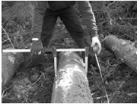
______________________________________________________________________________________________________________________________________________________________________________________
Cut same trees species, by placing log in order 'side by side’. Choose perfect trees ex:straight and no forked .

Slide 2
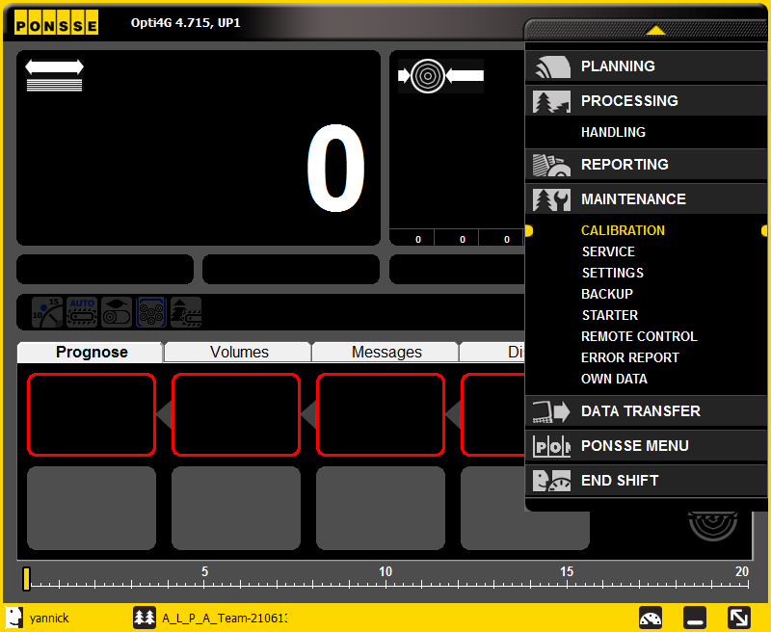
______________________________________________________________________________________________________________________________________________________________________________________
Click on tool bar.
Click on MAINTENANCE and than click on calibration.

Slide 3
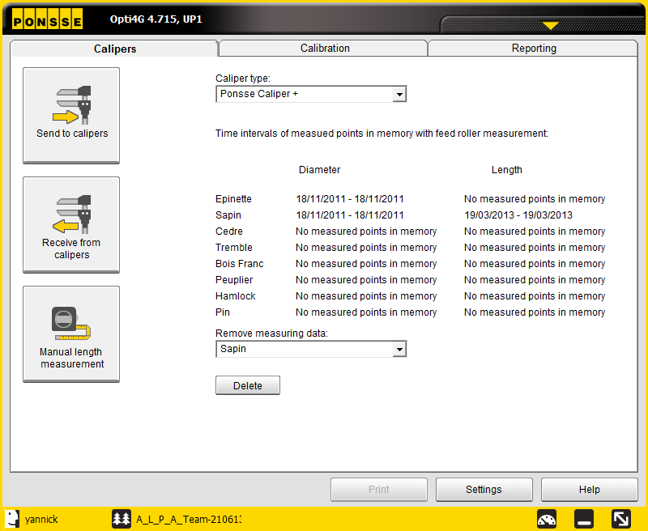
______________________________________________________________________________________________________________________________________________________________________________________
Click on send to calipers.

Slide 4
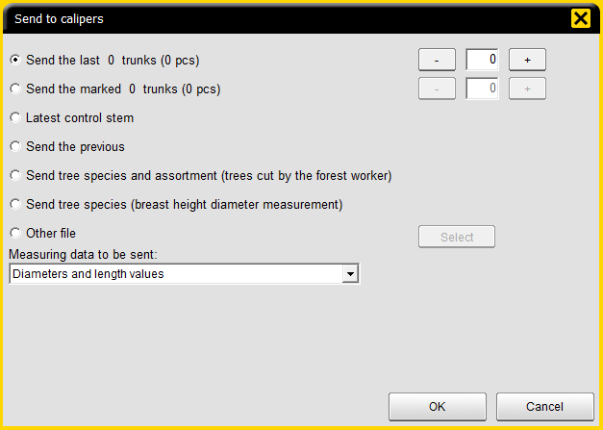
______________________________________________________________________________________________________________________________________________________________________________________
Number of trunks(trees) cut for calibration.
Click on ok
Wait until caliper receive data from OPTI you will hear a beep beep. Then remove caliper from docking station and start measuring from the last log cut.Measure from butt end to top of each piece from last to first cut.
After calibration is done shutdown caliper and install caliper in docking station.

Slide 5
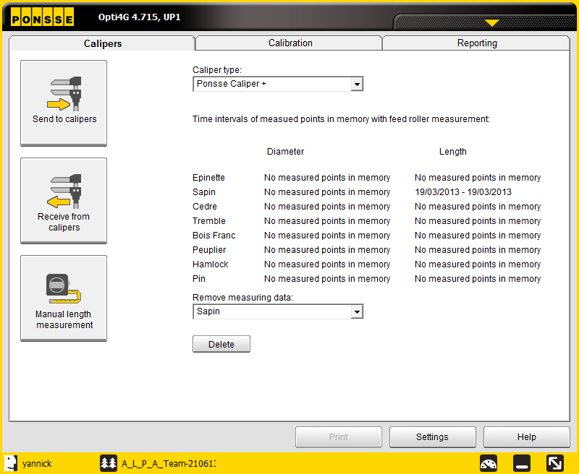
After installing caliper in docking station click on receive from caliper

Slide 6
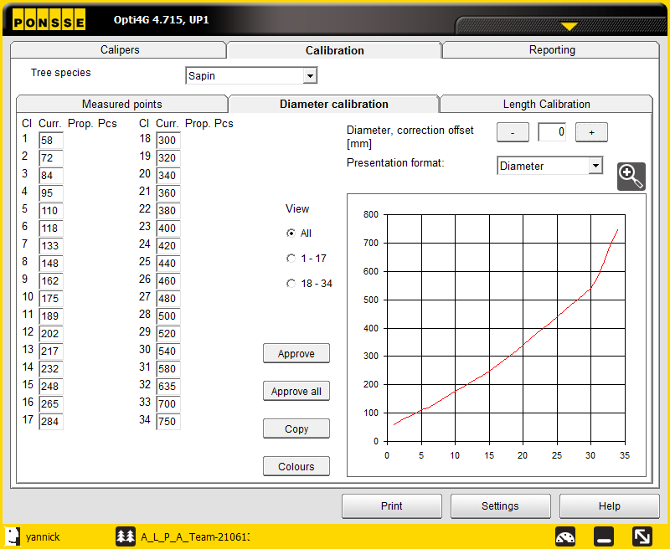
______________________________________________________________________________________________________________________________________________________________________________________
Click on diameter calibration
Click approve for each or approve for all measure point

Slide 7
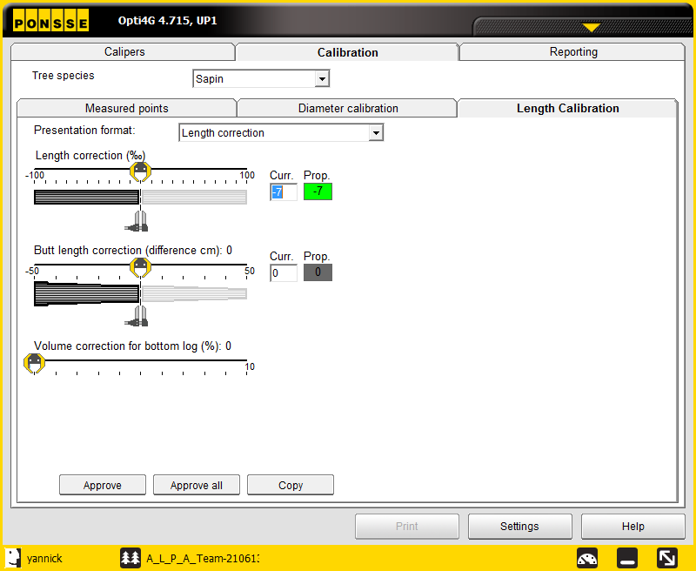
______________________________________________________________________________________________________________________________________________________________________________________
Click on length calibration
Click on approve

Slide 8
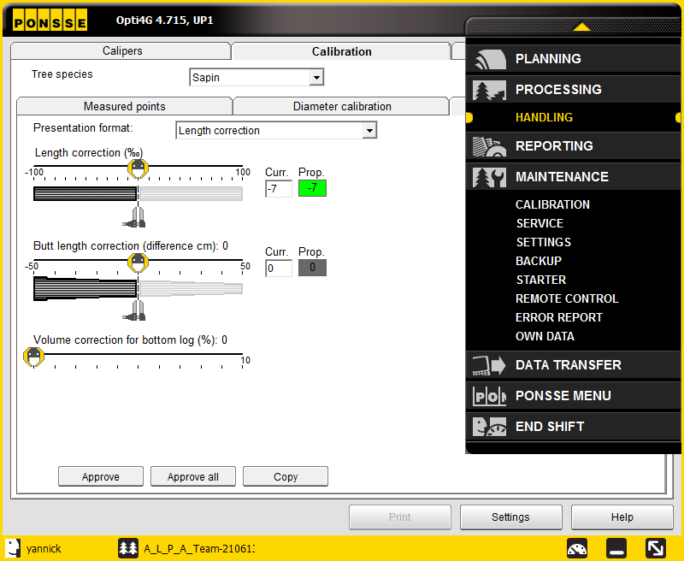
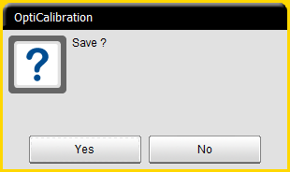
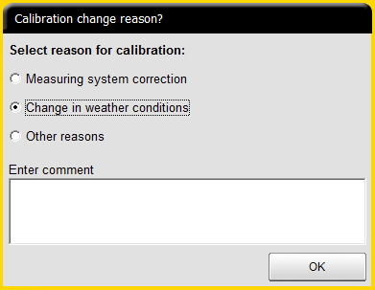
______________________________________________________________________________________________________________________________________________________________________________________
Click on handling
Click yes
Enter comment (date of calibration)

