Slide 1
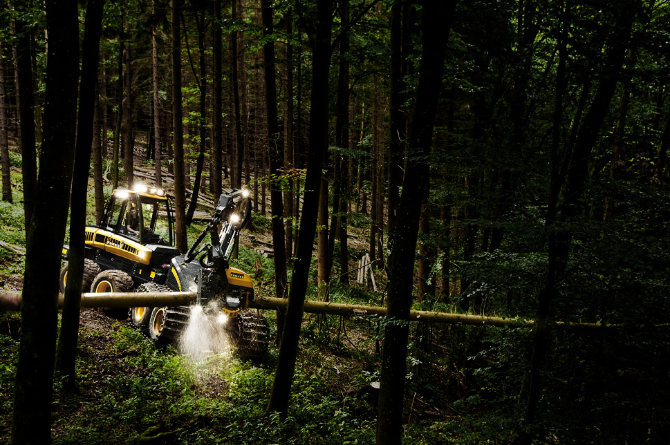
H-series harvester heads Adusting considerations
PONSSE

Slide 2
Adjusting considerations
Ponsse H-series harvester heads - Functions

Slide 3
Considerations on adjusting
Always remember safety when adjusting machines!
Factory settings are settings which will work in almost all conditions → they may not be optimized for all specific situations, but they work relatively well on most cases
If the machine is working well, adjusting is not needed! Adjusting should never be done just for the joy of adjusting, but because of a real reason.
Adjusting will take time → prepare to spend enough time at the machine when adjusting. Also let the customer know beforehand, that time is needed for adjusting.
Never go to a machine, make changes, and leave the machine without seeing that it works after the adjustments!
Big changes to e.g. compression curve settings, length drive settings or any other setting directly effecting the function of the head during harvesting should not be done in the workshop, but in the forest, where the effect and function can be seen.
Unless you are absolutely sure of what you are doing, adjust only one thing at a time and in small enough steps → easier to know what adjusted wrong functions and reach the correct settings
Always remember or write down what you have adjusted and where you started from → If something goes totally wrong, it is easier to go back.

Slide 4
Considerations on adjusting
If you find a good set of settings for your local conditions, you can start with them when adjusting → always be prepared to change and adjust a bit from them, and test the settings if changed from the factory settings. Remember that different base machine, crane and head combinatios require different settings
Do not set the settings too much “on the edge” between working and not working, especially if setting is done in good conditions. When setting a machine, the settings must always be a bit on the safe side in case the operator changes or harvesting conditions get worse.
Know your customers and operators. Some operators are more capable of doing adjustments themselves than others. The good operators can be taught to set the machine themselves much more than the bad operators.
Also make sure the mechanical condition of the harvester head is ok, and the delimbing knives and feed rollers are in proper condition when adjusting a machine, especially if there are feed or delimbing problems.
The length, diameter and saw blade calibrations of the harvester head must be done properly in order for the automatic functions and pressure adjustments to work correctly. Do not try to fix poor calibration with adjustments!
If you don’t know how to adjust someting, or don’t know if something can be adjusted, ask! Do not guess!

Slide 5
Saw
Ponsse H-series harvester heads - Functions

Slide 6
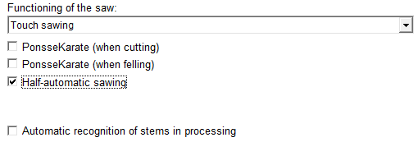
Saw automation
Settings → Driver specific → Automation
Function of the saw:
No automation: saw runs only when the button is pressed
Touch sawing: when the button is pressed, the saw will automatically saw through the trunk (to the saw bar position calculated from the saw control). If the saw is used manually for a second time without moving the trunk, the function is manual. Automation is only on for cutting, never for felling.
Automatic cutting of pulp: on sawlogs same as touch sawing, but fully automatic sawing of pulpwood sortiments.
PonsseKarate
If activated, the system will automatically try to saw the trunk again if the sawing did not go through on the first sawing (No automation: button has to be kept pressed, touch sawing: second and third sawing done automatically). This option is separate for cutting and felling.
Half-automatic sawing
During optimization the saw button can be pressed within one meter of the sawing window before the head stops, and when the head stops in the sawing window, sawing will commence automatically.

Slide 7
Saw automation
Settings → Harvester head → Saw
FELLING saw bar moves first
By using this setting, unnecessary rotation of the saw chain is minimized. Saw chain rotation is started at a set angle before the tree surface. The goal of setting the advance is to have the saw motor running at almost full speed when the chain hits the tree. If the motor runs at full speed before the chain touches the surface, it will overspeed which will cause a pressure drop and significant loss of sawing power.
Saw motor acceleration ramp 0 ms → saw chain rolling advance 10 -15˚
Saw motor acceleration ramp 100 - 200 ms → saw chain rolling advance 15 - 20˚
FELLING chain moves first
On sites with a lot of undergrowth, this option is recommended, because hitting the undergrowth with stopped chain may cause the starting saw chain to stall. Chain starts to rotate before the blade is pushed out → it will go through the undergrowth better, without losing the chain
CUTTING saw bar moves first
With cutting, this setting should be used in almost all cases. The function is the same as with felling, but generally the advance can be a little bit smaller than in felling
Saw motor acceleration ramp 0 ms → saw chain rolling advance 8 -15˚
Saw motor ascending ramp 100 - 200 ms → saw chain rolling advance 13 - 20˚

Slide 8
Saw automation
Settings → Driver specific → Automation
Feeding backwards after cut [cm]
The harvester head reverses automatically after cut sawing. Can be used when cutting very curvy trees. Using this function may hurt the measuring accuracy, so don’t use it unless absolutely needed.
Blade out delay (Stump spraying) [ms]
This function is used when stump spraying is used, so that the stump treatment system has enough time to pump the liquid to the sawbar.

Slide 9
Saw automation
Settings → Driver specific → Automation
Sawbar return advance [˚]
How many degrees before the saw reaches the saw control, the blade out pressure is turned off.
With high blade out pressure settings, the value must be higher.
If the blade out pressure is too high, just increasing this value too much won’t help. The saw bar out pressure has to be lowered
Adjust oversawing, if needed on curvy trees.
CT -tensioner
With settings 0 – 1 controlling oversawing may be difficult
With settings 2 – 3 the best function
If the sawbar out power is more than 50%, and sawbar return advance value ​is 5 or more, double sawings may be caused
CT + -tensioner
With settings 0 – 1 controlling oversawing may be difficult
With settings 2 – 5 the best function
If the sawbar out power is more than 50%, and sawbar return advance values ​​is 5 or more, double sawings may be caused

Slide 10
Saw chain rolling advance
Service → Settings → Measuring device outputs, harvester head → Saw motor → Adjustments
By using slight acceleration and deceleration ramps, it is possible to save fuel and extending the hydraulic system component lifetime
Ascending (acceleration) ramp
0 ms ramp, saw motor spool is opened with no ramp → full pressure right away
50 – 150 ms ramp, the spool is opened with a slight ramp → a bit bigger saw chain rolling advance is needed because the chain starts to rotate a bit slower
200 ms ramp may cause the pressure to increase so slow, that the chain will hit the tree before rotation → may not have enough power to start to rotate
Receding (deceleration) ramp
0 ms ramp, saw motor spool is closed instantly
100 – 200 ms, spool is closed with a slight ramp, pressure goes down more gently
200 ms, with long ramp it is possible to rotate the saw chain a bit while pulling the sawbar in → good in thick undergrowth and brush

Slide 11
Braking control level
Service → Settings → Measuring device outputs, harvester head → Saw bar cylinder pressure → Adjustments
When the saw bar is pulled back to the home position, there are 3 phases:
First, the blade is pulled in from the control with Maximum control level.
When the blade reaches the Braking start angle, it will be pulled in with the Braking control level. This is done to slow down the pulling of the blade to reduce the stress to the components.
When the blade reaches the Braking end angle, it will again be pulled in with the Maximum control level to ensure that the blade reaches the home position
During the wintertime, the Braking control level may have to be increased to 125 mA to ensure return of the blade even though there is snow in the saw housing
With CT+ -tensioner the Braking control level may have to be increased to 100 – 125 mA to ensure the correct returning of the blade.

Slide 12
Saw – Felling settings
Ponsse H-series harvester heads - Functions

Slide 13
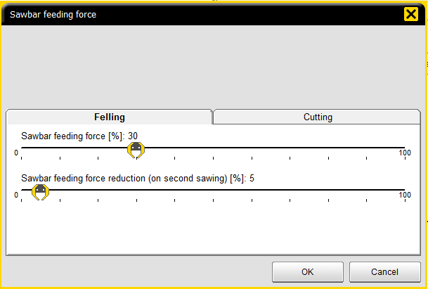
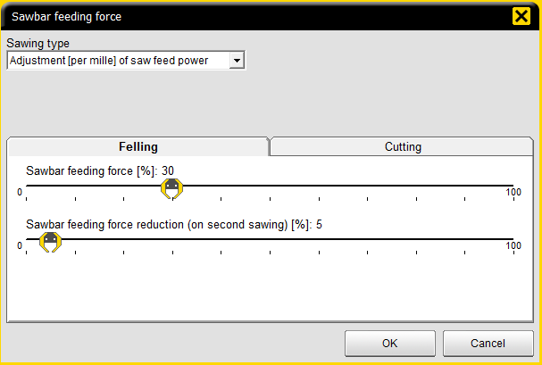
Sawbar feeding force CT Adjustment (per mille) of saw feed power - Cutting
Settings → Harvester head → Saw → Felling
Sawbar feeding force[%]
USING SHARP SAW CHAINS IS THE KEY TO EFFECTIVE SAWING! Using dull or poorly sharpened chains can not be compensated with any settings, and will also stress and shorten the lifetime of the saw components.
The value working the best is usually withing the range of 25 – 40%. When looking at the sawed surface on the end of a log, the sawing force when the surface is quite even and there should not be any ripping marks on the logs.
Examples
25 % with not sharp chains and bigger trees
40 % with sharp chains and/or smaller trees
Sawbar feeding force reduction (on second sawing) [%]
How much the sawbar feeding force is recuded on the second sawing, if first sawing does not reach saw control
The setting value working the best is usually within the range of 5 – 20%
Use more reduction with a bigger initial feeding force setting, less reduction with smaller initial setting
User level driver
User level service

Slide 14
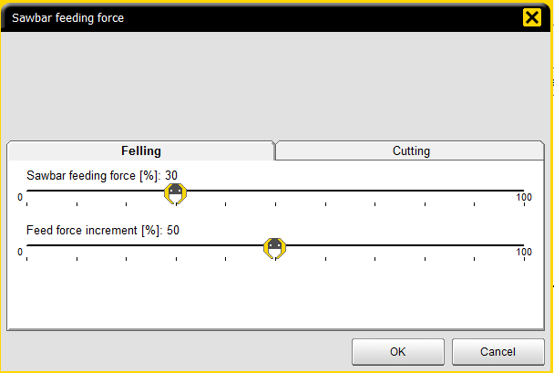
Sawbar feeding force CT+ Sawbar feed speed optimization - Felling
Settings → Harvester head → Saw → Felling
Sawbar feeding force
The value working the best is within the range of 20 – 40%, adjust and check the same way as with CT
Feed force increment
The control system tries to increase the feed force during sawing to achieve the maximum sawing speed
E.g. when the initial feeding force is 30% and the increment is set to 50%, the system tries increase the saw bar feed force from 30 to 45%. The system monitors the speed of saw bar advancing speed, and stops increasing when the speed does not increase anymore
Settings
When a machine is new and the bearings are stiff, the settings are a bit different from a tensioner used for a while. The following settings are quite good starting points:
Sawbar feeding force 30%
Feed force increment 50 – 100%
User level driver
User level service

Slide 15
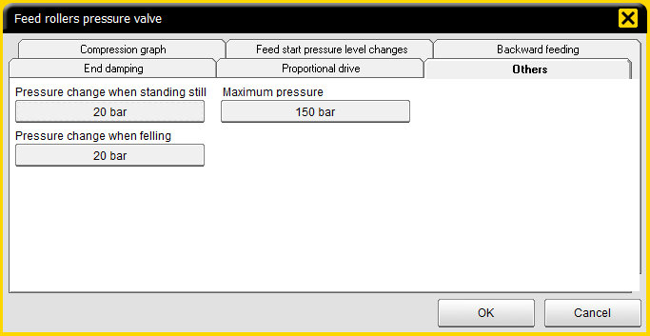
Pressure changes on felling
Feed roller and knives pressure change when felling
The goal is a good grip on the tree without causing extensive stress on the harvester head
Factory setting: pressure change when felling 20 bar → 20 bar is added on the diameter-based pressure from the compression curve, when felling.
E.g 200 mm tree, set pressure on the curve 100 bar → Felling compression pressure 120 bar.
The pressure will not be higher than the determined maximum pressure
Under test: With low knife pressures 30-40 bar pressure increase on felling
Recommended: 20 bar works well on front knives and rollers, back knife pressure change can be increased to 30-40 bar when using low back knife pressure

Slide 16
Grabbing the tree
Closing delays: Settings → Driver specific → Delays
When grabbing, the blades should pull the tree to the bottom of the head before rollers are pressed against the tree.
With small trunks 250 ms is usually enough, but with bigger thees up to 400 ms is sometimes needed
Setting in Ponsse driver, Closing delay, tilt up: rollers 250 ms, front knives 0 ms, rear knives 0 ms
Recommended settings: rollers 250 – 400 ms, front and rear knives 0 ms
When picking up trunks from the ground (processing, windfall etc.) it is easy to damage the feed rollers by picking up stones or dirt → increase the roller closing delay when tilt horizontal to e.g. 500 ms, the tree can be picked up with just the knives and rollers are closed when the head is already off the ground.

Slide 17
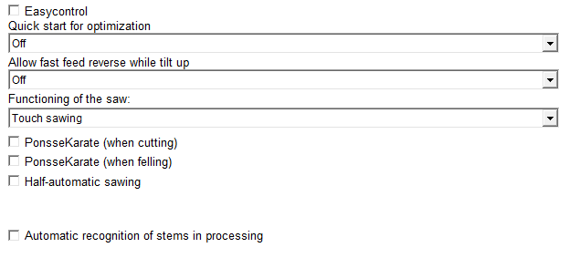
Felling automatics
Settings → Driver specific → Automation
Tilt automatics under different situations
Automation 3: Like 2 + under diameter limit goes down at end of sawing
When diameter is over the set limit, pressing tilt down begins immediately when felling sawing is started
When diameter is under the set limit, pressing begins when the saw is at the end of felling sawing
Automation 4: Like 3 + under diameter limit like 1
When diameter is over the set limit, pressing tilt down begins immediately when felling sawing is started
When diameter is under the set limit, tilt has to be released down by pressing the tilt button on the handle
Ponsse user setting: 3

Slide 18
Saw – Cutting settings
Ponsse H-series harvester heads - Functions

Slide 19
Saw automation
Settings → Driver specific → Automation
Function of the saw:
No automation: saw runs only when the button is pressed
Touch sawing: when the button is pressed, the saw will automatically saw through the trunk (to the saw bar position calculated from the saw control). If the saw is used manually for a second time without moving the trunk, the function is manual. Automation is only on for cutting, never for felling.
Automatic cutting of pulp: on sawlogs same as touch sawing, but fully automatic sawing of pulpwood sortiments.
PonsseKarate
If activated, the system will automatically try to saw the trunk again if the sawing did not go through on the first sawing (No automation: button has to be kept pressed, touch sawing: second and third sawing done automatically). This option is separate for cutting and felling.
Half-automatic sawing
During optimization the saw button can be pressed within one meter of the sawing window before the head stops, and when the head stops in the sawing window, sawing will commence automatically.

Slide 20
Saw automation
Settings → Driver specific → Automation
Sawbar return advance [˚]
How many degrees before the saw reaches the saw control, the blade out pressure is turned off.
With high blade out pressure settings, the value must be higher.
If the blade out pressure is too high, just increasing this value too much won’t help. The saw bar out pressure has to be lowered
Adjust oversawing, if needed on curvy trees.
CT -tensioner
With settings 0 – 1 controlling oversawing may be difficult
With settings 2 – 3 the best function
If the sawbar out power is more than 50%, and sawbar return advance value ​is 5 or more, double sawings may be caused
CT + -tensioner
With settings 0 – 1 controlling oversawing may be difficult
With settings 2 – 5 the best function
If the sawbar out power is more than 50%, and sawbar return advance values ​​is 5 or more, double sawings may be caused

Slide 21
Saw automation
Settings → Driver specific → Automation
Feeding backwards after cut [cm]
The harvester head reverses automatically after cut sawing. Can be used when cutting very curvy trees. Using this function may hurt the measuring accuracy, so don’t use it unless absolutely needed.

Slide 22
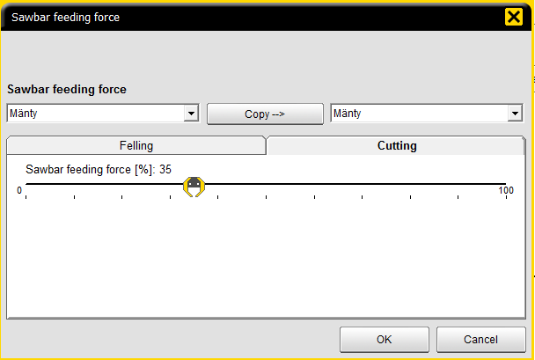
Sawbar feeding force CT Adjustment (per mille) of saw feed power - Cutting
Settings → Harvester head → Saw → Cutting
USING SHARP SAW CHAINS IS THE KEY TO EFFECTIVE SAWING! Using dull or poorly sharpened chains can not be compensated with any settings, and will also stress and shorten the lifetime of the saw components.
Sawbar feeding force
The setting that user can adjust
The value working the best is usually withing the range of 25 – 40%. The method of inspecting the ends of the logs is the same as in felling.
Sawbar feeding force when sawing starts (only at Service user level)
The force that is used when sawing starts
The value working the best is within the range of 25 – 25%.
If too much force is used at the beginning of sawing, the chain may to try to fall off the blade diagonally and break
If too small force is used, the cutting feels too slow
Sawbar feeding force transition point 30 - 60%
The point when the sawing force transitions from the start level to normal sawing force level.
The value working the best is withing in the range 30 – 40 %
The percentage means the percentage of the saw control calculated from the measured diameter → e.g. 30% means that the transition point is when 60 mm is sawed on a 200 mm diameter trunk
User level driver
User level service

Slide 23
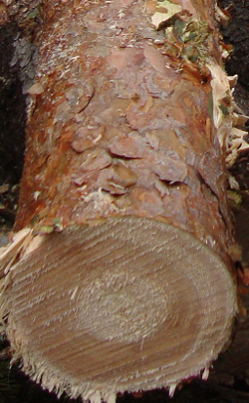
Sawbar feeding force CT Adjustment (per mille) of saw feed power - Cutting
Sawbar feeding force when sawing starts (only at Service user level)
This value is used when sawing is started, until the transition point
Sawbar feeding force transition point
Sawbar transition point is calculated from the measured diameter → diameter calibration must be correct in order for this function to work right!
Sawbar feeding force
When the saw bar reaches the transition point, the saw bar pressure is changed to the sawbar feeding force level so that the set maximum force is used ad saw control.
Transition point

Slide 24
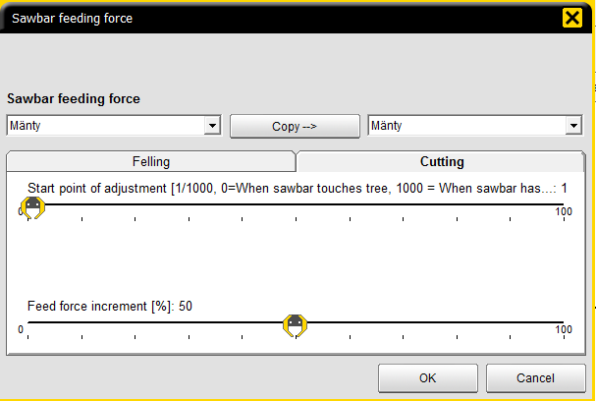
Sawbar feeding force CT+ Sawbar feed speed optimization - cutting
Settings → Harvester head → Saw → Cutting
Start point of adjustment
The setting defines the optimization starting point, so the point when the automatic increasing of the feeding force begins.
Sawbar feeding force when sawing starts (on a service level)
The same basic way of adjusting as with CT. Usually the values working the best are within the range of 25 – 45%.
Feed force increment
Same system as in felling, maximum increment is calculated from the starting feeding force
Settings
Start point of adjustment 1%
Sawbar feeding force when sawing starts 35%
Feed force increment 50 – 100%
Too high sawbar feeding setting in cutting may cause problems in controlling the oversawing, but not speed up the sawing anymore.
User level driver
User level service

Slide 25
Tilt
Ponsse H-series harvester heads - Functions

Slide 26
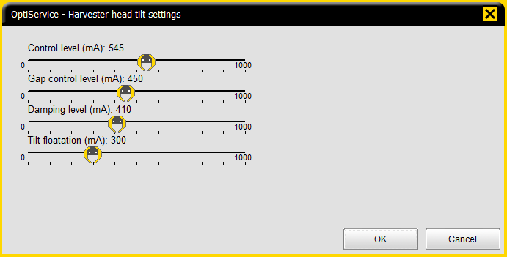
Harvester head up
Settings
The idea of tilt up settings is to make the lift smooth (no swinging, no jerks)
Factory settings → control level 545 mA
Damping level must be high enough for the tilt to come up and stay up → not so, that it comes up, goes back down a bit and then comes back up
Recommended values:
Control level: H5 460 mA, H6 450 ma, H7 480 mA
Damping level: H5 415 mA, H6 410 mA, H7 440 mA
Gap control level H5 and H6 410 mA, H7 450 mA

Slide 27
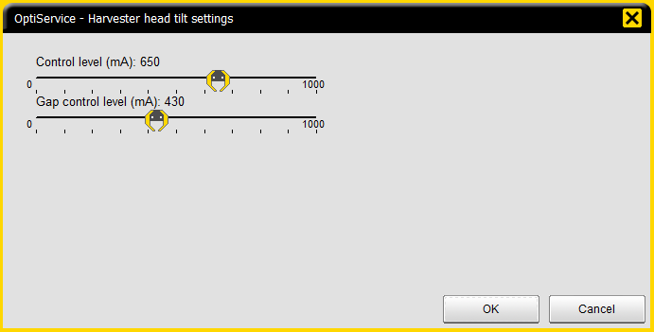
Harvester head down
Settings
The goal is as fast as possible, yet controlled felling
Factory settings → contol level 650 mA, gap control level 430 mA
If settings control level set too high: Especially in thinning sites the trunks may brake, when they are fell against each other too fast
Recommended values: H5 and H6 440-460 mA, H7 600 mA

Slide 28
Tilt automatics
Tilt flotation
Settings → Harvester head → Tilt → Function over and under diameter limit
Tilt flotation automatics in different situations
Factory setting: diameter limit 100 mm, floating over the limit and pressing under the limit
If floating used also over the limit, the feeding start is easier and more effective, when oil is not used for pressing the head. Also the head may follow the tree better.
Locking of tilt available under the diameter limit, can be used to make the treetop harvesting easier

Slide 29
Feeding and length drive
Ponsse H-series harvester heads - Functions

Slide 30
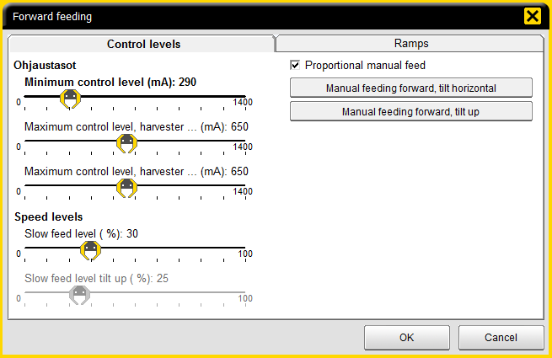
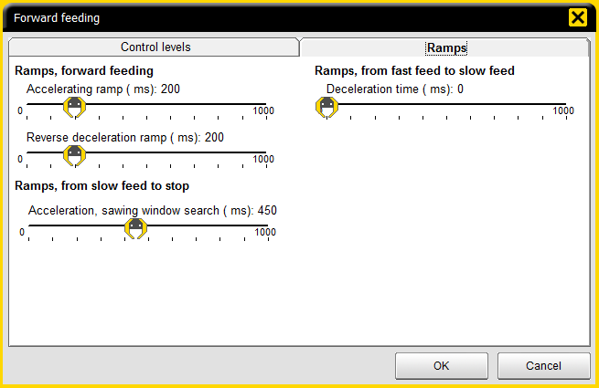
Feeding
Settings
Minimum- and maximum control level
Minimum current set by moving Minimum control level (mA) slide until feed rollers barely move
Maximum current 600 - 650 mA set to ensure spool is fully open during fast feeding, to ensure maximum oil flow
Slow feed level (%)
Slow forward/backward feeding speed.
effects the length measuring accuracy
Percentage calculated out of Minimum control level (mA).
30% out of 290 mA = 87 mA
The calculated current added on Minimum control level (mA) → slow feed current
87 mA + 290 mA = 377 mA
Slow feed current = 377 mA
Ramps – action when feeding starts/stops and in reversal.
Accelerating ramp (ms) – how fast the control power increases from min current to max current, when fast feeding is started
Reverse deceleration ramp (ms) – how fast the control power will decrease from maximum to minimum current when feeding is stopped from fast feed or feeding direction is changed.
Ramps, from fast feed to slow feed – how fast the control current is decreased from maximum to minimum current.
Acceleration, sawing window search (ms) - a specific slow acceleration ramp used in the sawing window search phase.

Slide 31
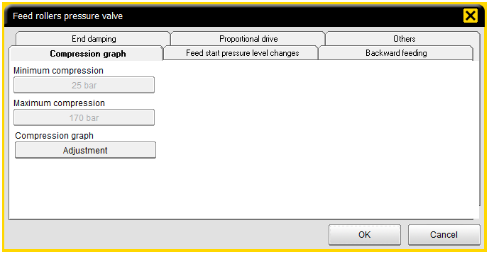
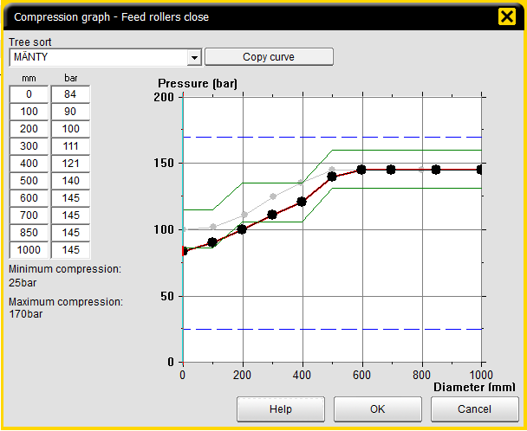
Feeding
The feed roller compression setting will effect the feeding characteristics
Have the knive pressures adjusted to correct values before adjusting the roller pressures → increasing the knife pressures may require increasing the roller pressures, if they are at the lower limit
When adjusting the feed roller compression, find the point when the rollers start to slip and then adjust the pressure 10 - 15 bar higher. With that setting there should be enough traction in all situations
When using roller measurement, remember to always perform diameter calibration after adjusting the pressures!

Slide 32
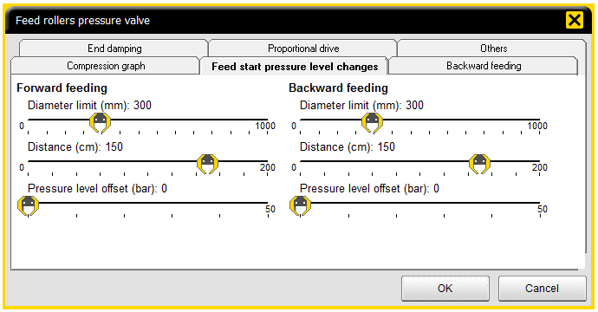
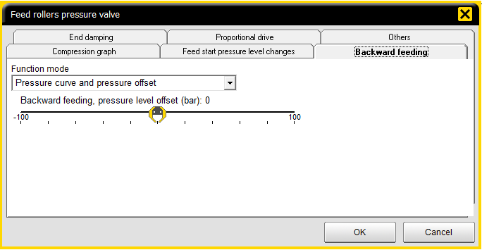
Feeding
With feed rollers, it is generally not needed to use pressure level changes when starting.
A small increase of pressure level when starting can be used in case of traction problems → if using minimum value measuring, use a short distance and the option to not use minimum value measuring during start of feeding.
Set the backward feeding function mode to ”Pressure curve and pressure offset”. If needed, the pressure can be offset from the curve with the slider bar.

Slide 33
Feeding
Pressure changes when standing still and felling can be used to add pressure to the pressure curve, when the head is stationary or in felling position
This ensures a firm grip on the trunk when felling the tree or pulling it with the crane.

Slide 34
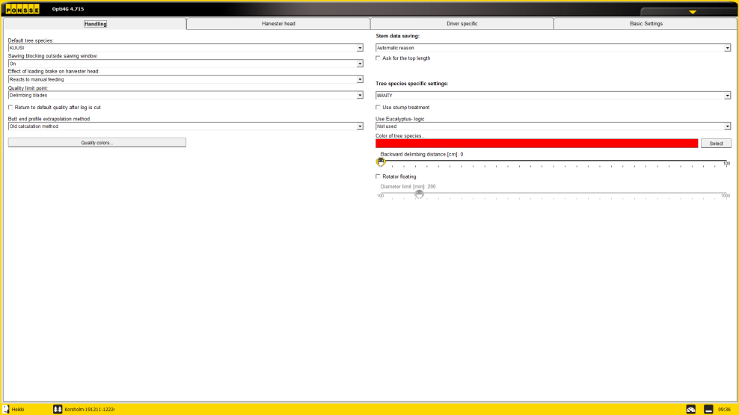
Feeding
Rotator floating
The purpose is to lower the stress on the rotator and prevent carving with the delimbing knives
If activated, the function is on:
When felling (harvester head up + saw) or ”Acknowledgement, harvester head in felling position” –button has been pressed.
When the set diameter limit is exceeded.
When function has been selected on (treesort specific)
When feeding backwards, and the set diameter limit is exceeded
Deactivated, when feeding forward, if:
The diameter of the stem is goes below the diameter limit
The rotator function is used by operator → If flotation is used, be sure that rotator lever deadband is large enough to prevent accidental overriding of the flotation.
Notes:
Rungon läpimitta alittaa ko. puulajille määritellyn minimiläpimitan, eikä aktivoidu vaikka rungon läpimitta muuttuisi suuremmaksi kuin ko. puulajille asetettu kellunnan paksuusraja.

Slide 35
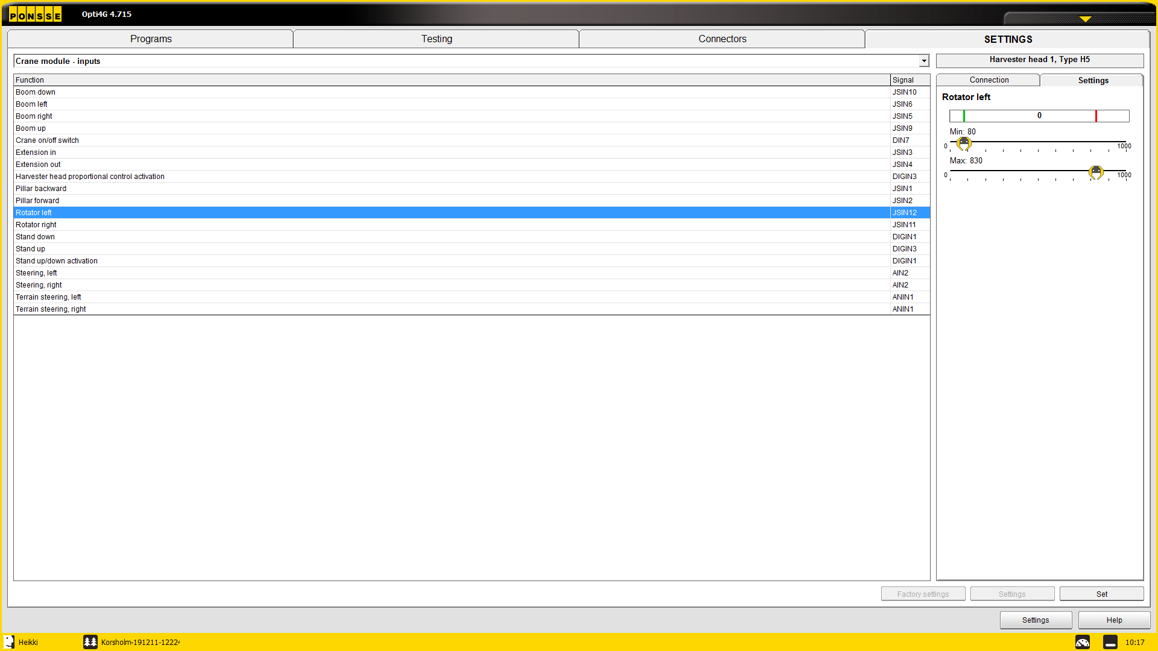
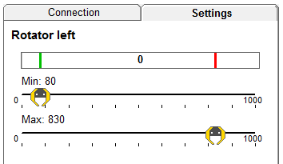
Feeding
Rotator floating
The deadband can be adjusted by adjusting the minimum value for rotator left and right input at service (Maintenance → Service → Settings → Crane module - inputs→ Rotator left/right

Slide 36
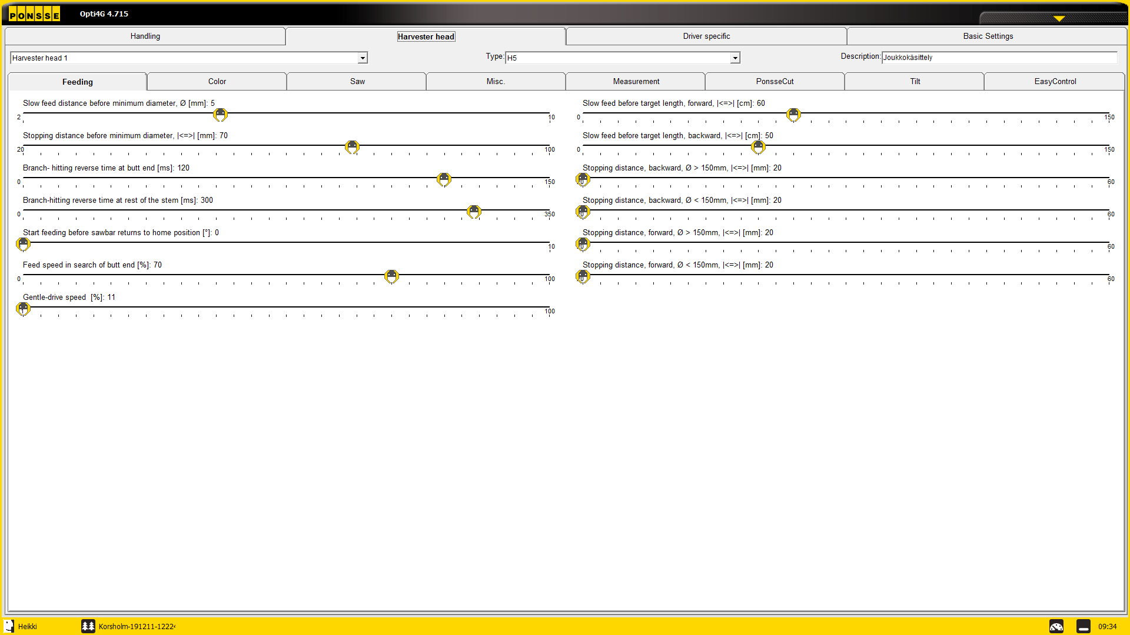
Feeding – length drive
Settings
Settings → Harvested head → Feeding

Slide 37
Feeding – length drive
mA
650
300
0
Aika ms
Fast feed
Slow feed
Ramps
Stopping advance
Sawing window

Slide 38
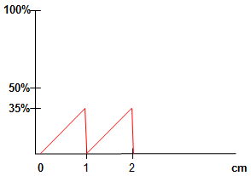
Feeding – length drive
Sawing window search
In this example, the stopping advance is too big and the head stops before sawing window
In this case, the system uses search pulses to find the sawing window
Search pulse
Sawing window
Head stops
Stopping advance
mm
450
300
150
0
150
300
450

Slide 39
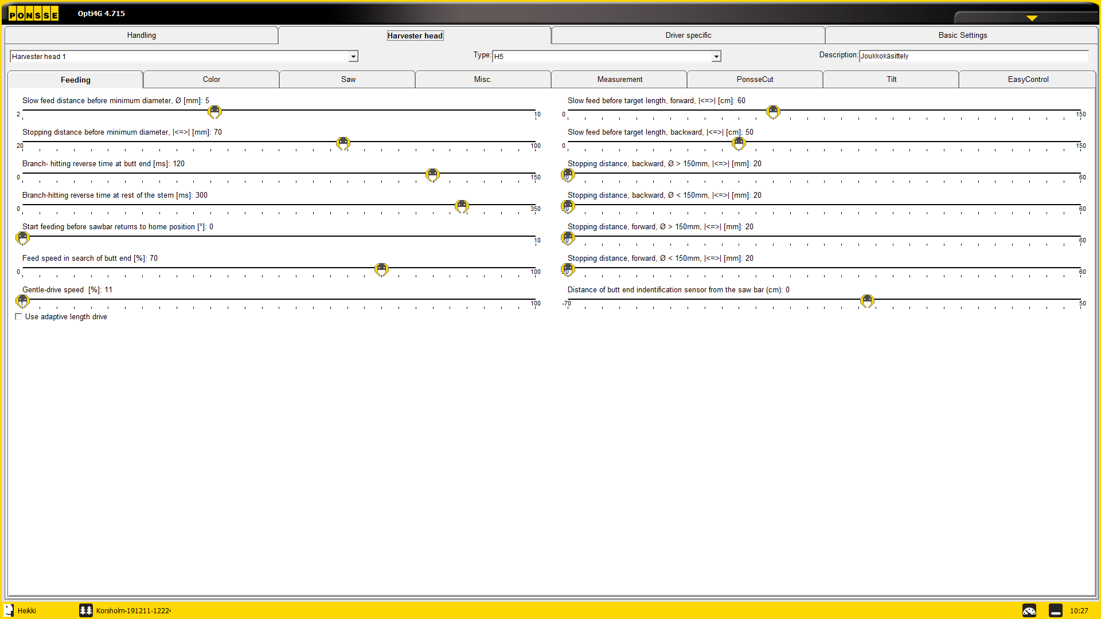
Feeding – adaptive length drive
Enabling adaptive length drive
Maintenance → Settings → Harvester head → Feeding
Adaptive length drive (ALD) can only be enabled on service level

Slide 40
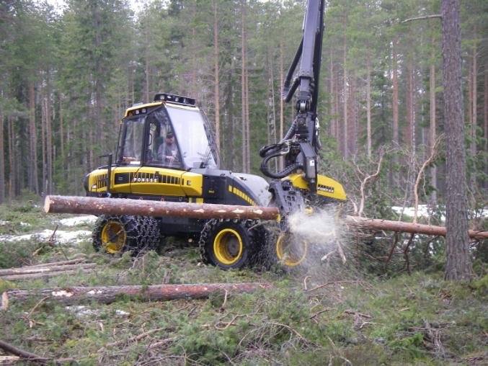
Adaptive length drive
Principles
Fixed minimum- and maximum currents (290/630 mA)
Always targeting at middle of the sawing window
Adaptive stopping advance
Specific to each tree specie
Specific to feeding direction
Specific to diameter → in diameter classes
Learning on each automatic stop
If the head does not stop to the middle of the sawing window, the settings are adjusted for the next stop on the same diameter class
Also the next diameter classes up and down are adjusted
Learns only from automatic stops, if the operator e.g. stops feeding manually, the system ignores the stop.
Start of a work area
During the start of a work area, larger corrections are allowed → faster learning
When harvesting one tree specie, the learning takes 10 to 15 minutes

Slide 41
Adaptive length drive Control current to feeding
ALD automatically adjusts all phases of length drive
1. Braking phase 2. Approach phase 3. Stopping
mA
630
290
0
Aika ms
Fast feed
Ramps
Sawing window

Slide 42
Adaptive length drive
Settings, harvester head
Settings active with ALD
Slow feed distance before minimum diameter mm
Stopping distance before minimum diameter
latva-ajon pysäytysennakko > pysäytysennakko ennen minimiläpimittaa > mm/pituus
Accelerating ramp
Reverse deceleration ramp
THE OTHER SETTINGS DO NOT HAVE ANY EFFECT WHEN ALD IS IN USE!

Slide 43
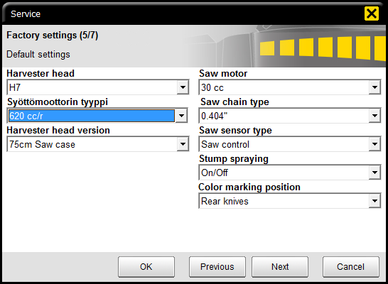
Adaptive length drive
Service - settings
Feed motor type
Has to be correct, effects ALD
(two functions over/under 520 cc/r
The functions, when regular settings are used
(min. current, max. current etc.)
Manual feed
Butt search
Automatic reverse after sawing
Branch hitting
Euca debarking
Minimum diameter drive
So even if ALD is used, the regular length drive settings should be relatively correct!

Slide 44
Adaptive length drive
Enabling
ALD is enabled from Settings → Harvester head → Feeding
Setting available only at service level

Slide 45
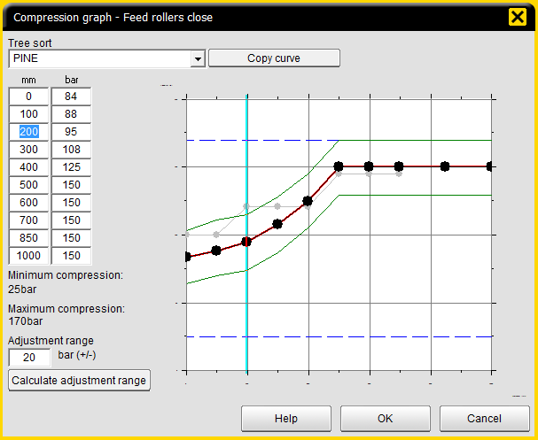
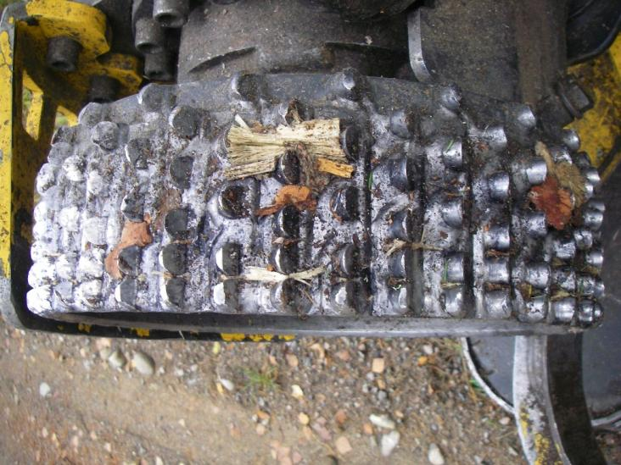
Adaptive length drive
Feed roller compression pressure and traction
Feed rollers must have sufficient traction, there must not be any slippage during different phases of the length drive → check roller tracks on the log ~1 m before cut and ~0,5 m after the cut
Slippage can be caused by wrong pressure settings or worn out feed rollers
If slippage occurs, the system won’t be able to calculate the corrections correctly
Recommended curve, ALD
H5 and H6, for H7 add 10 bar

Slide 46
Delimbing and knives
Ponsse H-series harvester heads - Functions

Slide 47
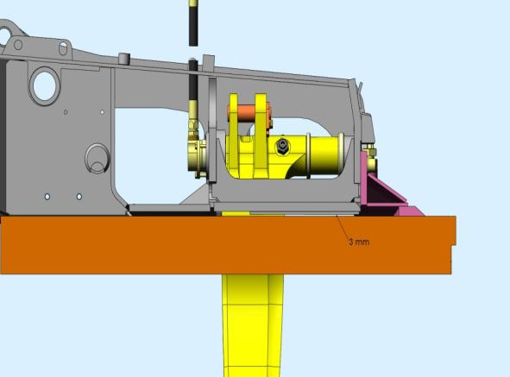
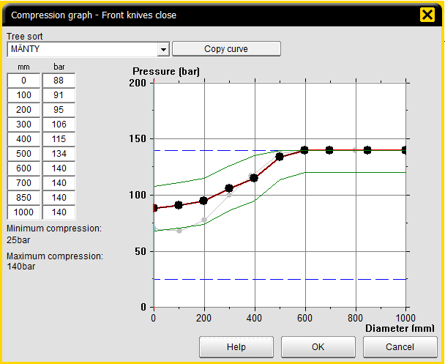
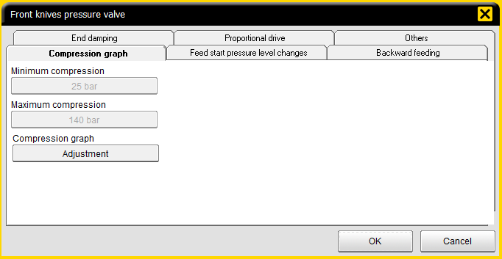
Delimbing
Front knife settings
Upper front delimbing knife
Manually adjustable
Important that the knife is properly adjusted and sharpened (see picture for correct adjustment)
”Cleans” the stem from bark and branches to ensure accurate length measuring
Prevents the head from ”diving” into the stem when delimbing/feeding.
Front delimbing knives
Adjustable compression in Opti 4G (min/max pressures)
Automatic compression control for front delimbing knives when working (diameter ←→ compression).
Proper front knives compression ensures
Firm grip of the tree in all situations
Good delimbing → good log quality, accurate measuring, especially when using front knives diameter measuring
Lower friction, when delimbing → lower fuel consumption, higher feeding speed
Durability of the harvester head and knives
Compression curve, front knives diameter measuring

Slide 48
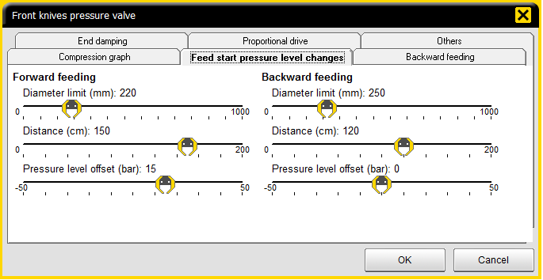
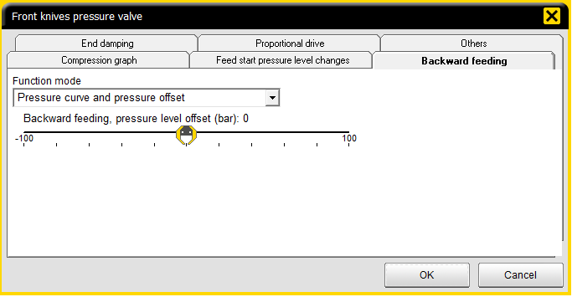
Delimbing
Front knife settings
Feed start pressure level changes
The set pressure level offset offset added to the pressure value from the compression curve, for the set distance above the diameter limit
Separate settings for forward and backward feeding
Diameter limit (mm) – pressure level change active over the set limit
Distance (cm) – pressure level change active for the set distance
Pressure level offset (bar) – sets the change of the knife pressure (negative/positive)
increased pressure,
+ Firm grip at feed start
High friction → harder to start feeding
Can effect measuring accuracy, if the value is too high
reduced pressure
+ Low friction
+ Easy and smooth start of feeding
Can effect measuring accuracy if the value is too low
Can cause problems of trunks falling off the head, especially if using branch hacker
Notes:
”keulimisen” estämiseksi etuterien painetta nostetaan 10 – 20 %
kitkan pienentämiseksi takaterien painetta lasketaan 10 – 20 %
jos halutaan mahdollisimman kevyt liikkeellelähtö niin käytettään kevennystä lyhyellä matkalla
Taaksesyöttö
takaterien painetta nostetaan 20 - 30 % ja etuterien painetta lasketaan 20 - 30 %

Slide 49
Delimbing
Front knife settings
Backward feeding – used to ensure proper grip during backward feeding
Use Pressure curve and pressure offset function
For smooth backward feeding, the compression on front knives can be reduced and the compression on back knives increased a bit
Adjust bakward feeding pressure to ensure a firm grip and good centering of the stem in the harvester head when reverse feeding
Notes:
”keulimisen” estämiseksi etuterien painetta nostetaan 10 – 20 %
kitkan pienentämiseksi takaterien painetta lasketaan 10 – 20 %
jos halutaan mahdollisimman kevyt liikkeellelähtö niin käytettään kevennystä lyhyellä matkalla
Taaksesyöttö
takaterien painetta nostetaan 20 - 30 % ja etuterien painetta lasketaan 20 - 30 %

Slide 50
Delimbing
Front knife settings
Others – adjustable additional pressure to ensure a firm grip when felling a tree or when moving stem with the crane (the set pressure is added on the compression curve).
Pressure change when standing still – ensures proper grip when moving stems (sorting assortments).
Pressure change when felling – ensures proper grip when felling.
Maximum pressure sets the maximum compression pressure for the front knives in any situation → maximum pressure is used, even if the pressure value from the pressure curve added by the pressure change setting values is higher than the maximum pressure.

Slide 51
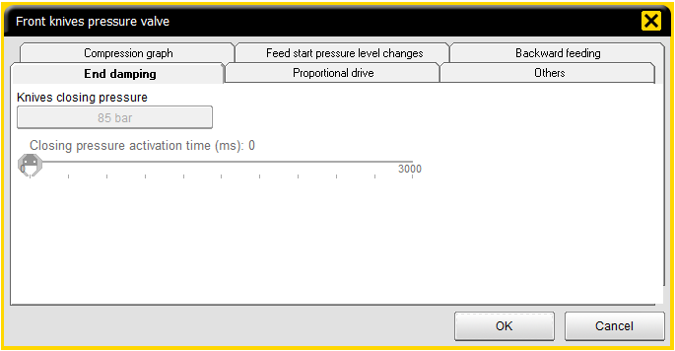
Delimbing
Front knife settings
End damping – the pressure for closing the knives is adjusted here.
Diameter sensor data is being used to identify closed position → when movement of the knives stops, the head is closed.
When knives are detected to be closed against the trunk or empty head, the pressure level set by the compression curve is activated.
Knives closing pressure – pressure used when closing front knives
Closing pressure activation time – adjustable time for knives closing pressure function (heads with no front knive sensors)

Slide 52
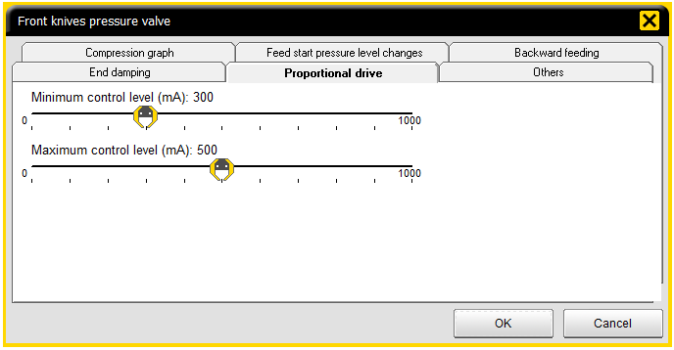
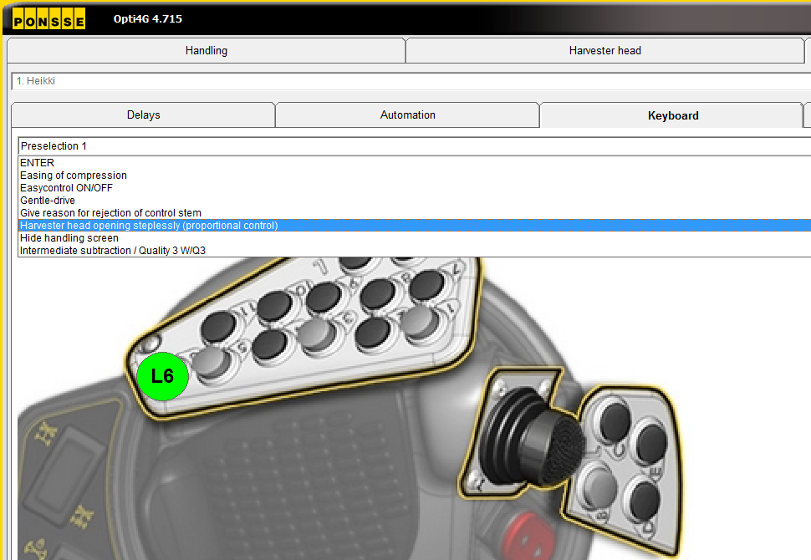
Delimbing
Front knife settings
Proportional drive – With the proportional drive, the harvester head (knives and rollers) can be opened to intermediate positions.
Function is activated with left crane tilt pedal (Pedals activate proportional control) and controlled by manual feed handle.
Harvester head can be opened steplessly also by using a programmed button on the keyboard matrix.

Slide 53
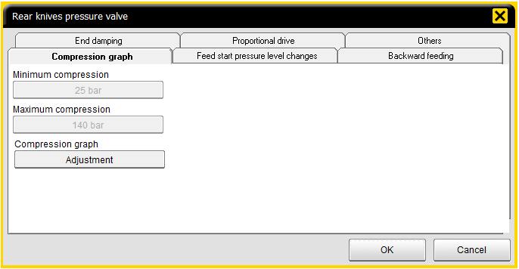
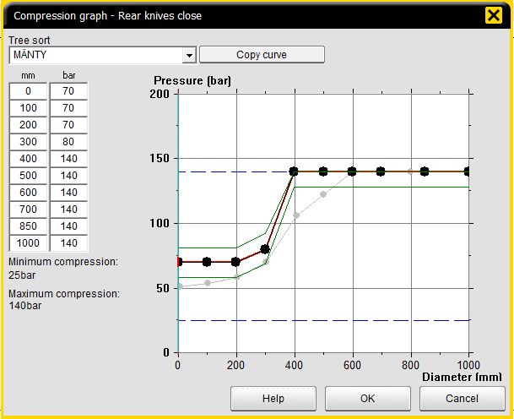
Delimbing
Rear knife settings
Rear delimbing knives
Adjustable compression in Opti 4G (min/max pressures)
Automatic compression control for rear delimbing knives when working, similar to front knives.
Proper rear knives compression ensures
Firm grip of the tree in any situation
Good delimbing → good timber quality.
Lower friction, when delimbing, especially when feeding backward -→ lower fuel consumption,
Durability and lifetime of the harvester head
Notes:
Puristuskäyrä - säätö siten, että takaterillä alhainen mutta riittävä paine, jotta painavat runkoa yläsyöttörullaa vasten.

Slide 54
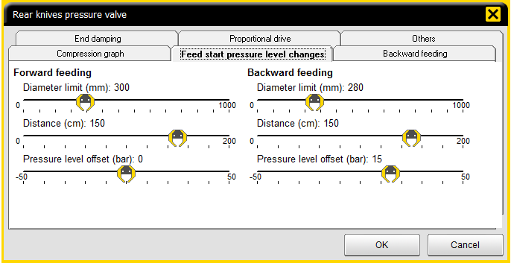
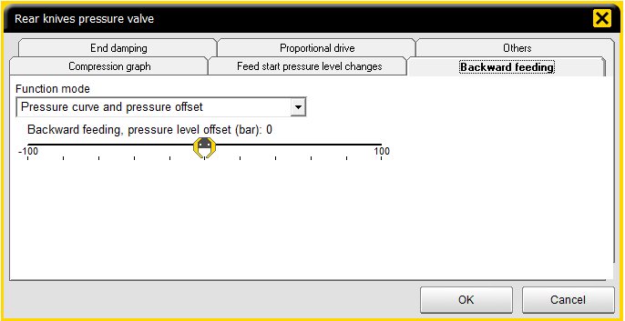
Delimbing
Rear knife settings
Feed start pressure level changes
The set pressure level offset offset added to the pressure value from the compression curve, for the set distance above the diameter limit
Separate settings for forward and backward feeding
Diameter limit (mm) – pressure level change active over the set limit
Distance (cm) – pressure level change active for the set distance
Pressure level offset (bar) – sets the change of the knife pressure (negative/positive)
increased pressure,
+ Firm grip at feed start
High friction → harder to start feeding
Can effect measuring accuracy, if the value is too high
reduced pressure
+ Low friction
+ Easy and smooth start of feeding
Can effect measuring accuracy if the value is too low
Can cause problems of trunk falling off the head especially if using the branch hacker
Notes:
Taaksesyöttö – optimoidaan rungon pysyminen kourassa ja mahdollisimman pieni kitka (toimintatapa Puristuskäyrä ja paineen muutos).

Slide 55
Delimbing
Rear knife settings
Backward feeding – used to ensure proper grip during backward feeding
Use Pressure curve and pressure offset function
For smooth backward feeding, the compression on front knives can be reduced and the compression on back knives increased a bit
Adjust bakward feeding pressure to ensure a firm grip and good centering of the stem in the harvester head when reverse feeding
Notes:
Taaksesyöttö – optimoidaan rungon pysyminen kourassa ja mahdollisimman pieni kitka (toimintatapa Puristuskäyrä ja paineen muutos).

Slide 56
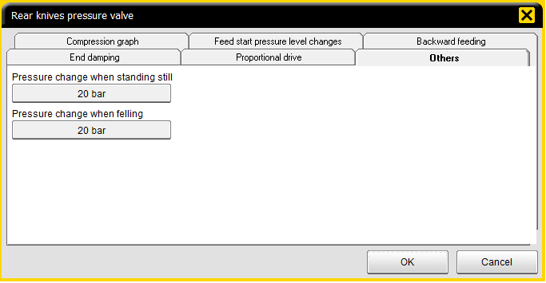
Delimbing
Rear knife settings
Others – adjustable additional pressure to ensure a firm grip when felling a tree or when moving stem with the crane (the set pressure is added on the compression curve).
Pressure change when standing still – ensures proper grip when moving stems (sorting assortments).
Pressure change when felling – ensures proper grip when felling.
Maximum pressure sets the maximum compression pressure for the front knives in any situation → maximum pressure is used, even if the pressure value from the pressure curve added by the pressure change setting values is higher than the maximum pressure.
Notes:
etuterien sulkeutumispaine 85 baria
syöttörullien sulkeutumispaine 85 baria
takaterien sulkeutumispaine 85 baria
sulkeutumispaineen vaikutusaika 0 ms jolloin seurataan antureiden liikettä ja paine nostetaan sen jälkeen kun terät ja rullat ovat pysähtyneet

Slide 57
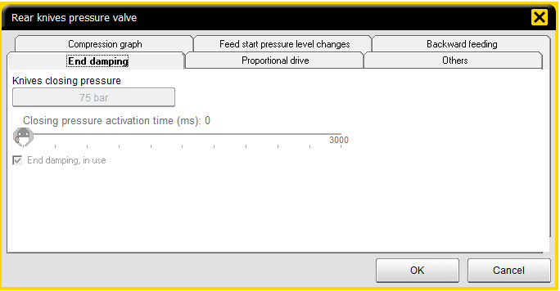
Delimbing
Rear knife settings
End damping – the pressure for closing the knives is adjusted here.
Diameter sensor data is being used to identify closed position → when movement of the knives stops, the head is closed.
When knives are detected to be closed against the trunk or empty head, the pressure level set by the compression curve is activated.
Knives closing pressure – pressure used when closing front knives
Closing pressure activation time – adjustable time for knives closing pressure function (heads with no front knive sensors)
Notes:
etuterien sulkeutumispaine 85 baria
syöttörullien sulkeutumispaine 85 baria
takaterien sulkeutumispaine 85 baria
sulkeutumispaineen vaikutusaika 0 ms jolloin seurataan antureiden liikettä ja paine nostetaan sen jälkeen kun terät ja rullat ovat pysähtyneet

Slide 58
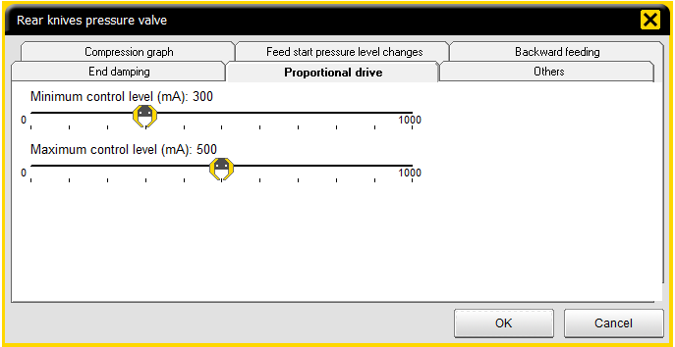
Delimbing
Front knife settings
Proportional drive – With the proportional drive, the harvester head (knives and rollers) can be opened to intermediate positions.
Function is activated with left crane tilt pedal (Pedals activate proportional control) and controlled by manual feed handle.
Harvester head can be opened steplessly also by using a programmed button on the keyboard matrix.
Notes:
Proportionaaliajo – proportionaalista terien ja rullien hallintaa käytetään, kun halutaan esim. harvennuksella ottaa rungosta löysä ote ja sen jälkeen asettaa harvesteripää haluttuun asentoon.
Proportionaaliohjaus aktivoidaan käyttöön vasemmalla jalkapolkimella kun automatiikasta on valittu kohta Polkimet aktivoivat proportionaaliohjauksen.
Nopeuden säätö - kahvan 1 % vastaa minimi ohjaustasoa ja 100 % maksimi ohjaustasoa.

Slide 59
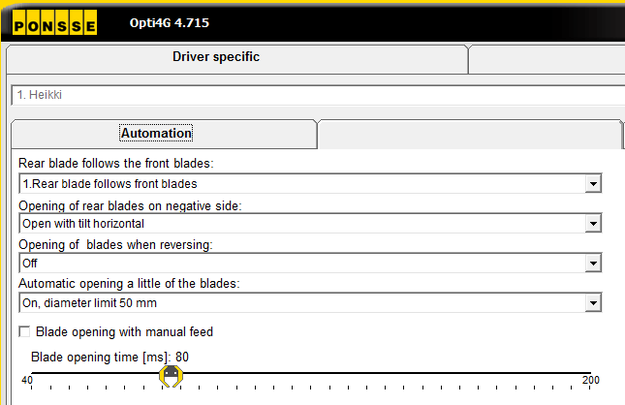
Delimbing
Settings for delimbing
Maintenance → Settings → Driver specific → Automation
Rear blade follows front blades usually on → all knives can be opened temporarily during feeding using the front knifes open-button
Opening of rear blades on negative side usually on → when the head is reversed so much, that the rear knives are off the trunk, they are automatically opened to make forward feeding possible
Opening of blades when reversing → if selected, eases feeding on curved and bad quality trunks, but may cause the trunk to fall off the head more easily
Automatic opening a little of the blades → easier start of feeding, but may cause bad delimbing quality

Slide 60
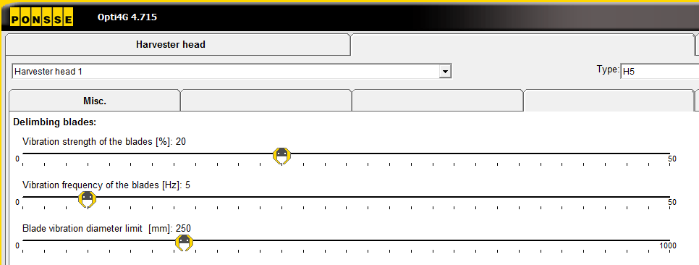
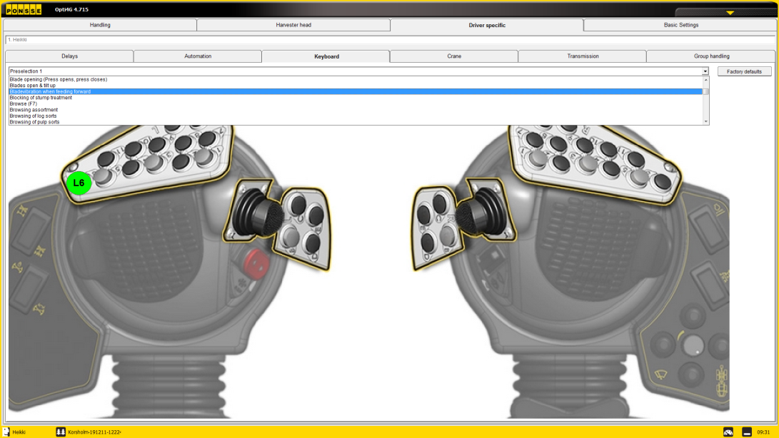
Delimbing
Settings for delimbing
Maintenance → Settings → Harvester head → Misc
Delimbing knife vibration
Delimbing knives are vibrated with open/close –signals according to the set values → easier feeding
The precentage value shows the duration of the pulse → how long the open current is sent to the valve.
The bigger the value, the longer knives stays open and the more they are opened
Frequency of the vibration, e.g. 6 Hz equals to 6 times per second
Vibration diameter limit sets the limit to automatic vibration → the function is always active under this limit
Button-controlled delimbing knives vibration when feeding forward
Forward feeding
Select a button to control vibration under
Maintenance → Settings → Driver Specific → Keyboard
No diameter limit
Check the delimbing quality after activating the vibration or changing the vibration settings

Slide 61
Equipment
Ponsse H-series harvester heads

Slide 62
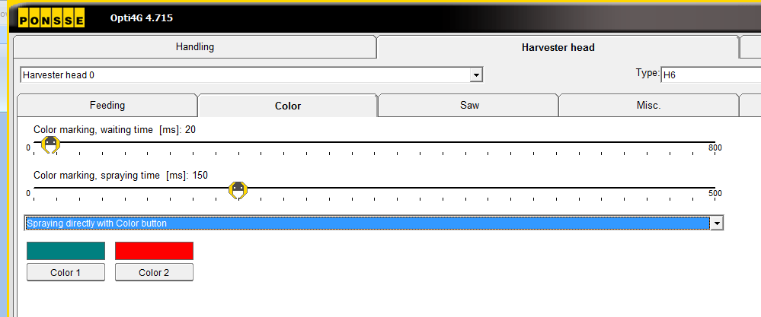
Color marking
Settings
Maintenance → Harvester head → Color
Waiting time sets delay between spraying and end of sawing → if set too small, the color will wit the saw bar, if too long, log will fall before spraying
Spraying time sets the duration of spraying → should be set so, that there is a clear mark on the tree but color is not sprayed after the log has fallen
On the drop down menu the operator can select, if shift button is needed on manual spraying

Slide 63
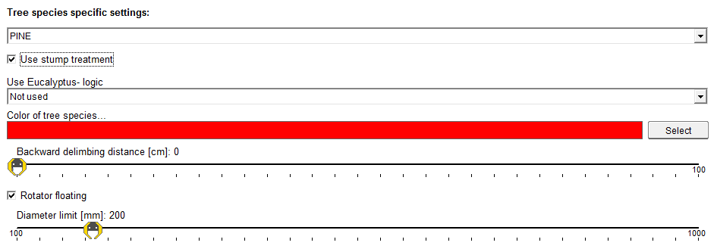
Stump treatment
Use
Activated from Settings → Handling → Tree species specific settings → Use stump treatment
Remember to turn spraying on for all species needed. If the default tree species has stump treatment on, tree species must be changed before felling sawing in order to prevent stump treatment.
If stump treatment is not used, turn the function off to prevent damage to the pump piston seals!
Under Settings → Harvester head → Saw → Blade out delay (stump spraying) the delay for the saw bar out can be set. It must be adjusted so, that the spraying covers the entire stump.

Slide 64
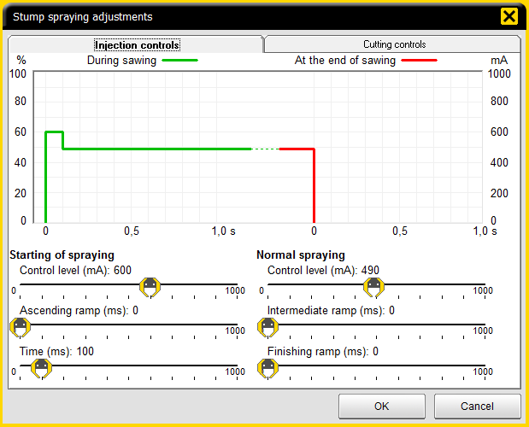
Stump treatment
Settings
Service → Settings → Base machine – controls → Stump spraying
Separate settings for Start of spraying and normal spraying → usually a bit higher control level used on start of spraying to ensure that spraying starts normally. Time of start level is usually set between 100 and 200 ms.
The correct values depend on the case and e.g. viscosity of the additive used.

Slide 65
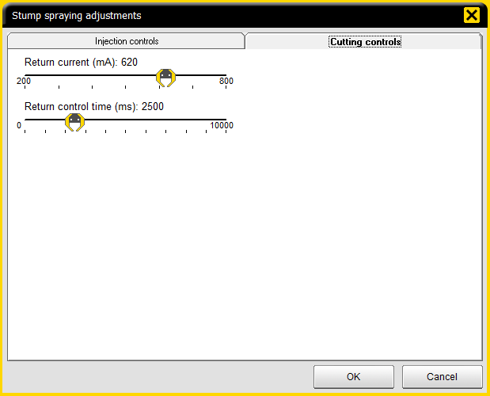
Stump treatment
Settings
Service → Settings → Base machine – controls → Stump spraying
Cutting controls set the current and time for the pump piston return pressure. It must be set high enough to allow the piston to suck sufficient amount of treatment additive to cover the next stump completely.
The values depend on the characteristics of the additive.

Slide 66
A logger’s best friend
PONSSE PLC
Ponssentie 22
FI-74200 Vieremä, Finland
Tel. +358 20 768 800
Fax +358 20 768 8690
www.ponsse.com

