Slide 1
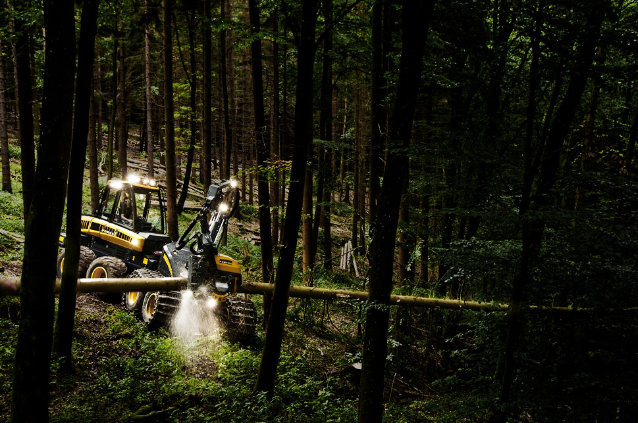
H-series harvester heads Calibration
PONSSE

Slide 2
Calibration
Why calibration is needed?
The most important reason obviously is the correct quality of timber:
Correct length
Correct diameter classes
Correct volume measurements
However, correct calibration of the harvester head, especially the diameter calibration, has an effect on multiple harvester head automation functions:
Saw control and saw automatics
Saw bar pressure adjustments (per mille or optimization)
Delimbing knife and feed roller pressure adjustment → if diameter calibration is not correct, the pressure set on the curve is set according to the trunk size correctly
Even if the timber volume is not measured by the harvester head, the calibration must be at least relatively correct and checked periodically in order to the automatic functions of the harvester head to perform correctly!

Slide 3
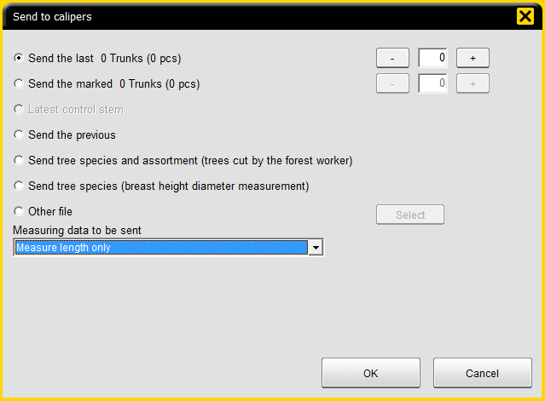
Lenght measuring
Daily follow-up and control with calipers
Sending calipers from only the length dimensions
Measure pieces the calipers
Sending data from the calipers which provides comparison and calibration of the proposals and the but-end and of the other parts of the trunk
From the measured data consists of the KTR file

Slide 4
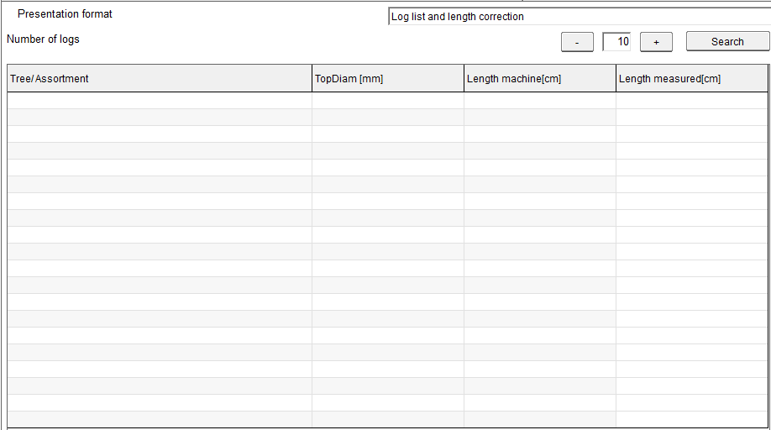
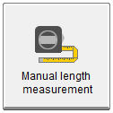
Lenght measuring
Daily follow-up and control manually with tape measure
Lenght checking with tape measure
Measured for example the last 10 pieces with tape measure and is fed to the measured length of the Opti system next to the length machine
When each the length is fed after that press the calculate button at the bottom right of the window

Slide 5
Lenght measuring
Calibration changes
Length adjustment will be made in parts per thousand to correct the machine to display the length of the resulting length of the calipers
General rule of thumb is that a 5 meter log 1 per mille unit correction affects 0.5 cm
That adjustment no need to take into account the length of paragraphs (middle length)
Length correction to butt end shall be subjected to +/- cm
Butt end log volume correction is used if it is found volume error butt end log

Slide 6
Lenght measuring
Cutting window
Small cutting window:
When a small cutting window is selected, the log types to use Opti Conntrol price list lengths
Target length tolerance is, for example, 5 mm indicates 10 mm of the cutting window and this means 490 cm log length 4895 - 4905 mm in length with cutting accepted

Slide 7
Lenght measuring
Cutting window
Assortment spesific cutting window:
When a small cutting window is not a selected Opti Control use assortment spesific cutting window
Assortment specific length of which is calculated according to the cutting window means that, for example, start = 0 and end = 2 cm. Which means 490 cm a log cutting between 490-492 cm

Slide 8
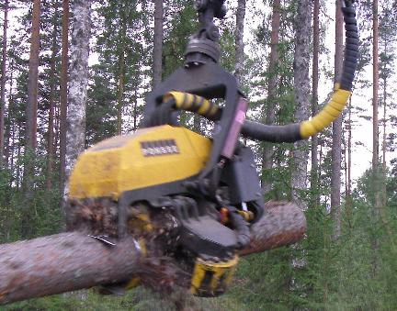
Control measuring
Volume measuring accuracy is effected by bark characteristics, number of limbs, operation technique of the operator, condition of the delimbing knives, condition of the harvester head and Opti 4G settings
Loose bark season
Change in feed roller spike penetration → temperature, size of the trunk, tree specie, position on the trunk (butt, middle, top)
Feed rollers collecting bark
Feed rollers digging in the trunk, if slipping during feeding
Condition of feed rollers (sharp or dull spikes)
Surface contours on the trunk (Roller measurement vs. caliper measurement)
Delimbing quality

Slide 9
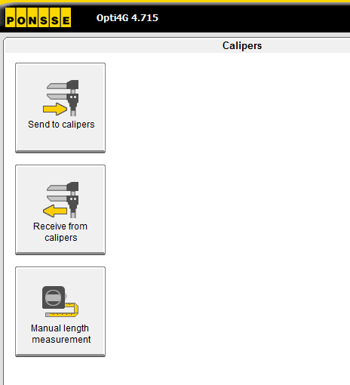
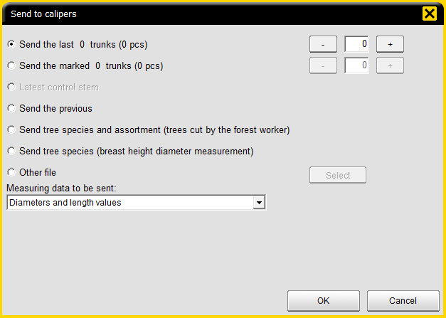
Control measuring
Sending the data to the calipers
Cut the trees selected for calibration so that they are easy to measure.
Push on Send to calipers
Select the number of trunks cut and push on OK. With the new caliper software, the data transfer will begin automatically after a few seconds.
After the transfer is complete, you can measure the trunks.

Slide 10
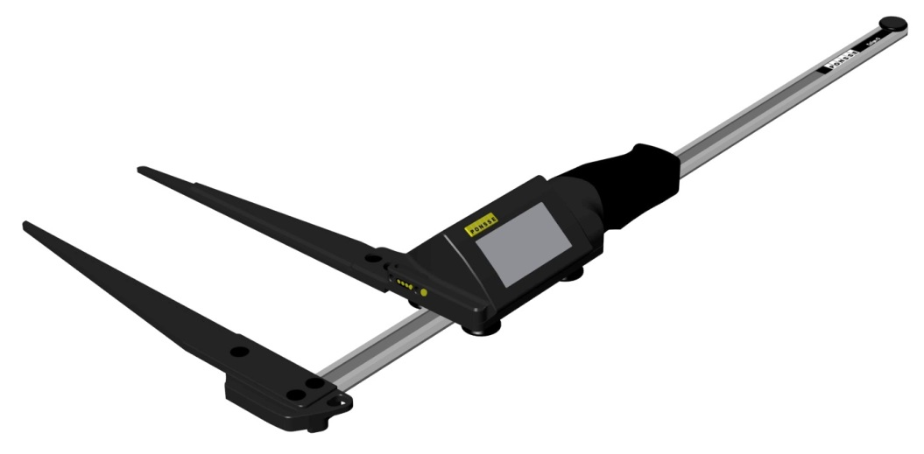
Measuring with calipers
The person making the measurement has a very great effect on the accuracy and success on the control measurement
It is important to try to learn and maintain a similar way of working between the persons doing the control measurement
A tree is never completely round, almost all trees are more or less elliptic
Two samples taken at a single point on a log must always be taken in an angle of 90 degrees to each other
There are two ways of measuring:
The true 90 degree measuring, which will compensate for the elliptic shape of the trunk.
Lazy person’s measuring by barely moving the calipers between the two measurements → can lead to having two similar samples, which both are either too thick or too thin → WRONG WAY!

Slide 11
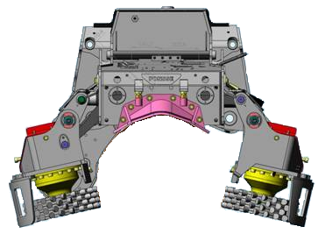
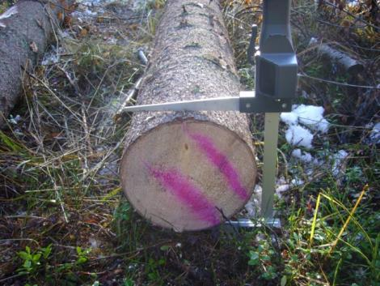
Measuring with calipers
2. With the calipers, the shape of the log is observed by the 90 deg. measuring
The harvester head measures the log
with the triangular calculation → shape of the trunk is observed very well

Slide 12
Measuring with calipers
Difference between the harvester head and the calipers
The volume of the log is calculated by measuring 100 cm long cylinders of the log
TOTAL VOLUME = CYLINDER 1 + CYLINDER 2 + CYLINDER 3 + CYLINDER 4
The harvester head measures the log as 1 cm long slices
TOTAL VOLUME = SLICE 1 + SLICE 2 + SLICE 3 + … + SLICE 370

Slide 13
Measuring with calipers
Effect of 1 mm measuring error to 1 m long log cylinder in %
Diameter | Difference %
50 mm | 4,04
100 mm | 2,01
150 mm | 1,34
200 mm | 1,00
250 mm | 0,80
300 mm | 0,67
400 mm | 0,50
500 mm | 0,40

Slide 14
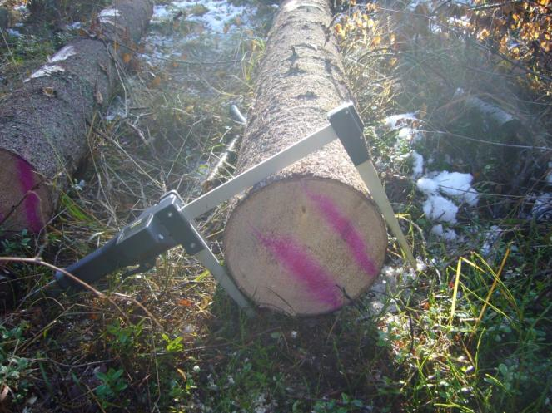
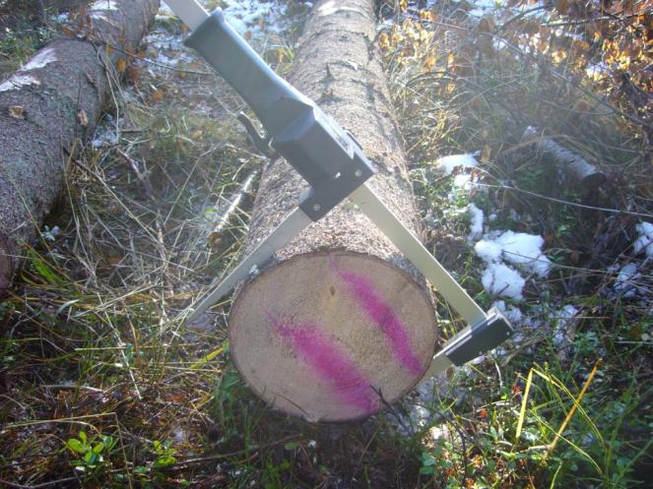
Measuring with calipers
For the most accurate result measure each measuring point with 90 degree measurement with one on the thinnest and one on the thickest point.
The results are always nearly as good if the measuring is not done on the thinnest and thickest point, as long as there is a 90 degree angle between the measurements.

Slide 15
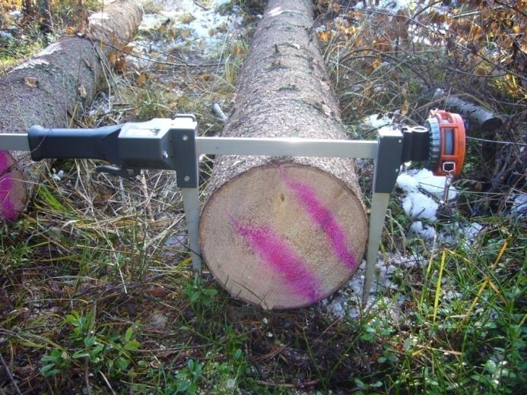
Measuring with calipers
Lazy person’s measurement
First measurement directly from above, for the second measurement the caliper position changed only a little, if at all → the measuring average may be correct, may be too low, may be too high → impossible to know!
Elliptic trunk will lay on it’s wide side, if there is no snow or thick undergrowth → if calipers are not turned, the measurement is in the thickest direction
If there is snow or undergrowth, it can be in any position → if the calipers are not turned, the measurement is in a random direction
On the logs in the tree on the pictures, the difference between thickest and thinnest measurement at the same point was 18 mm at 150 cm and still 5 mm at the top.

Slide 16
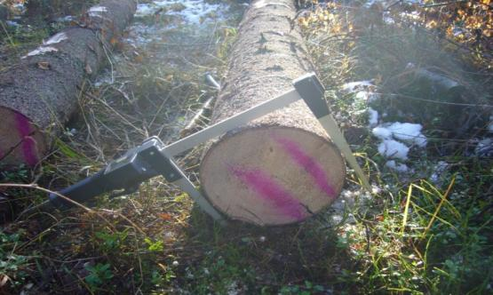
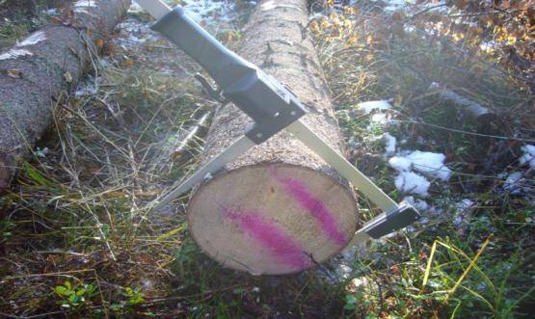
Measuring with calipers
26,4 cm
25,5 cm
26,0 cm
26,1 cm

Slide 17
Sample log 1
Harvester head: spruce pulp, top diameter 95 mm / length 299 cm / volume 30,6 l
Measuring method volume l
Harvester head 30,6
Lazy person, two measurements from the thinnest point 29,1
Lazy person, two measurements from the thickest point 32,1
Correct way (90 degrees, thickest and thinnest point) 30,6
Sample log 2
Harvester head: spruce pulp, top diameter 132 mm / length 297 cm / tilavuus 53,5 l
Measuring method volume l
Harvester head 53,5
Lazy person, two measurements from the thinnest point 51,2
Lazy person, two measurements from the thickest point 54,7
Correct way (90 degrees, thickest and thinnest point) 53,7

Slide 18
Sample log 3
Harvester head: spruce sawlog, top diameter 175 mm / length 524 cm / volume168,5 l
Measuring method volume l
Harvester head 168,5
Lazy person, two measurements from the thinnest point 157,4
Lazy person, two measurements from the thickest point 170,4
Correct way (90 degrees, thickest and thinnest point) 167,9
Sample log 4
Harvester head: spruce sawlog, top diameter 230 mm / length 382 cm / volume185,1 l
Measuring method volume l
Harvester head 185,1
Lazy person, two measurements from the thinnest point 178,4
Lazy person, two measurements from the thickest point 191,9
Correct way (90 degrees, thickest and thinnest point) 185,2

Slide 19
Sample log 5
Harvester head: spruce sawlog, top diameter 262 mm / length 381 cm / volume 244,4 l
Measuring method volume l
Koneen mittaama 244,4
Lazy person, two measurements from the thinnest point 232,9
Lazy person, two measurements from the thickest point 252,4
Correct way (90 degrees, thickest and thinnest point) 244,2
Sample stem, total volume comparison
Log/Stem | Head | L. Thinnest | L. Thickest | 90 deg thin/thick
Log 1 | 30,6 | 29,1 | 32,1 | 30,6
Log 2 | 53,5 | 51,2 | 54,7 | 53,7
Log 3 | 168,5 | 157,4 | 170,4 | 167,9
Log 4 | 185,1 | 178,4 | 191,9 | 185,2
Log 5 | 244,4 | 232,9 | 252,4 | 244,2
Stem total | 682,1 | 649,0 | 701,5 | 681,6
Difference (l) | 0,5 | - 32,6 | 19,9 | 0
Difference (%) | 0,1 | - 4,8 | 2,9 | 0

Slide 20
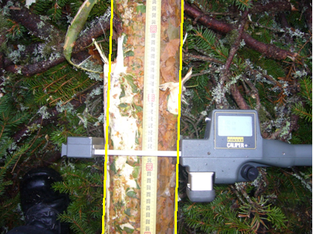
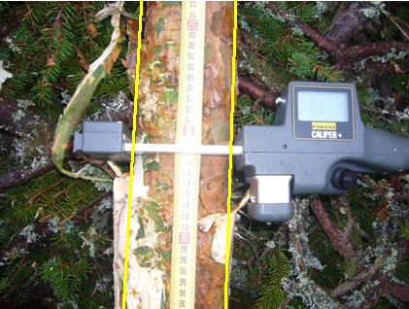
Measuring with calipers
If the measuring point happens to be on a big branch stump or a branch group and the measurement is done on the point, the measuring result will not be correct, because the measuring cylinder diameter is not correct
Measure the thickness from above and below the branch(es) and the calipers will calculate the average diameter correctly

Slide 21
Measuring with calipers
In case of bad delimbing, always measure on the trunk, not on top of the poorly delimbed branches.

Slide 22
Measuring with calipers
Example log: A big branch bunch with poor delimbing at 150 cm and 250 cm measuring points. Measurements taken exactly at the measuring point or above and below the measuring points.
Measuring point | Harvester Head | Exactly at point | Above and below bunch | Difference in measurement
50 cm | 169 mm | 166 / 170 | 166 / 170 | 0 mm
150 cm | 150 mm | 163 / 158 | 154 / 143 | 12 mm
250 cm | 122 mm | 141 / 139 | 127 / 115 | 19 mm
350 cm | 92 mm | 94 / 91 | 94 / 91 | 0 mm
407 cm | 73 mm | 72 / 76 | 72 / 76 | 0 mm
Volume | 58.8 l | 65,4 l | 58,6 l | 6,8 l
% | 0,0 | 11,6 | 0,0

Slide 23
On a bigger amount of logs measured, the number of measurement points increase. This will even out the deviation caused by trunk shape and branch groups effectively. The poorer the timber quality, the bigger the amount of logs measured should be. If only a single stem is measured, the correct and careful measuring method is extremely important to reach the correct results!.
Measuring with calipers

Slide 24
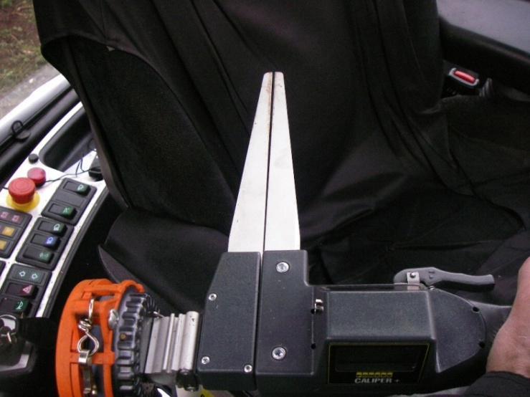
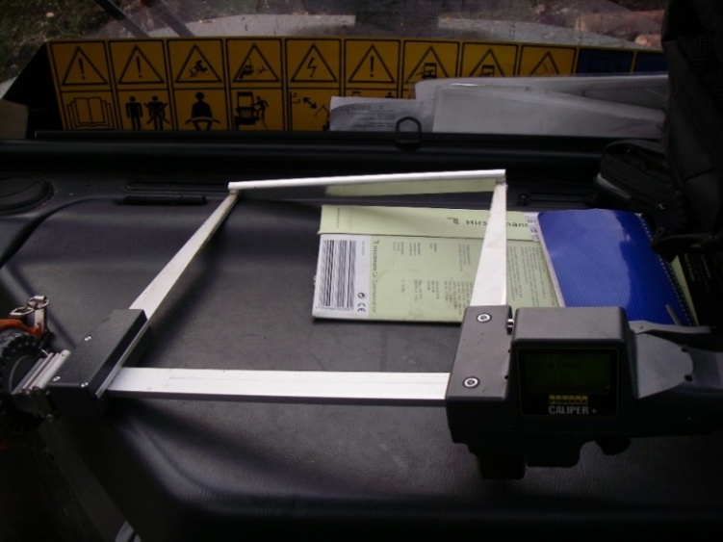
Caliper+
Caliper+ is a measuring device → Learn and use the correct procedures when measuring timber!
Calibration
Only calibrate with one tree species at a time
Choose stems with at least relatively good quality for calibration
Choose stems of different size to calibration → measuring data for all diameter classes
Lay the calibration logs on the ground in sawing order and far enough apart, so that they are easy to measure and there is enough room to do 90 degree measurement
When taking the measurement, apply light compression force to calipers → do it the same way every time!
For a thorough calibration, use at least 30 logs. Quick check can be done with a smaller amount.
Measuring a single stem is not a good way to calibrate! If a single stem check shows difference, take a larger sample.
Take care of and follow the mechanical condition of the Calipers
The slider of the caliper must be clean
The resistance of sliding must be small enough and even
Jaws must close evenly, with an even gap between
Regularly check the measurement accuracy with the 240 mm control gauge delivered with the machine
Send the mechanically worn or broken calipers to service!
Kuva 1.
Mittasaksien tarkistusmittapala

Slide 25
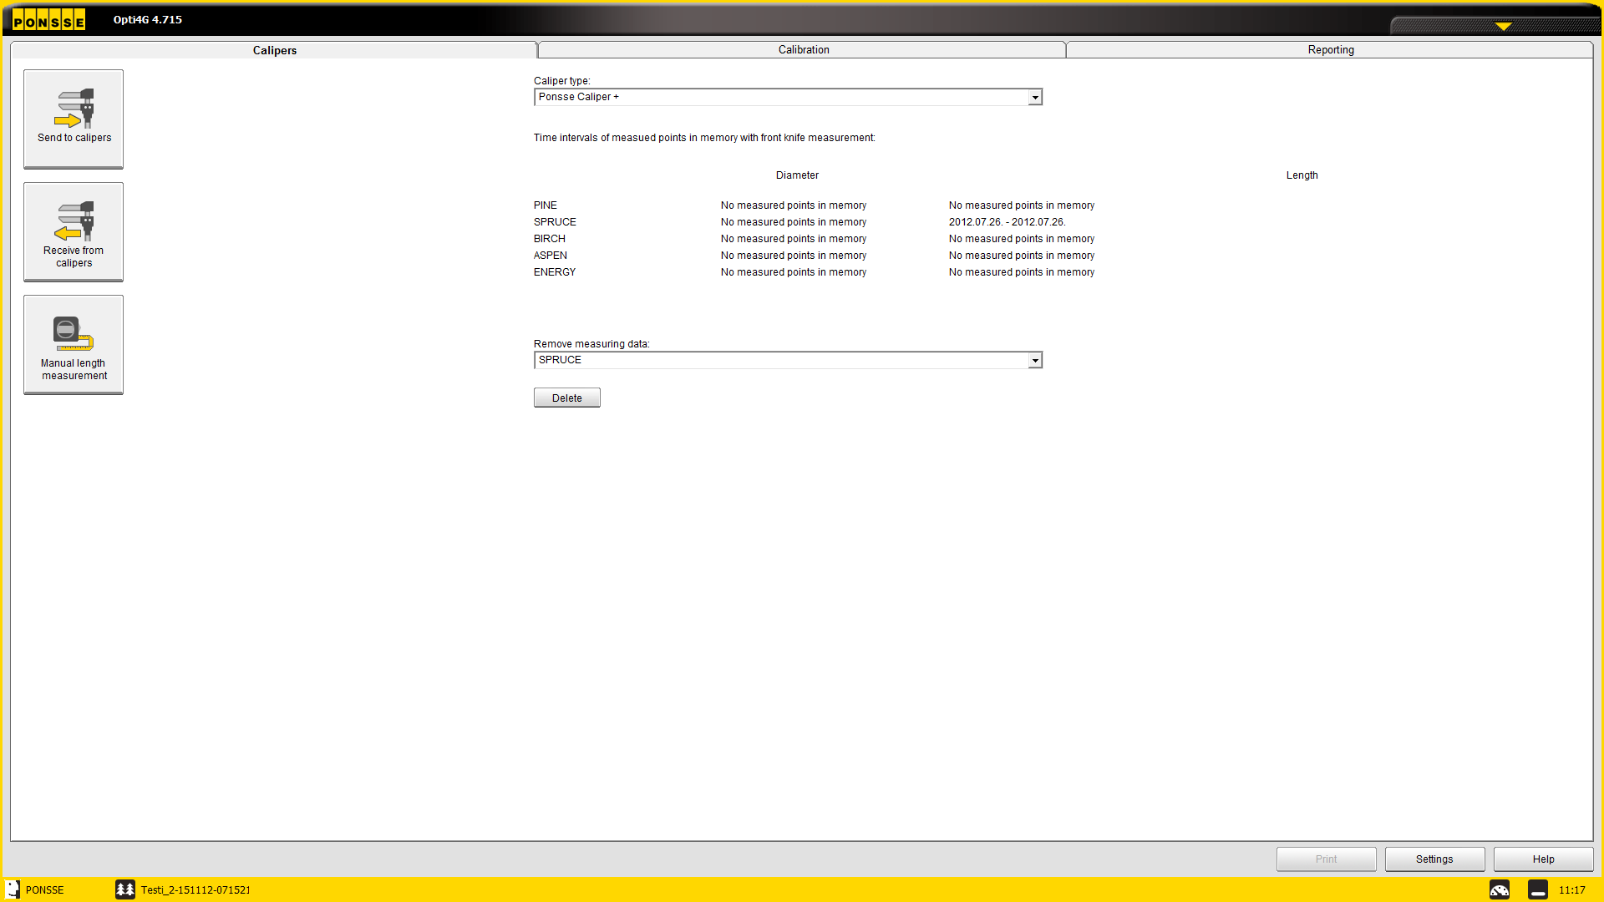
Control measuring
Calibration
The data after the last calibration and/or last removing of the measuring data is used to calculate calibration proposal. The data between the last change in the calibration and the current measurement is used in calculations.
The operator should use the measuring data removal –function, if the measuring has changed e.g. after harvester head repairs (feed roller change, measuring device service), or if the trees are totally different on a new work area.
If the calibration is changed a bit all the time, the older measuring data is not used for the proposals. The storing time of the measuring data can be adjusted under Calibration → Settings → Calibration
Remove measuring data- The calibration data since the last change in calibration is stored in the program. To delete the data, use this function (tree species specific). The removal should be done after mechanical repair to the measuring system and big change in tree type in the forest.

Slide 26
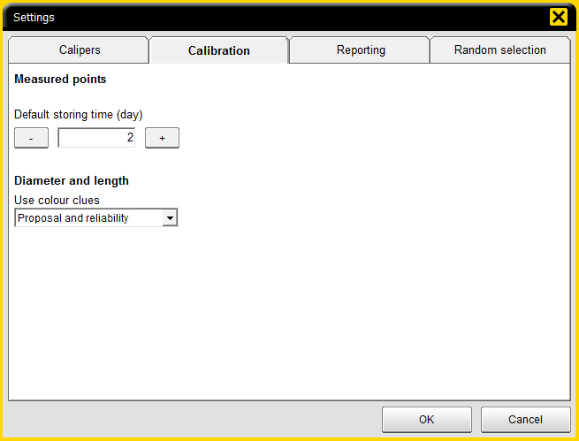
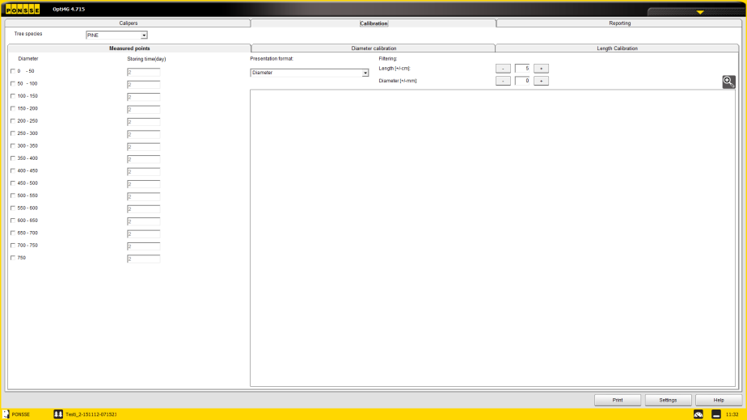
Control measuring
Calibration storing time
Default storing time (day) – Sets the default storing time for measuring points. Sets the time in days, during which the calibration measurements are taken into account when calculating the calibration proposal. E.g. if the setting is 10 days, all measurements during the last 10 days are taken into account when calculating the proposal, by weighing the current and the last ones.
Under Calibration → Measured points the storing time can be set individually for diameter classes, with the same effect as the default settings. If this setting is set to a different value compared to the default value, the set value here is used.
Filtering: The values outside the set filtering limits are not taken into account when calculating the measuring results. Filtering limits are calculated by calculating the average of the measuring point group and adding the filtering values. In the matrix showing the measured points the points outside the filtering limits are shown as yellow and the points inside the values as grey.
A reasonable filtering should be used to remove the false measurements from calculations. The amount of filtering needed depends greatly on the tree type.

Slide 27
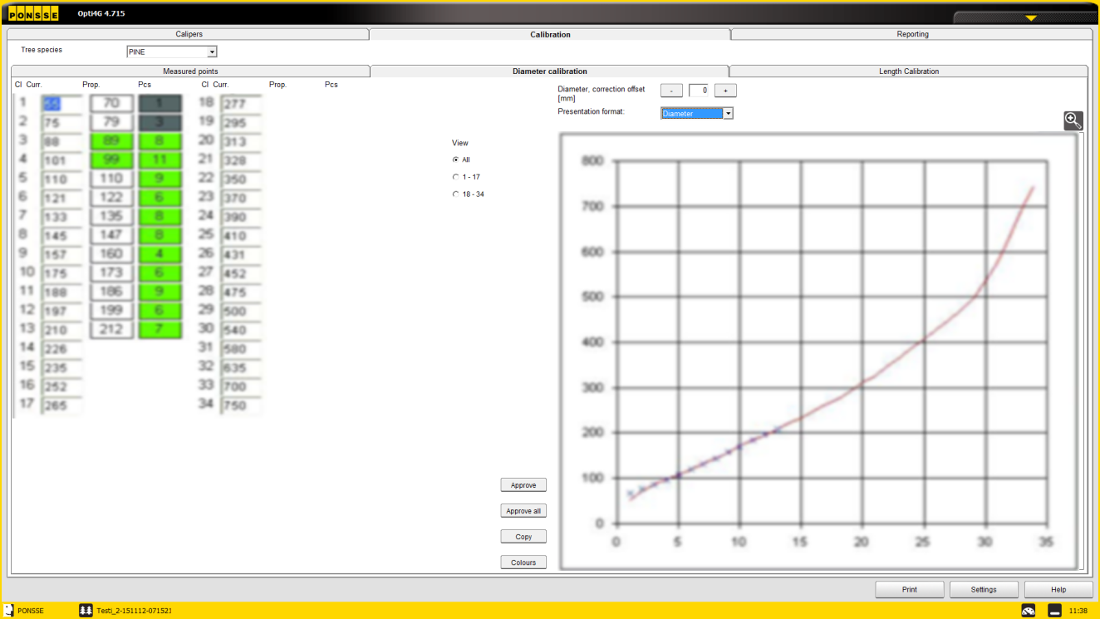
Control measuring
Diameter calibration
Diameter, correction offset [mm]
Used in situations, e.g. weather changing from freezing to thawed, when the entire calibration curve changes the same way
The offset moves the entire curve for the set amount
Diameter
Red line – the current diameter curve
Blue dots- the new calibration curve proposal calculated by Opti, based on the measurement data from calibration measurement
Correction proposal
From the proposal it is possible to see, how much the proposal differs from the current calibration curve and whether the differencies are on a specific diameter class or on the entire curve.
The X -axis is for the curve classes (Cl on the chart on the left.
The Y-axis is for diameter.

Slide 28
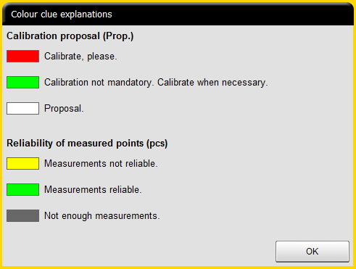
Control measuring
Diameter calibration
The program assist the user with the color coding
The explanation for color coding can be seen by pressing the colors -button

Slide 29
Calibration measurement
To achieve accurate calibration it is important to measure enough points in all diameter classes, also the large end.

Slide 30
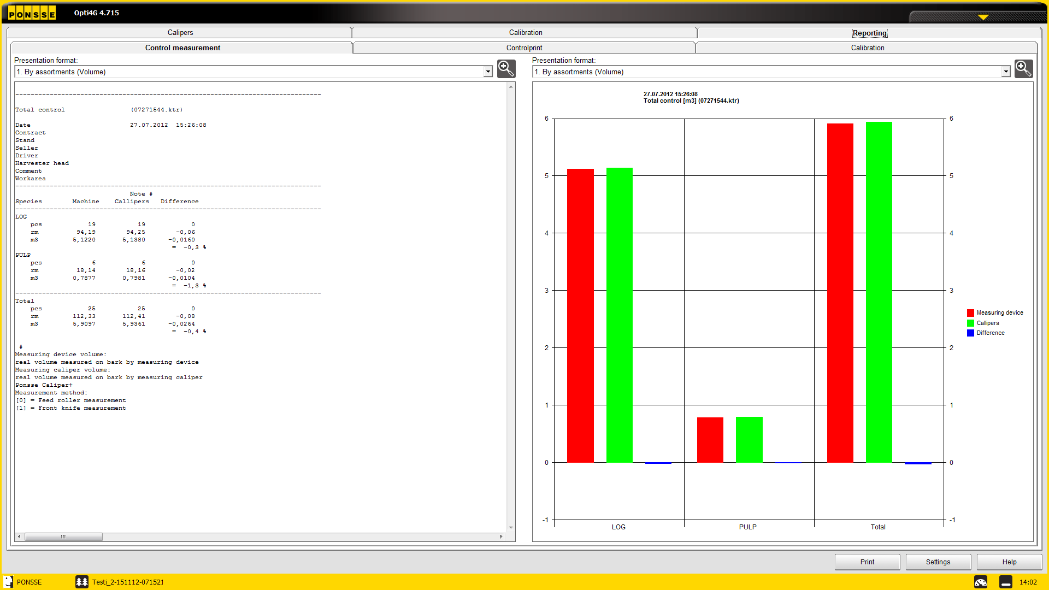
Control measuring
Reporting: Calipers vs. Harvester head
After measuring data is transferred to Opti, different kind of reports can be seen under reporting
Under Control measurement –tab the default report shows comparison according to species (logs/pulp)

Slide 31
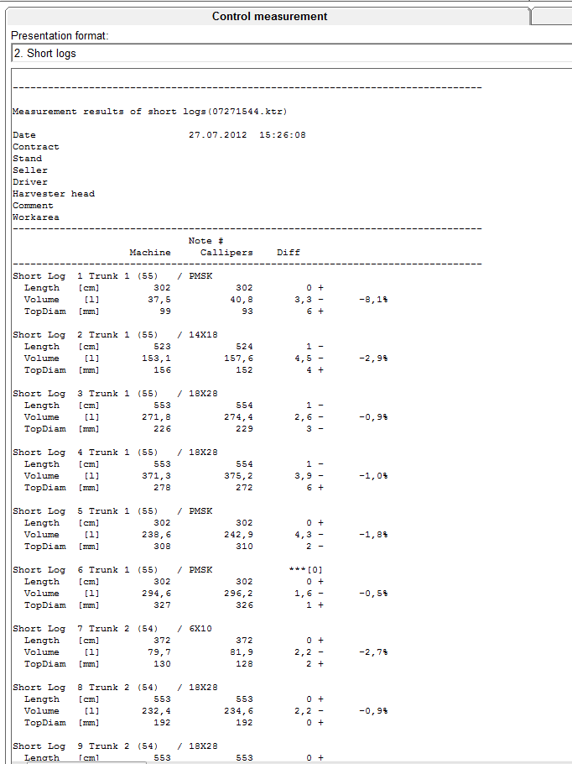
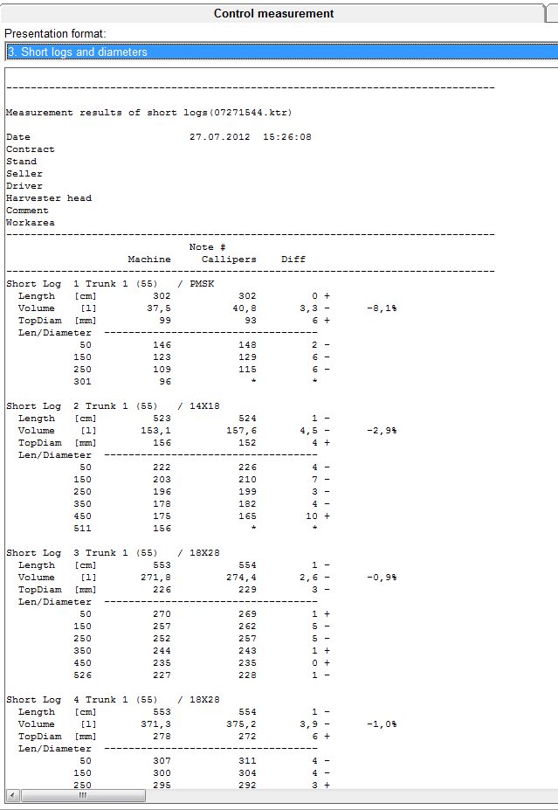
Control measuring
Reporting: Caliper vs. Harvester head
By selecting on the drop down menu, more specific reports can be opened: Short logs, Short logs and diameters, …

Slide 32
Control measuring
Reporting: Caliper vs. Harvester head
By selecting on the drop down menu, more specific reports can be opened:
Short logs: difference in volume by measured logs
Short logs and diameters: difference in volume by measured logs and difference in all diameter points
Difference in length values: difference in length measurements in pcs/cm class and %/cm class
Difference in diameter values: difference in diameter measurement in pcs/mm class and %/mm class
Measured diameter points: Measured diameter points’ deviation by diameter class
Variation in length measurement difference: Variations in length on different calibration measurements
Variation in diameter measurement difference: Variations in diameter on different calibration measurements

Slide 33
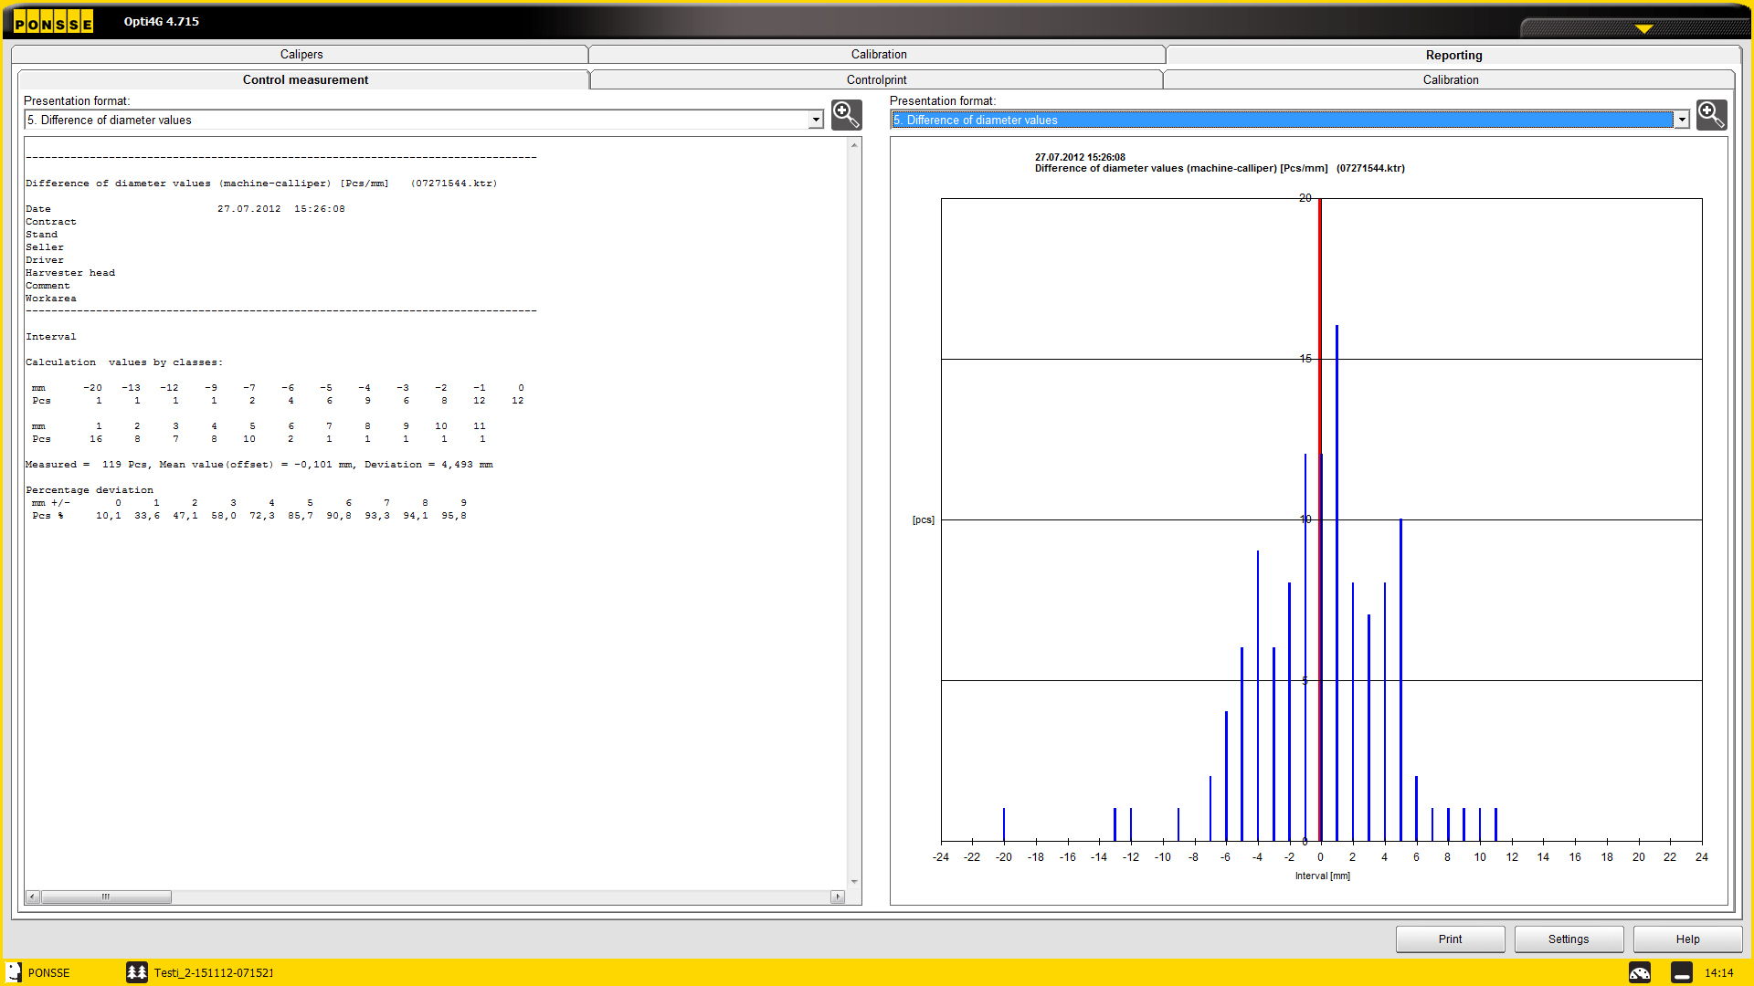
Control measuring
Reporting: Caliper vs. Harvester head
The difference in diameter values in both numeric and graphical presentation can help the operator to correct the calibration → if the curve is correct, the needed offset can be seen by looking at the average in diameter deviation on the graph (red line)

Slide 34
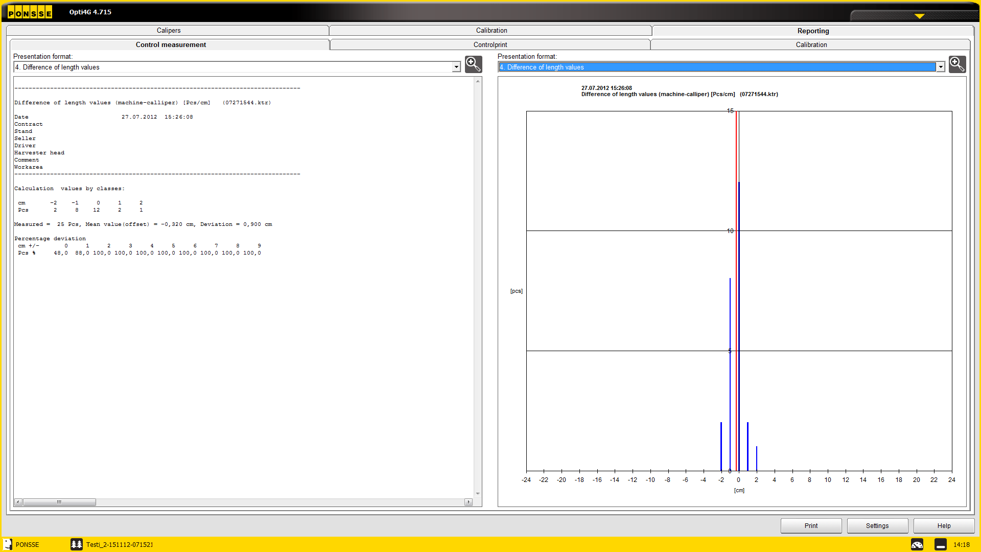
Control measuring
Reporting: Caliper vs. Harvester head
Similar logic works also with length calibration

Slide 35
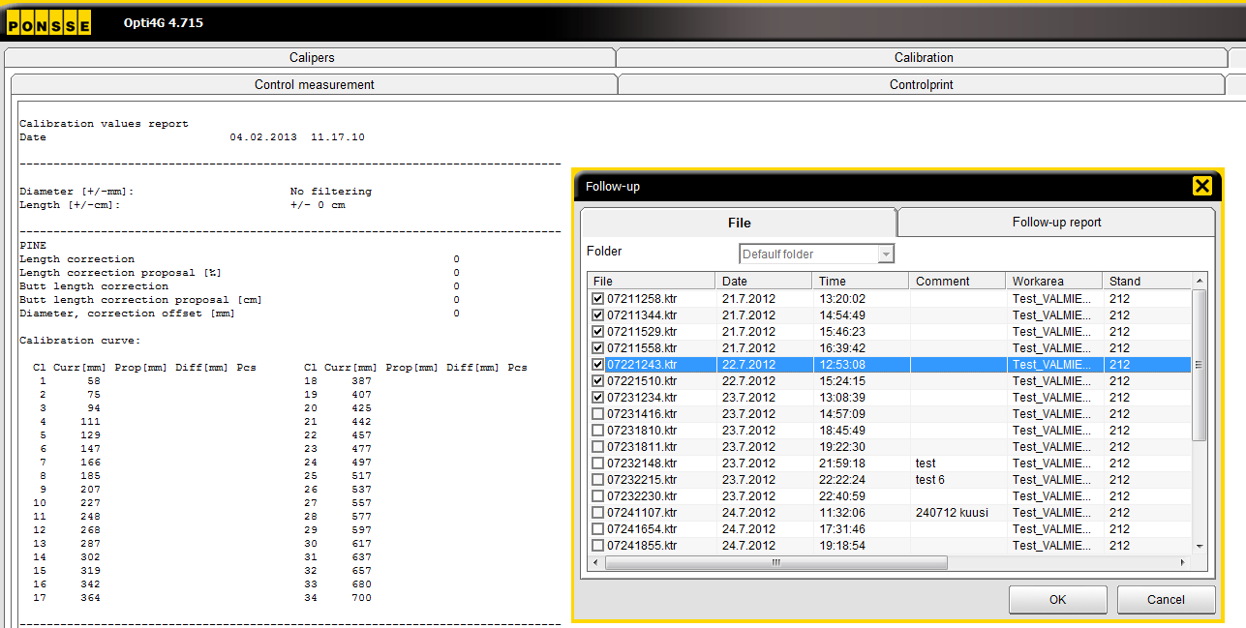
Control measuring
KTR -files
The follow-up for measuring accuracy can be done also by selecting multiple received KTR-files to the report. This is recommended, if multiple single-stem calibration measurements are done.
Files can be selected from Calibration → Reporting → Calibration by pushing the File –button and selecting the files from the list opening.

Slide 36
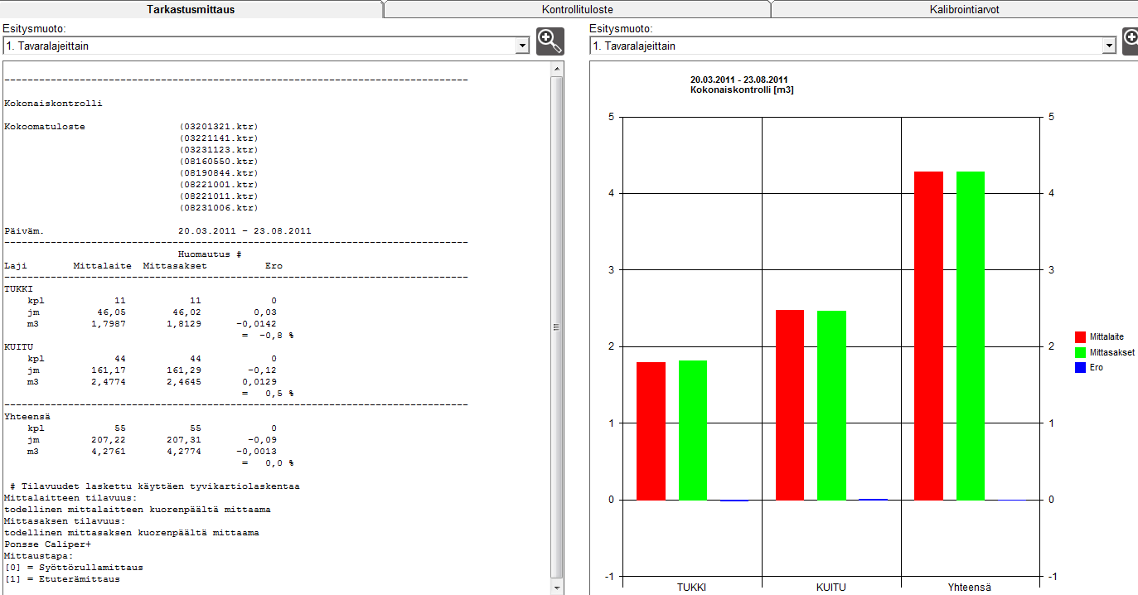
Control measuring
Multiple KTR reporting
With multiple KTR reporting it is possible to follow the measuring accuracy over a longer period of time or from multiple one trunk measurements.

Slide 37
A logger’s best friend
PONSSE PLC
Ponssentie 22
FI-74200 Vieremä, Finland
Tel. +358 20 768 800
Fax +358 20 768 8690
www.ponsse.com

