Slide 1
Ponsse Information Systems

Slide 2
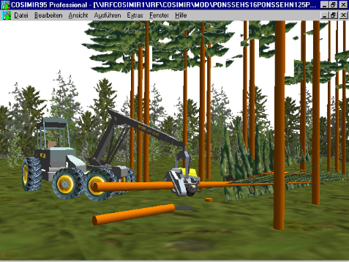
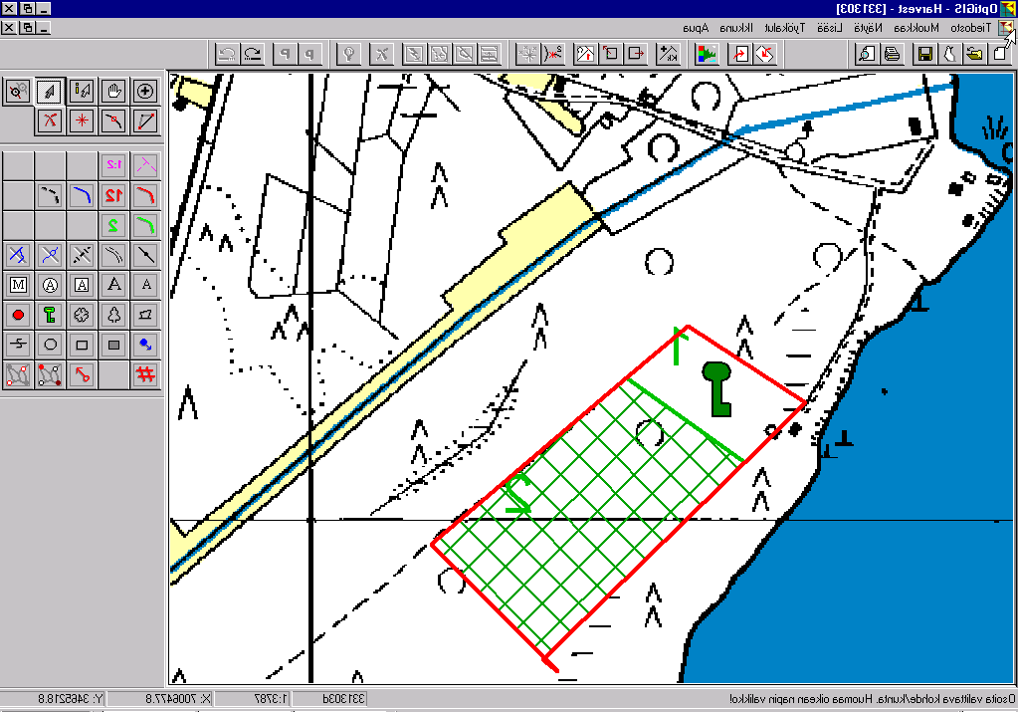
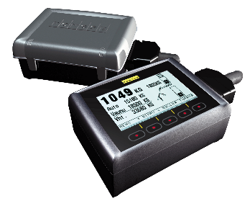
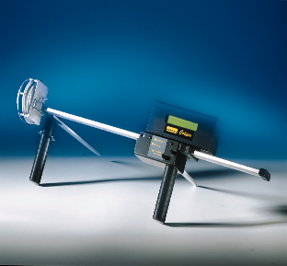
Ponsse Ltd in Kajaani
The software designing
  Tools for the management of the wood procurement chain
    harvesting
    harvesting instructions and stand maps
    logistics and reporting
Hardware designing and compiling of
measurement units
3D simulator
Electronic measurement scissors
Load Optimizer
Service department

Slide 3
Wood procurement today

Slide 4
Sawmills Cash Flow
Incomes from sawn timber
Profit
Capital costs
Production costs
Wood procurement costs
Payment to forest owners

Slide 5
Sawmills Cash Flow
It is possible to increase the profit by
lowering wood procurement costs,
production costs and capital costs.
You can make it with Opti wood
procurement control system

Slide 6
Customer oriented wood procurement
Dim. A Dim. B Dim.C Dim. D
Sawmill has 500 units of this kind of sawn timber in order book
and 2000 units of this kind of sawn timber
but no customer for this kind of sawn timber

Slide 7
Customer oriented wood procurement
Dim. A Dim. B Dim.C Dim. D
Conclusion: Sawmill needs 150 logs in dimension A and
100 logs in dimension C but none in dim. B and D
It is very important to have good bucking system in the harvester to achieve the desired dimension distribution.

Slide 8
Ponsse software tools for wood procurement

Slide 9
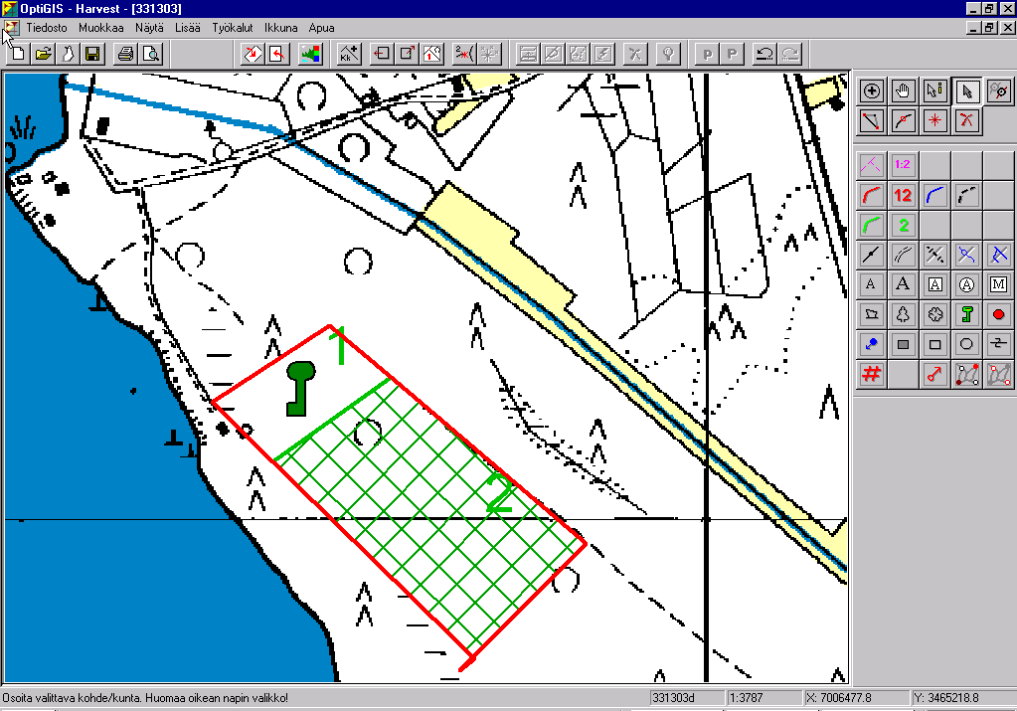
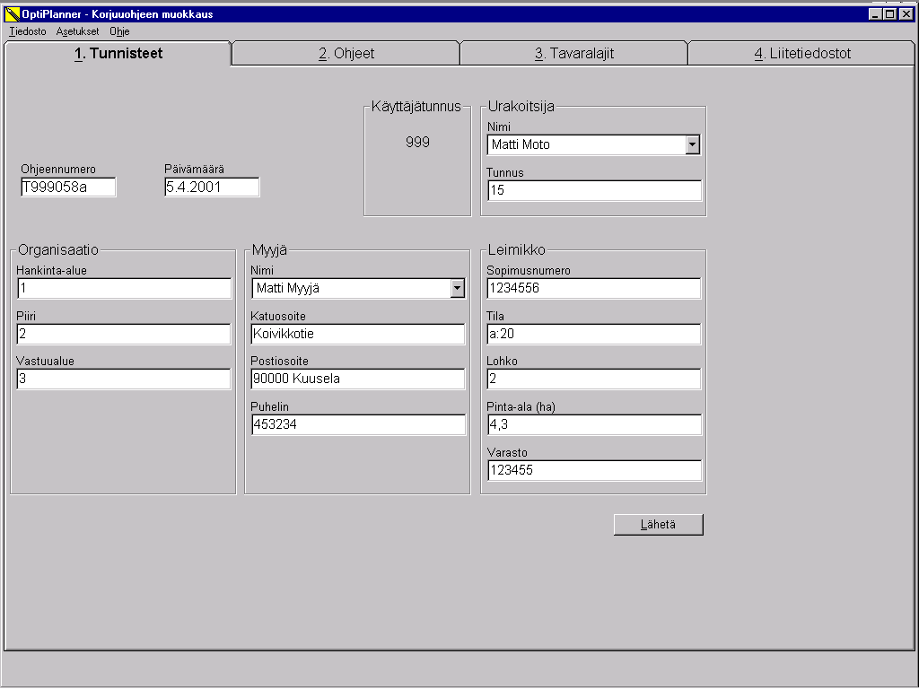
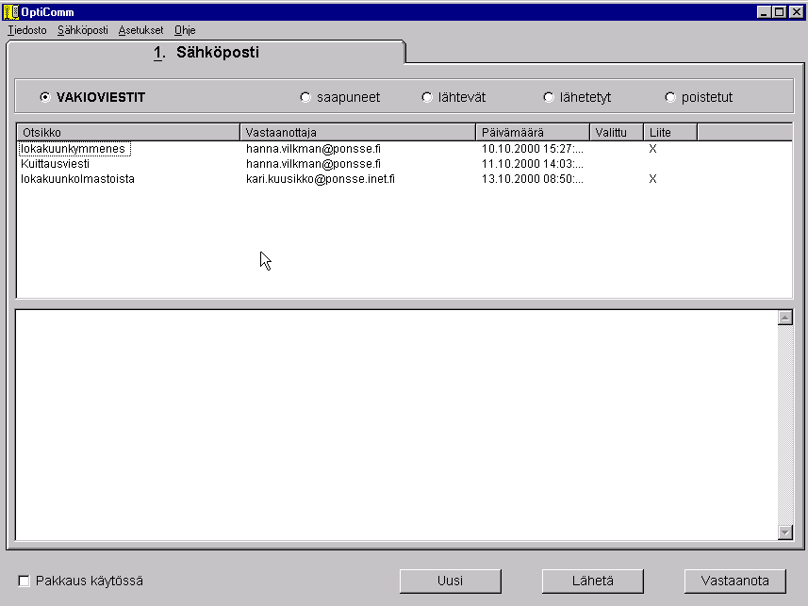
WOOD PROCUREMENT FLOW
OFFICE
Planning of harvesting area
OptiGIS Office
APT -file producing and testing
Opti Editor, Opti Simu
Harvesting instructions
Opti Planner
Information to harvester
Opti Comm

Slide 10
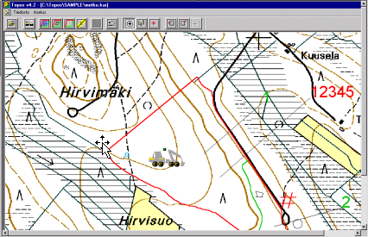
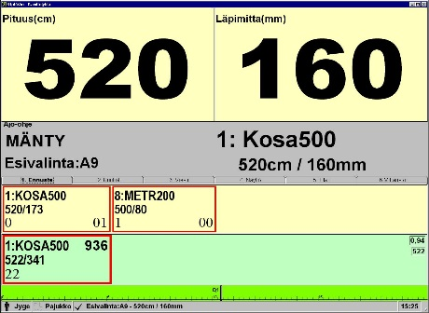
WOOD PROCUREMENT FLOW FOREST
Harvesting instructions and APT -file from office
Opti Comm
Study of instructions and maps
Opti Plan Viever
OptiGIS Harvester
Reading of APT-file and harvesting
Opti 4G
Production file to office
Opti Comm

Slide 11
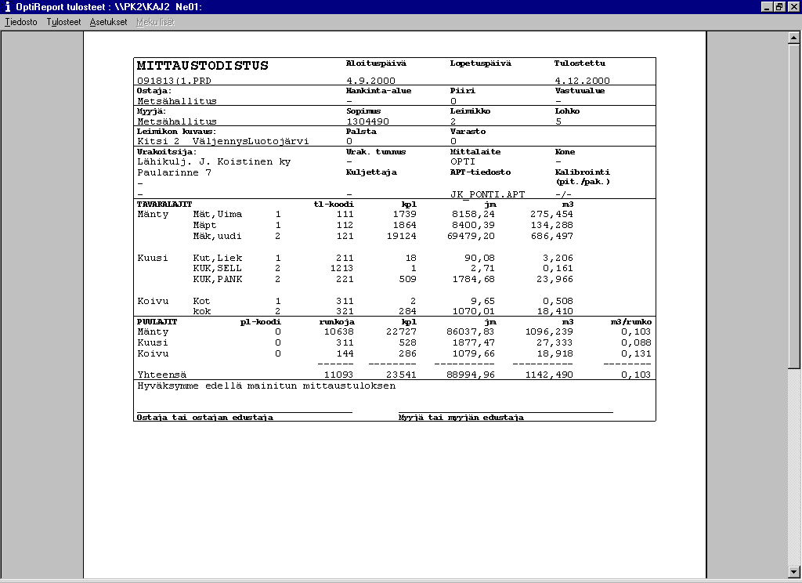
WOOD PROCUREMENT FLOW OFFICE
Receiving production file from forest
Opti Comm
Follow-up of production
Opti Report
Planning of transportation
Opti Logi
Sending transportation information to truck
Opti Comm

Slide 12
Some research results
Dedicated to Excellence

Slide 13
We are better off, says
research & tests
Degree of distribution
  Length distribution > 97 % (=97 logs of 100 as ordered)
  Length & diameter distribution > 90 %
How precisely timber section of stem is utilised
  better as traditional 10 %
Productivity of logging
  Spruce + 22 %
  Pine + 7 %
Dedicated to Excellence

Slide 14
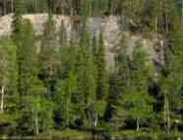
Length distribution for diameter classes
Norway Spruce, two log products
  - Aure log and Lapua log
  - length distribution by diameter classes for each product
Material: 7 stands
  - 4580 pcs of Aure logs and
  3310 pcs of Lapua logs
  - total volume of logs about 1600 m³
  - logging was done in August 1999
Data Metsäteho -99
Dedicated to Excellence

Slide 15
Case: Aureskoski
Degree of distribution
Diameter class
Dedicated to Excellence

Slide 16
BUCKING TO VALUE & TO DISTRIBUTION
COMPARED TO TRADITIONAL BUCKING ON HARVESTER
MATERIAL:
Finnish Forest & Park Service - Western District
* 2 stands of Norway Spruce
- in Kivijärvi region average size of stems 0,3 m³ & in Viitasaari 0,8 m³
* 1 stand of Scots Pine
- average size of stems 0,4 m³
- as homogenous parts as possible was selected from the stands,
total volume of the logs being over 500 m³
Dates of logging
14.5 - 29.5.1997
17.7 - 22.7.1997
Dedicated to Excellence

Slide 17
  Productivity gain while using
  bucking to value & bucking to distribution
Pine in average + 7,2 %
Spruce in average + 21,8 %
Dedicated to Excellence

Slide 18
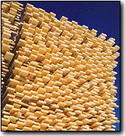
Sawmill or plywood mill
Stock of logs
Utilisation of timber
Stock of sawn timber
Quality of sawn timber
Delivery time
Profitability
Smaller
More efficient
Smaller
Better
Shorter
Higher
Dedicated to Excellence

Slide 19
Advantages of using the Ponsse System
Ponsse contractor serves better and makes better quality
for clients
Ponsse harvester with the Opti bucking system is more efficient
Ponsse information system fulfills all demands also in the
future
Ponsse measurement systems are easy to use and easy to
maintain
Dedicated to Excellence

Slide 20
Optimisation in harvesting
Dedicated to Excellence

Slide 21
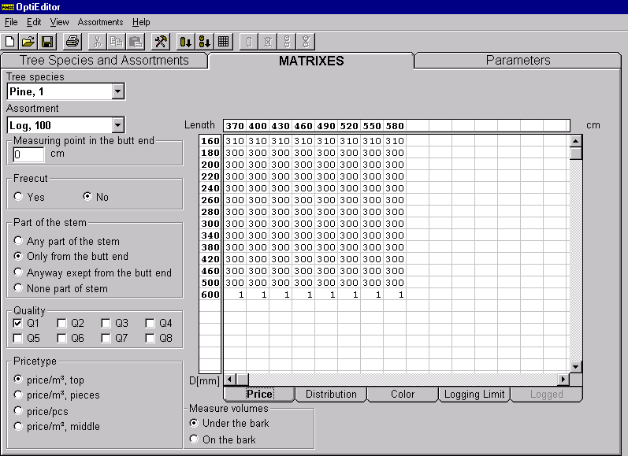
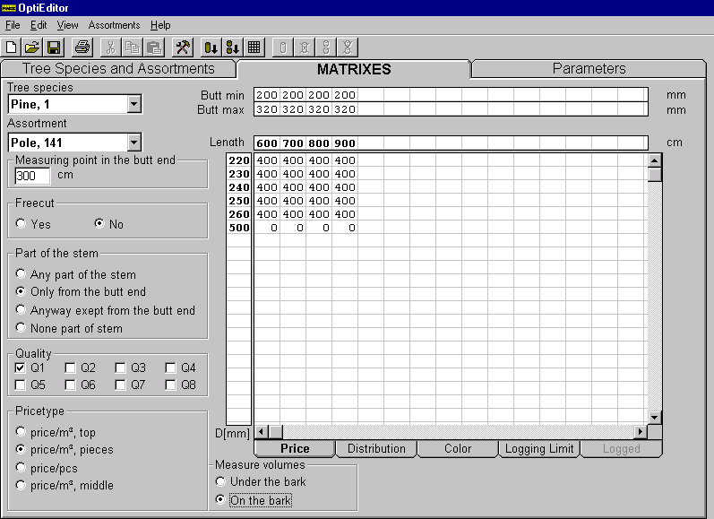
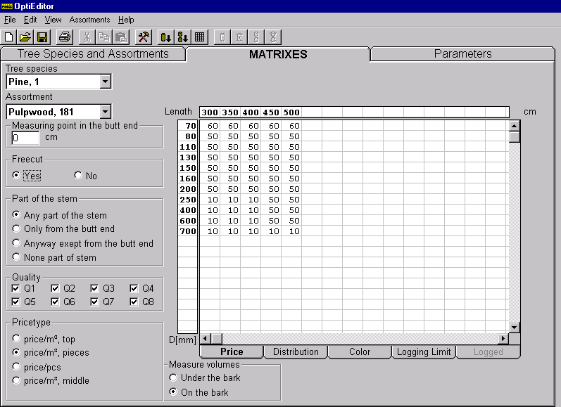
Information needed for bucking:
Stem curve
Values of assortments to be logged
    - Ordered & allowed dimensions
  Pine: log Pine: pole Pine: pulpwood
Dedicated to Excellence

Slide 22
Stem curve
300
200
Known part of stem
=>
reference diameter
100
550
1150
1890
y = a + bx + cx² + dx³
Stem banks (species,diam, work area)
=>
8 nearest (reference diameter)
y = a + bx + cx² + dx³
y = a + bx + cx² + dx³
y = a + bx + cx² + dx³
y = a + bx + cx² + dx³
Prediction for each stem
-bank is updated after each stem
Dedicated to Excellence

Slide 23
Length distribution for each diameter class
Order/assortment
Difference/assortment
deficiency +
surplus -
Logged/assortment
- Allowed price variation e.g. 5 %
- After every stem the counting starts from the beginning
Change of the price list
Price list
Dedicated to Excellence

Slide 24
Bucking for distribution
Order/ assortment
Difference/assortment
Price matrix/assortment
Change
of price:
deficiency +
surplus -
Logged/assortment
Bucking alternatives
Bucking proposal
Dedicated to Excellence

Slide 25
Specific orders & colour marking
Order/ assortment
Difference/assortment
Dimension
41, 340
done =>
Opti does
not allow
cross-cutting
Logged/assortment
Long logs separated for hauling by colour marking
Dedicated to Excellence

Slide 26
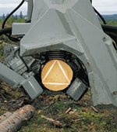
Production chain begins at forest
=> Demands for information system of harvester
Bucking with automated system:
1. Logs without defects
  Timber measuring
  Ponsse Cut
2. Optimized bucking
  Distribution and price matrix bucking
3. Ability to react fast
Efficient data transfer with PC -based applications
  Wireless data transfer: instructions for cutting & free text
  With GPS the ability to check harvesters position on a map
  Efficient software for bucking instructions & production follow-up
Dedicated to Excellence

Slide 27
Well calibrated Ponsse:
- HS15 with a H73 harvester head (Nisula A&S Oy)
- 14.5.1997 in Middle Finland
- 60 Scots Pine stems, 183 logs
- 60 Norway Spruce stems, 173 logs
- lengths measured with tape
200
Length, % logs:
140
±3 cm ± 5 cm
Norway spruce 91 98
Scots Pine 96 99
100
40
21
61
101
141
181
221
Dedicated to Excellence

Slide 28
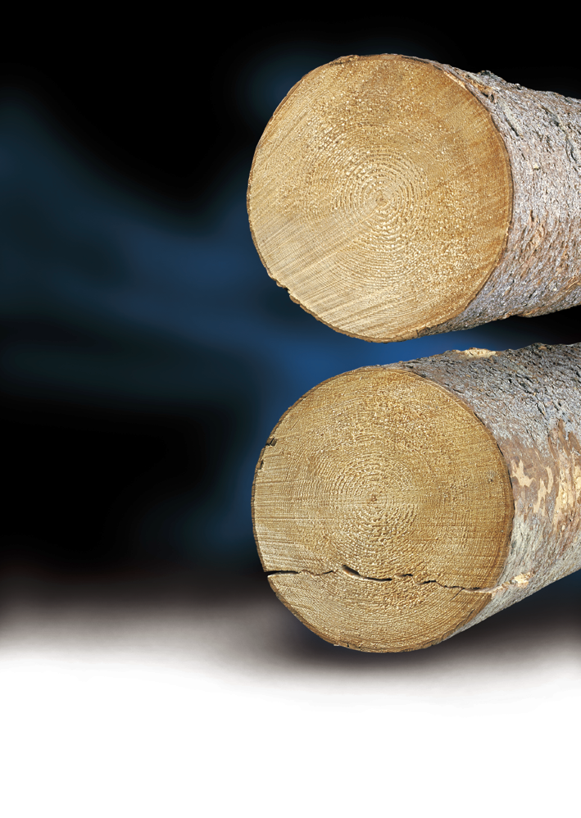
PonsseCut
Minimize crosscutting damages (cracks in logs)
  Opti controls automatically the
  lowering of the crane
  Parameters for minimum diameter
    - Two limits => bigger diameter,
    different movement
  Parameter for starting point
  - % of sawn diameter
Dedicated to Excellence

Slide 29
Cutting without PonsseCut
Cracks with normal logging operations
Helgesson Trätek Sweden 1997
- 13 harvesters (Ponsse, Valmet, Timberjack, Rottne,...)
- summer 1997, 57 stands, all over Sweden
- 2100 logs, D_{top} 16-30 cm, length 49 + dm
    - 70 % of logs had cracks (19 % visible in forest)
    - average length of cracks 8.5 cm
    - location of cracks 2/3 - 3/4 of diameter
    - cracks in top end were shorter than in but end (2. Log)
There were differences between harvesters, but variation was bigger
within manufacturer than between them.
Dedicated to Excellence

Slide 30
PonsseCut: Results
Stora Skog & SkogForsk Sweden - May 1999
  3 stands, pine & spruce logs
  no cracks on butt log
  but end of second log
    - 68 % of logs no crack
    - 97 % of logs cracks shorter than 10 cm
Cracks (on
Logs
(on average)
average)
Number
Lenght
Topdiameter
Length
cm
60
526
25
2.5
inch
17'3"
10"
1"
Loss of 300 milj. SKr each year for Swedish industry
=> about 12 000 £/harvester
Dedicated to Excellence

Slide 31
Price matrix
Dedicated to Excellence

Slide 32
Length distribution for each diameter class
Spruce log
Length distribution
for each diameter
class as percentages
=>
easier way to
create a goal
Diameter distribution
“unsorted”
430
460
490
520
550
580
Total
160
10
20
30
20
10
10
100
180
10
20
30
20
10
10
100
200
0
20
35
20
15
10
100
220
0
20
35
20
15
10
100
240
0
20
35
20
15
10
100
260
0
20
35
20
15
10
100
280
5
20
30
25
15
5
100
320
5
20
30
25
15
5
100
340
5
20
30
25
15
5
100
360
5
20
30
25
15
5
100
Dedicated to Excellence

Slide 33
Length distribution for each diameter class
Simple price matrix,
same price for all.
Smallest diameter class
should be given a 10 % higher price
=>
log section is utilised
more precisely
Spruce Log
430
460
490
520
550
580
160
410
410
410
410
410
410
180
400
400
400
400
400
400
200
400
400
400
400
400
400
220
400
400
400
400
400
400
240
400
400
400
400
400
400
260
400
400
400
400
400
400
280
400
400
400
400
400
400
320
400
400
400
400
400
400
340
400
400
400
400
400
400
360
400
400
400
400
400
400
Dedicated to Excellence

