Slide 1
Highlights of the Changes to 91-191 Fall Protection Regulations

Slide 2
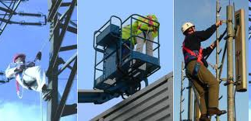
When is Fall Protection Required?
The New Brunswick Occupational Health and Safety Act, Regulation 91-191 as well as Regulation 2010-159 require workers to use a fall protection system in an unguarded work area that is
3 meters or more above water or the nearest permanent safe level,
above any surface or object that could cause injury to the employee upon contact or
above any open top tank, bin, hopper, or vat.
Fall protection is also required on a work platform that is 3 m or more above a permanent safe level and from which a person may fall if the work platform tips or fails or
where an officer has determined that it is necessary for employee safety for an employee to use an individual fall-arresting system.

Slide 3
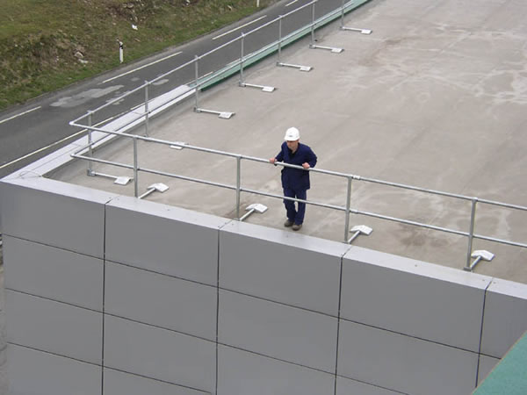
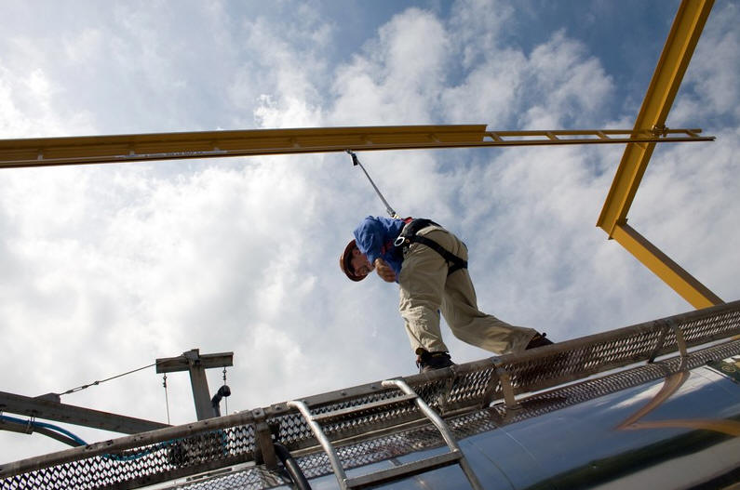
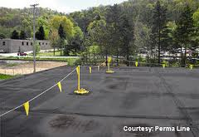
Fall Protection Systems
“fall-protection system” means a guardrail, a travel restraint system, a
fall-arresting system, a fall restricting system, that is either a personal
fall restricting system or a collective fall restricting system that was
designed to:
(a) prevent or eliminate the risk of falling,
(b) restrain an employee who is at risk of falling, or
(c) stop an employee who has fallen;

Slide 4
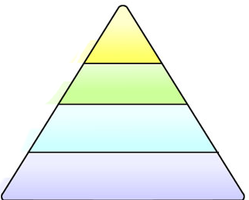
Hierarchy of Fall Protection Systems
Most Effective
Guardrails
Travel Restraint
or Fall Restricting
Fall Arresting
Control Zones
Least Effective
Notes:
Implementation of a “Hierarchy of Intervention” - systems that do not allow employees to fall are preferred because there is no longer a risk of minor injury from having a fall arrested or the need for the employee to be rescued. For this reason, guardrails and travel restraint are first in the hierarchy,
With the use of a fall arresting system there is still the potential for personal injury if a fall arrest occurs; therefore, the addition of the hierarchy is to engineer out the risk of falling before resorting to a fall arresting system. Therefore, we begin with guardrails and travel restraint, followed by fall arrest systems, which include safety nets and finally control zones. We allow for moving down the hierarchy when things are not practical. The owner, employer or contractor is responsible to ensure the hierarchy is followed.
The control zone is an option in our fall protection hierarchy. This allows all NB employers, regardless of the industry and of the type of work being performed, to use the control zone with warning lines as a mode of fall protection. Taken from BC regulations.
There are some cases where the control zone method of fall protection cannot be used such as scaffold erection and dismantling (to narrow) or where the provisions of section 102(2) (considered to be permanent surfaces) apply.
In the roofing industry 3 in 12 is considered a flat roof.
On surfaces with slopes greater than 6 in 12, guardrails are not acceptable.
The result of the study by the Wood Science and Technology Centre indicates that the force created by a worker sliding down a roof with a slope of 6 in 12 is more than the 900N the guardrails were able to withstand during the tests.

Slide 5
Hierarchy of Fall Protection Systems
The idea of introducing a hierarchy of fall protection
systems is to use the most effective system to reduce the
risk of falling before resorting to fall arresting systems.
The laws allow for moving down the hierarchy when things
are not practical
The Owner, employer or contractor is responsible to ensure
that the hierarchy is followed

Slide 6
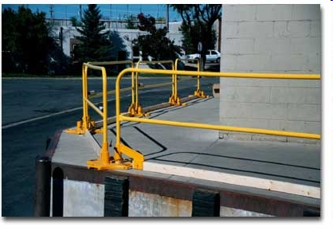
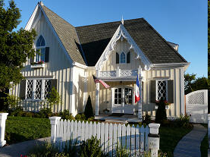
Guardrails
Guardrails occupy the top of the hierarchy
They are considered an engineered control.
When used they should eliminate the risk of falling.
Guardrails cannot be used on surfaces that have slopes greater that 6 in 12.
Notes:
Section 97 – Guardrails
No. 2 grade lumber acceptable
New provisions for pre-engineered guardrails
Requirements for strength and rigidity are defined and are based on slope of surface
Not permitted for slope greater than 6 in 12
Allow vertical supporting posts for guardrail on scaffolds to be 10 feet (3 metres) apart because typical scaffold dimensions are 5’ x 10’ and it is very difficult to meet the 2.4 metre requirement.

Slide 7
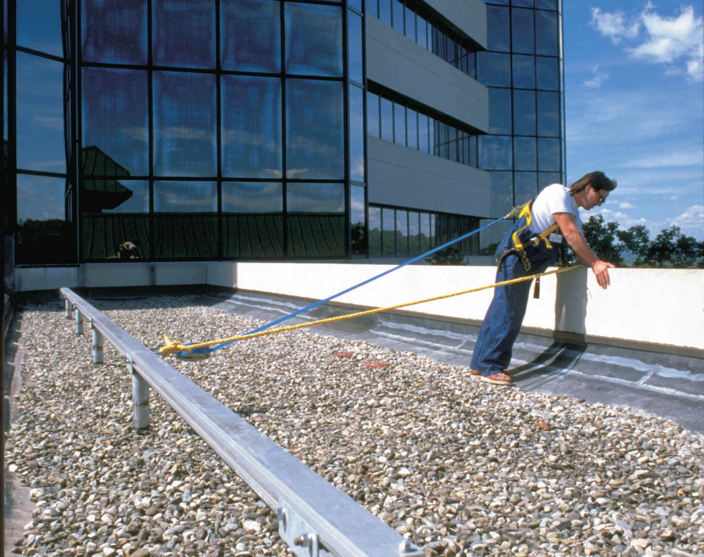
Travel Restraint
The intent of travel restraint is to limit or restrain
an employee’s travel in such a manner that they
cannot get close enough to the edge to fall.

Slide 8
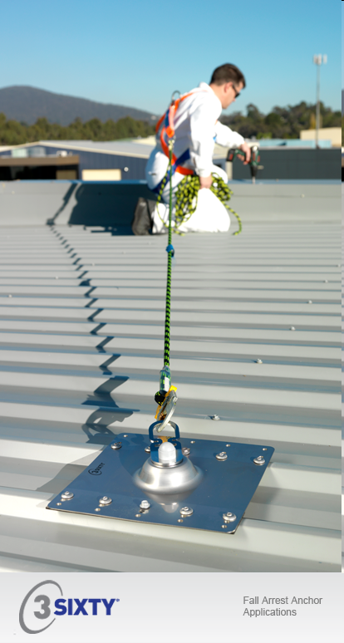
Travel Restraint
For Sloped roofs of 3 in 12 or less, attached to an anchor capable of supporting two times the maximum load.
For sloped roofs of more than 3 in 12, attached to an anchor capable of withstanding 22kN( 5,000 lbs) of force.
Notes:
The intent of travel restraint is to limit or restrain an employee’s travel in such a manner that they cannot get close enough to the edge to fall. A one-metre buffer is recommended because when an employee trips, forces are put onto the system. This force causes the lifeline, lanyard and harness to stretch (can be as much as a few feet). A 1 metre buffer was not discussed by committee; therefore the requirement can’t be put into legislation; however it would be preferable that the language chosen for this provision be such that it is not interpreted that the employee can reach the unguarded edge, but not fall off.
A factor of safety of two is standard. The more the roof is sloped the greater the impact on the system if the employee were to roll down the roof before being stopped. Therefore the anchor on a sloped roof should be as strong as the fall arrest anchor.

Slide 9
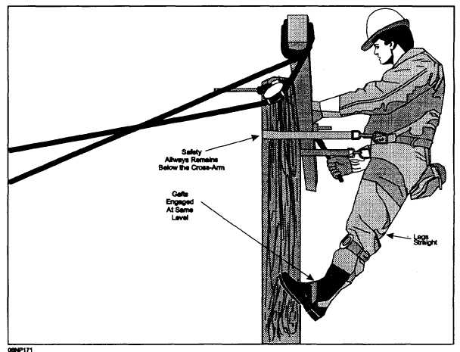
Fall-restricting systems combine work positioning and fall-restricting equipment to limit a person’s fall distance. The use of this fall protection system is limited to wood poles.
Fall Restricting
49(4) and 49(5) – Wood Poles
Continually use fall-arresting system
when ascending and descending
Work Positioning system in addition to
fall-arresting at the working level.
Where impractical to use both, then
use fall restricting system when
ascending and descending and to
secure themselves when at rest or at
working level.

Slide 10
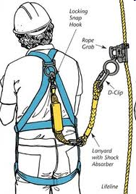
Personal Fall Protection System
Fall Arresting Systems
Components of a fall protection
system for which the user has
responsibility and includes some of
the following: a full body harness, a
body belt, a energy absorbing
Lanyard (or a lanyard and a
separate energy absorber), a fall
arrester, a self retracting device
and the connecting hardware.

Slide 11
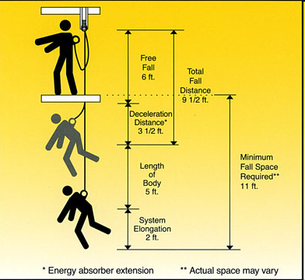
Fall Arresting Systems
Free Fall Distance
49.2(2) and 49.2(3)
When an energy absorbing lanyard or separate energy absorber is used in the fall arresting system the Maximum Free Fall distance of 1.8 m or maximum shock on the body 8kN( provided there is sufficient clearance).
Free fall must be limited to 1.2 m when using energy absorber is hazardous or impracticable.
Notes:
11
Slide 32:
C) connecting devices: the third system component is the connecting device. This device can be a rope or web lanyard, rope grab or retractable lifeline. However, shock absorbing lanyards are recommended because they significantly reduce the forces generated in a fall.
These three components must be used in conjunction with each other to be effective.

Slide 12
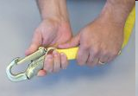
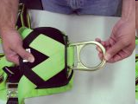
Fall Protection System Inspection
Section 50.4 and 50.5 – Fall Protection System inspection (Collective or Personal)
By the employee, visually before use
By a competent person before initial use and as
recommended by the Manufacturer, installer or
engineer
Use not permitted when defective
Components are compatible and fit for
environment

Slide 13
Fall Arresting Systems
Building Owner Responsibilities
49.3 Anchor Points
Applies when fall Arresting systems are used
Provide and ensure the use of permanent or temporary anchors
Provide and post sketches of permanent anchors,
Ensure inspection of every anchor being used for the first time:
-Every 12 months or as recommended,
-after any event or maintenance and repair.
No one shall use defective anchors.
Notes:
Anchor Point:
Anchor points can be permanent or temporary and it must be clear that the requirements found in this regulation include both kinds.
There is a wide variety of anchor points. They can be
· an independent unit sitting on a or
· a unit that wraps around a beam, is bolted to concrete wall, is welded to a beam, is screwed into wood, etc
The anchor point is part of the fall protection system, therefore we cannot say “to which a fall protection system is attached”.
Contractors doing work on roofs of buildings don’t often have the authority to install anchors on roofs; therefore it is important to add the following requirements for building owners. This will allow employees on their roofs to work safely. The wording was chosen so that building owners who find alternate ways to have the work done (e.g. use of scaffolding or elevating work platforms) will not be affected by this requirement.
On some roofs, there are many elements that may appear to be an anchor point for fall arrest (such as anchor points for suspension equipment, for travel restraint). Therefore a sketch of the roof that clearly indicates the location of the fall arrest anchors is important.
Copy must be provided to employee so that they can use while on roof at the location of the anchor point and not have to return to entrance of roof. This could lead to possible confusion between anchor points.
Copy must be provided to employee so that they can use while on roof at the location of the anchor point and not have to return to entrance of roof. This could lead to possible confusion between anchor points.

Slide 14
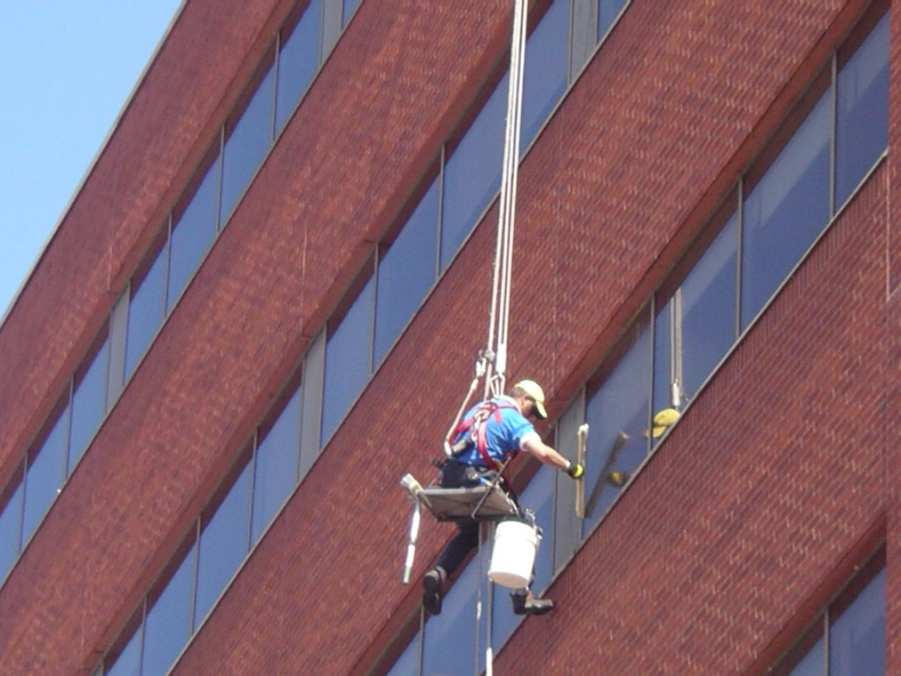
Fall Arresting Systems
49.4 Vertical Life lines
Details of vertical life lines used in a fall-arresting system,
Can only be used by one employee at a time.
Complies to CSA Standard Z259.2.1-98 or Z259.2-M1979 (section 49.1(2)(b))
Notes:
We now have requirements for vertical lifelines and we have added these provisions to allow the safe use of vertical lifelines. They are an important part of the fall arrest system. This provision brings our regulation in line with CSA standards and industry practices.
This standard contains some requirements regarding use. As it cannot be expected for all users to have obtained the standard, these requirements a reproduced in this section.
A vertical life line in a fall-arresting system shall
(a)extend to a safe level,
(b)be adequately secured or weighted at the base of the life line to prevent tangling or disturbance of the life line,
(c)be securely attached to an anchor point,
(d)be free of imperfections,
(e)be free of knots or splices, except for those that are necessary to connect the life line to an anchor point,
(f)be provided with protective devices at all sharp edges or corners to protect against cuts to or chafing of the life line, and
(g)be clearly identified as a life line by colour or other means.
49.4(2)A vertical life line in a fall-arresting system shall be used for its intended purpose only and shall be used by one employee at a time.

