Slide 1
PREFORMING REPAIRS AND MAINTENCE
LOCK OUTS

Slide 2
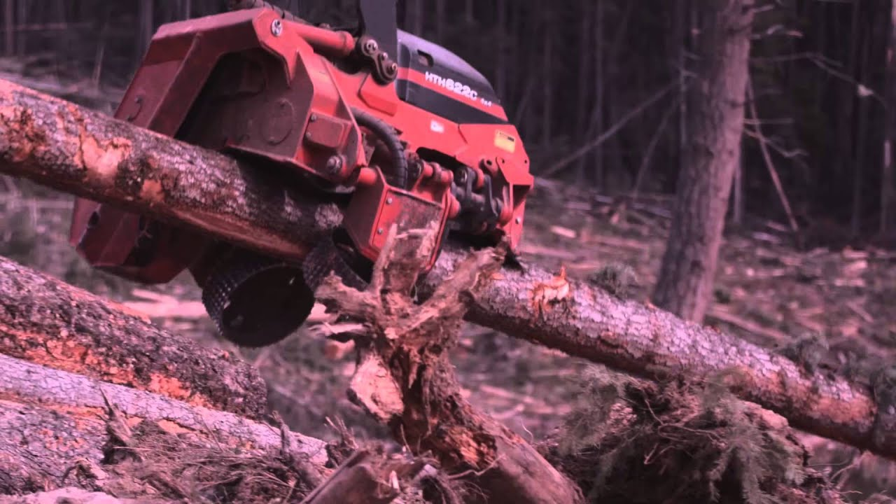
PURPOSE OF THE LOCK OUT PROCEDURE
PREVENT INJURES DURING REPAIRS

Slide 3
LOCK OUT PROCEDURE PONSSE BEAVER
THE MACHINE NEEDS TO BE LOCKED OUT EVERYTIME THERE IS WORK BEING PREFORMED ON IT! (SEE LIST OF EXCEPTIONS)
STEP 1. SHUT OFF HEAD AND CRANE SWITCH
STEP 2. TURN OFF IGNIGTION
STEP 3. PRESS RED EMERGENCY SWITCH
STEP 4. TURN OFF AND REMOVE MASTER SWITCH HANDLE LOCATED ON THE OUTSIDE OF THE MACHINE UNDER THE DRIVERS DOOR AND SECURE THE HANDLE TO THE MACHINE WITH A LOCK OR SCISSOR DEVICE WITH LOCK.
STEP 5. CARRY OUT WORK TO BE COMPLETED
STEP 6. WHEN WORK IS COMPLETED RETURN TO WORK BY COMPLETING THE ABOVE STEPS IN REVERSE ORDER

Slide 4
EXCEPTIONS
1.CHANGING A BAR OR CHAIN (FOLLOW BAR AND CHAIN PROCEDURE
2.A SERVICE TECHNICIAN IS MAKING ADJUSTMENTS OR LOOKING FOR LEAKS FOR WHICH THE ENGINE MUST BE RUNNING IN WHICH CASE GREAT CARE MUST BE TAKEN TO PREVENT AN ACCIDENT (PLANNING AND COMMUNICATION IS KEY)
3.REFUELING AND A PRESTART UP INSPECTION

Slide 5
IN THE EVENT YOU LEAVE THE SITE THE LOCK OUT MUST REMAIN IN PLACE AS LONG AS THE MACHINE IS NOT OPERABLE IT MUST BE TAGGED OUT SO THAT SOMEONE ELSE SHOWING UP KNOWS THAT THE MACHINE IS DISABLED.
IN THE EVENT AN OPERATOR LEAVES HIS LOCK IN PLACE AND GOES HOME, EVERY EFFORT SHOULD BE MADE TO CONTACT THAT OPERATOR BEFORE REMOVING HIS LOCK

Slide 6
TROUBLE SHOOTING WITH THE MACHINE RUNNING
REASONS NOT TO BE
LOCKED OUT
LOOKING FOR PRESSURE LEAKS
SETTING PRESSURES
DIAGNOSING NOISES
THINGS TO REMEMBER
COMMUNICATION IS VERY IMPORTANT
PAY ATTENTION (NO DISTRACTIONS)
DON’T DO ANYTHING THE TECHNICIAN HASN’T TOLD YOU TO DO

Slide 7
HANDS OFF

Slide 8
AVOID ACCIDENTAL OIL INJECTION

Slide 9
Touching a hose or pipe that is under pressure
with your bare hands raises particular risks. If
the motor is running, a tiny hole in the hose
may result in a so-called “oil injection”, i.e. oil
being injected into your body. If you are searching
for a leak and the engine is running, do
not do so in any way that involves touching a
pipe or hose with your bare hands. An oil injection
is very dangerous. If oil enters your body
you will become very sick (to the point that the
injected part of the body may require amputation).
You may even die! If you are a victim of
an oil injection, you must go to an emergency
care unit. You must also tell the staff at the unit
that you have suffered an oil injection, since
they are not treated in the same way as normal
wounds. Proper treatment for such injuries
can greatly reduce their long-term effects, or
even save your life.

Slide 10
THE EFFECTS OF OIL INJECTION

Slide 11
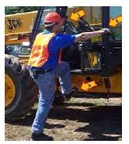
USE 3 POINT CONTACT AT ALL TIMES

Slide 12
MOST FOREST INDUSTRY INJURIES OCCUR DUE TO SLIPS AND FALLS

Slide 13
USE THE PROPER TOOL FOR THE JOB

Slide 14
WEAR YOUR PPE

Slide 15
SCALDS AND BURNS
MOST FLUIDS IN THE MACHINES ARE HOT ENOUGH TO SCALD YOU
( MOTOR OIL, HYD OIL, ANTIFREEZE) IF OPENING THESE MAKE SURE MACHINE HAS COOLED ENOUGH AND THAT THERE IS NO RESIDUAL PRESSURE INSIDE THEM

Slide 16
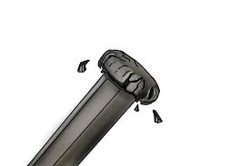
ENSURE TOOLS ARE IN GOOD CONDITION

Slide 17
FROST BITE AND HEAT STROKE ARE REAL!
FROSTBITE
HEATSTROKE

Slide 18
Working on a machine equipped with an accumulator
On forest machines there is often an accumulator.
When servicing or repairing any such machine,
make sure that the accumulator is not under pressure.
Ask a technician/repairman for advice about
the various functions of the accumulator. If you
are going to repair a component in the hydraulic
system, or do any kind of work in the head, make
sure that the accumulator is not under pressure.

Slide 19
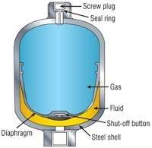
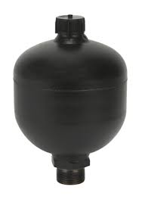
HYDRAULIC ACCUMULATOR

Slide 20
REPLACING XENON BULBS
There is always the possibility of burning your hands
as the lights are hot. Be careful and use the
right type of gloves.
A basic rule for any repair work on Xenon bulbs
is that it should always be done by someone
certified by the manufacturer. Also read the safety When working with the lighting system there
chapter included in the machine’s instruction
manual.

Slide 21
Risk of explosion
There is a risk that Xenon bulbs may explode
and throw around glass shards, because they
are filled with gas. Therefore, always use safely
glasses when working with Xenon bulbs.

Slide 22
Between 5,000 to 10,000 volts
The working voltage of a Xenon light is between
5,000 and 10,000 volts. Always turn off the
main power switch before working on the lights

Slide 23
Common rules for working on machines
Other rules to consider when working on
machines include the following:
• Do not work under a hanging load: Do
not stay under a crane or head hanging in
the air!
• Do not stay between the head and, for instance,the wheels of the machine as this
may cut off your escape route.

Slide 24
WHEN IN DOUBT??
WHEN IN DOUBT HOW TO SAFELY CONDUCT A REPAIR ASK
YOUR SUPERVISOR IF THERE IS NOT A SUPERVISOR ON SITE
AND YOU DECIDE TO TRY TO CONDUCT THE REPAIR YOURSELF
STOP AND THINK ABOUT YOUR PLAN AND ALL THE HAZARDS
AND UNFORSEEN DANGERS THAT MAY PRESENT THEMSELVES
REMEMBER THERE IS NO JOB, NO PRODUCTION TARGET,
NO REAPAIR YOU ARE UNTRAINED TO CONDUCT, THAT IS
WORTH YOUR LIFE

Slide 25
QUESTIONS

